Slide 1


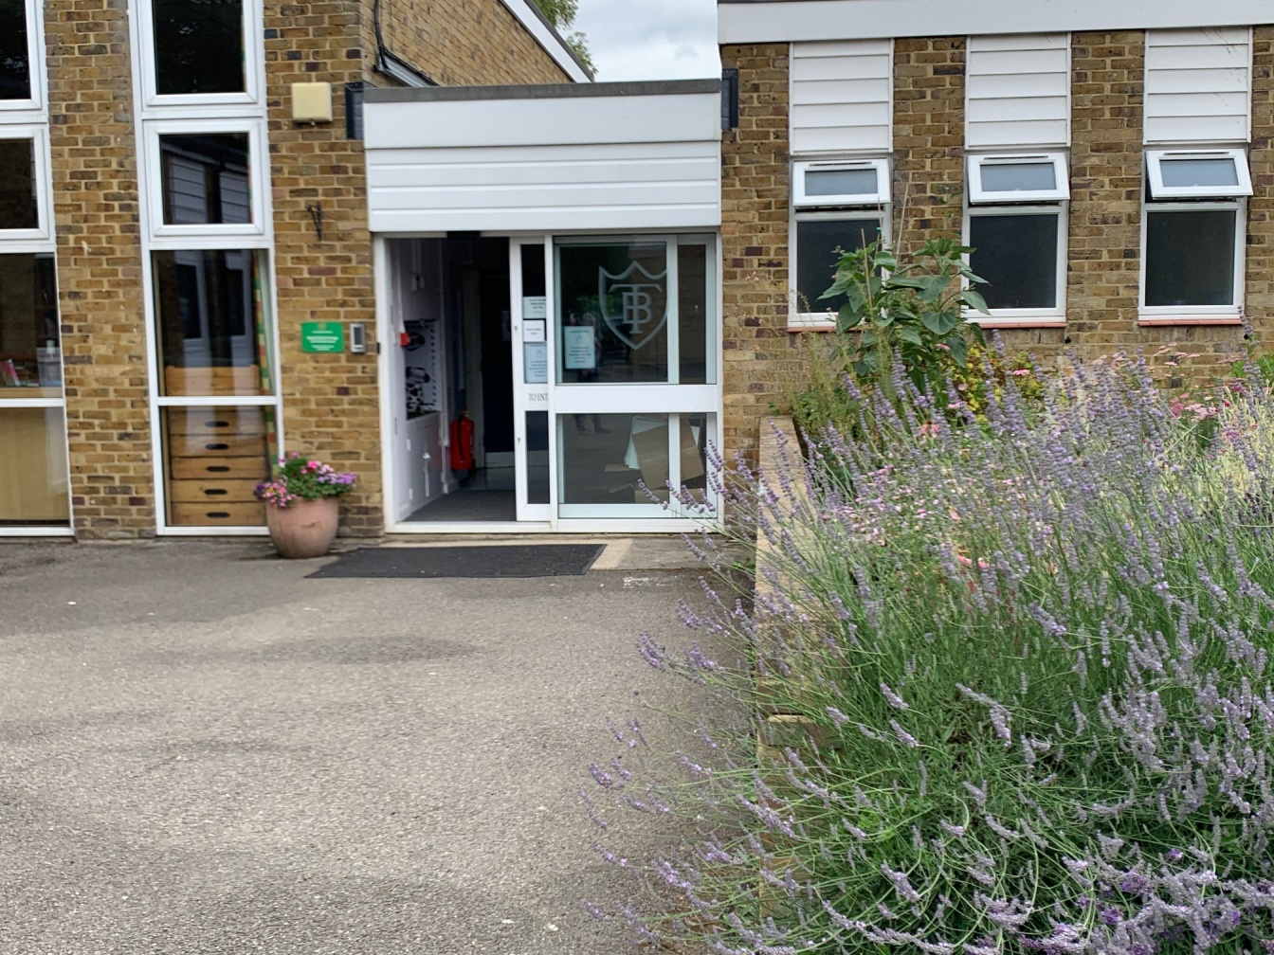
Welcome Back To School!

Slide 2
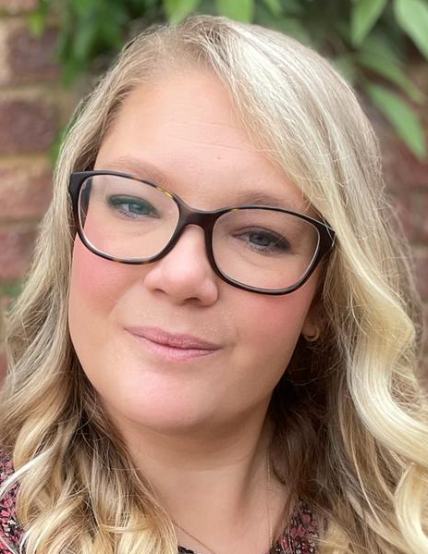
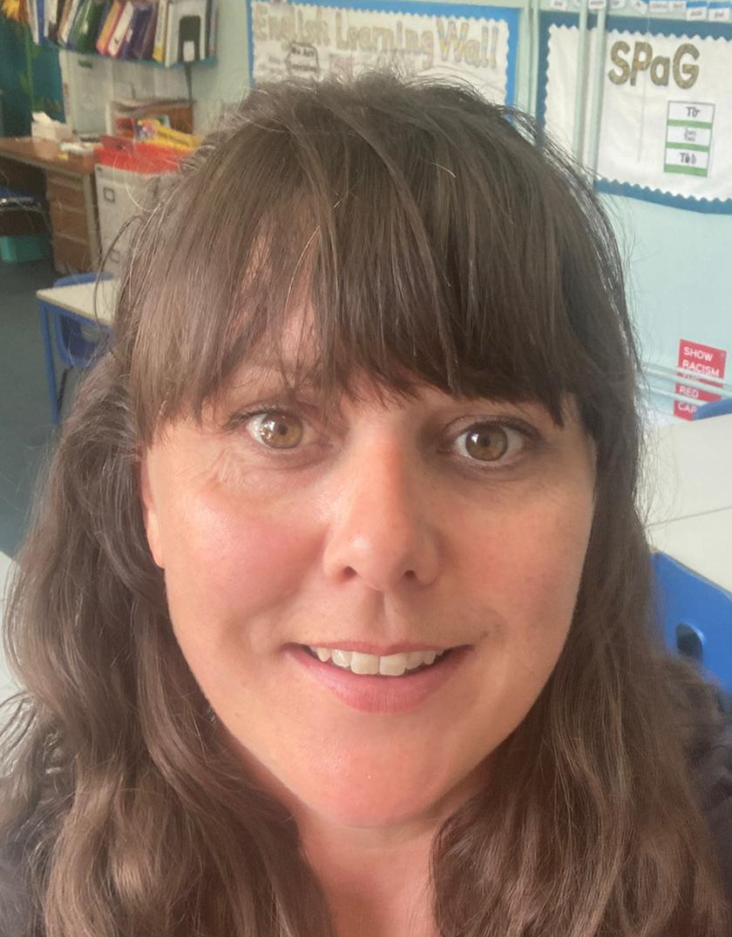
Year 2 Teachers
Mrs Eldridge
Week 1: Mon, Tues
Week 2: Mon, Tues, Wed
(alternating)
Mrs Clark
Week 1: Wed, Thurs, Fri
Week 2: Thurs, Fri
(alternating)

Slide 3
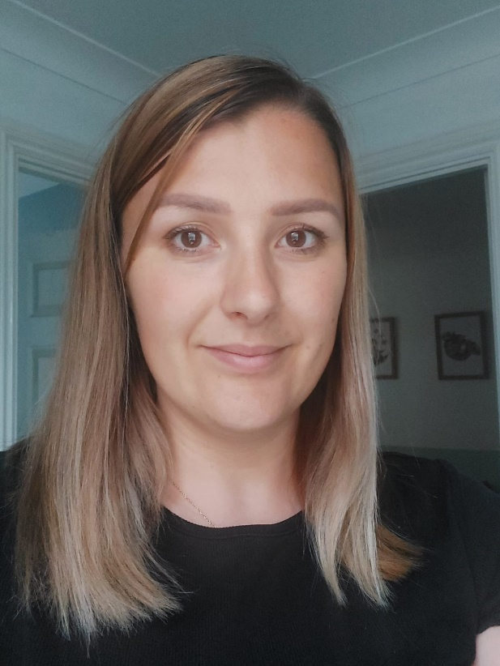
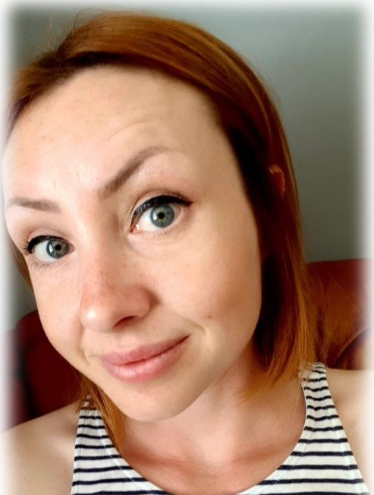
Year 2 Support Team – all day every day!
Mrs Muscat
Mrs Hoult

Slide 4
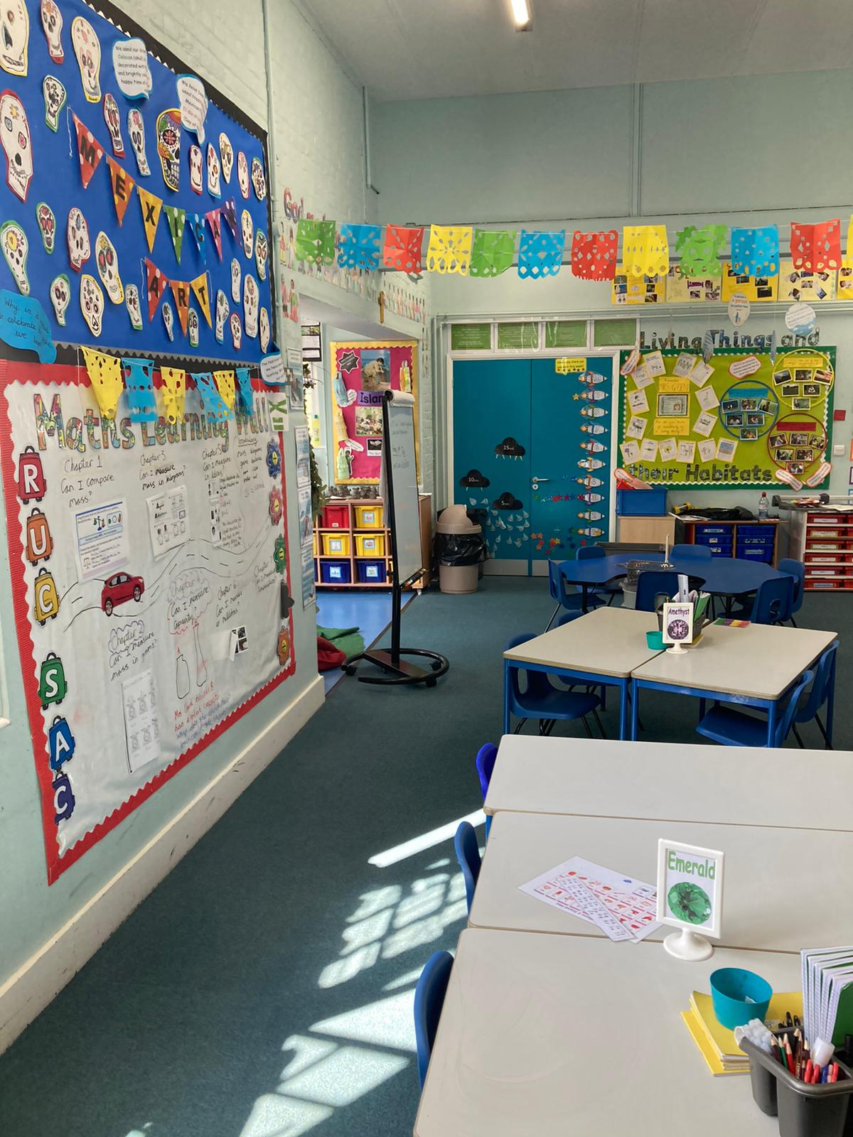
Here is your new classroom!
This is Year 2

Slide 5
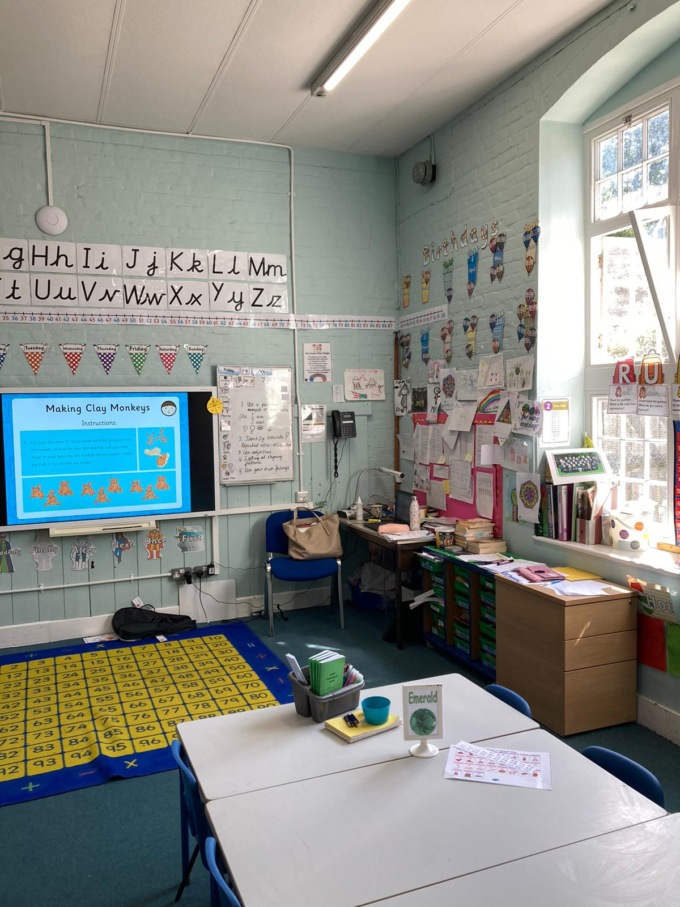
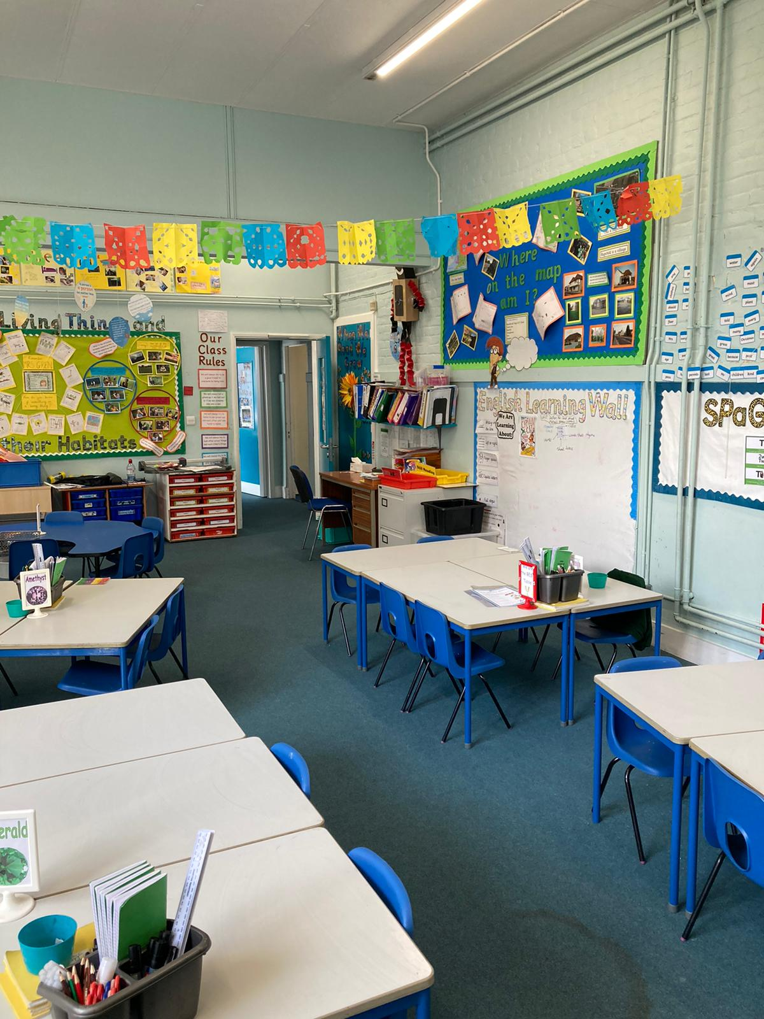

Slide 6
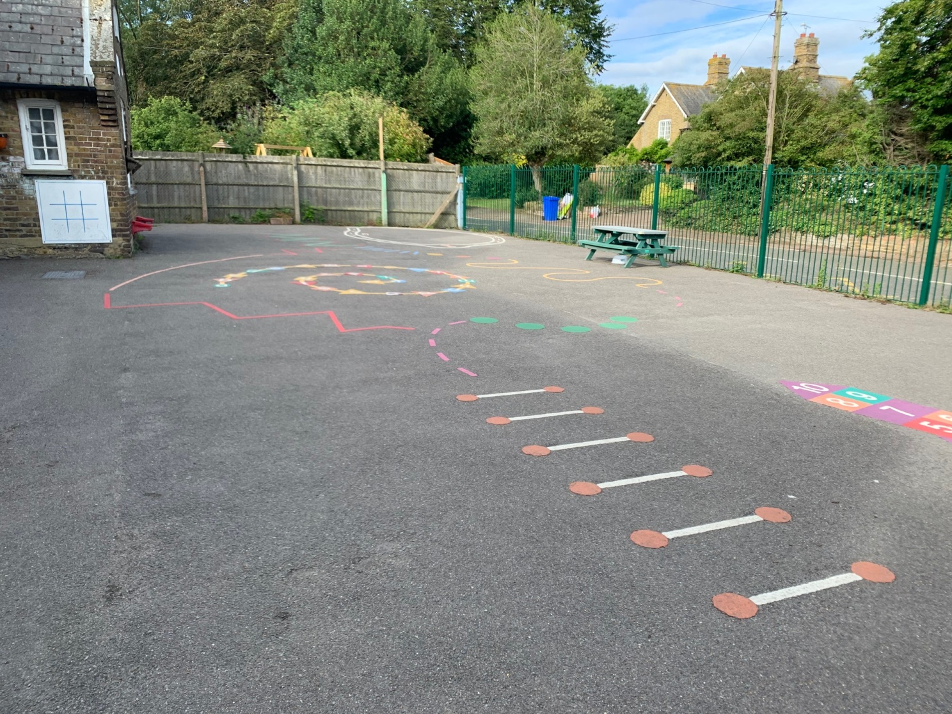
This is the playground for Year R, 1 and 2
Year R use this at lunchtimes

Slide 7
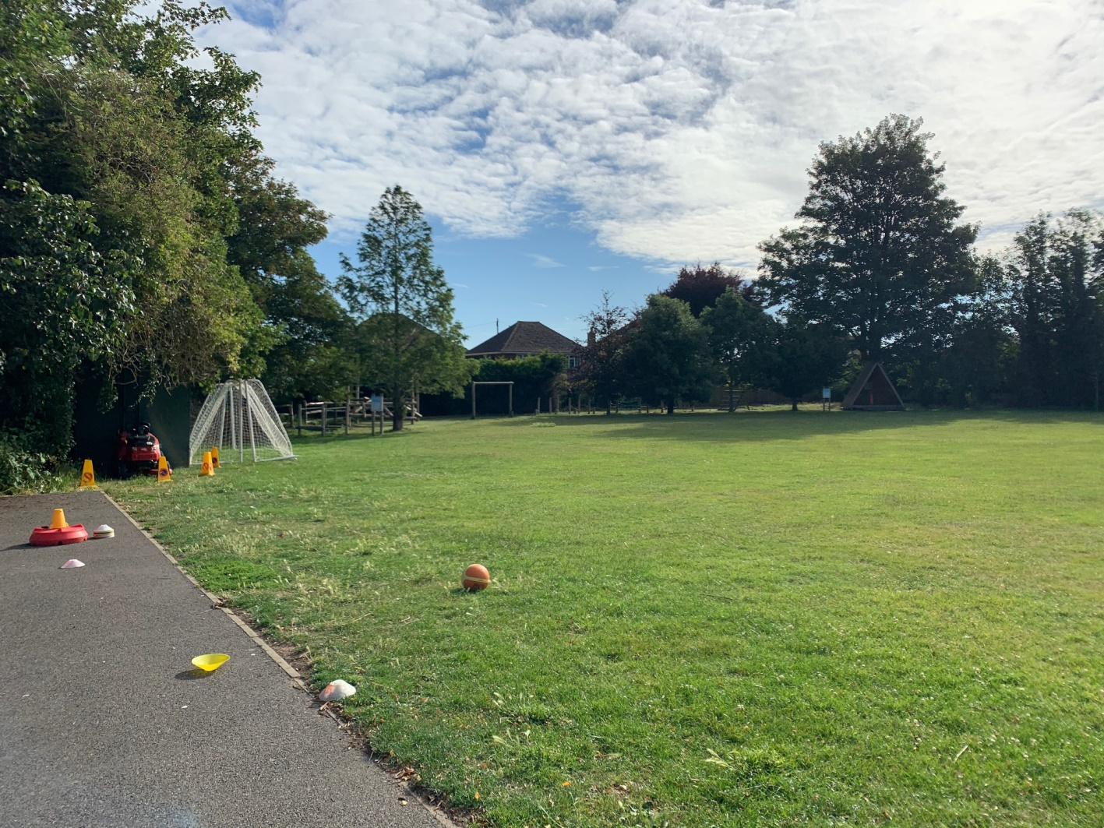
Here is the field where we join the ‘big children’ at lunchtimes if the weather is sunny.

Slide 8
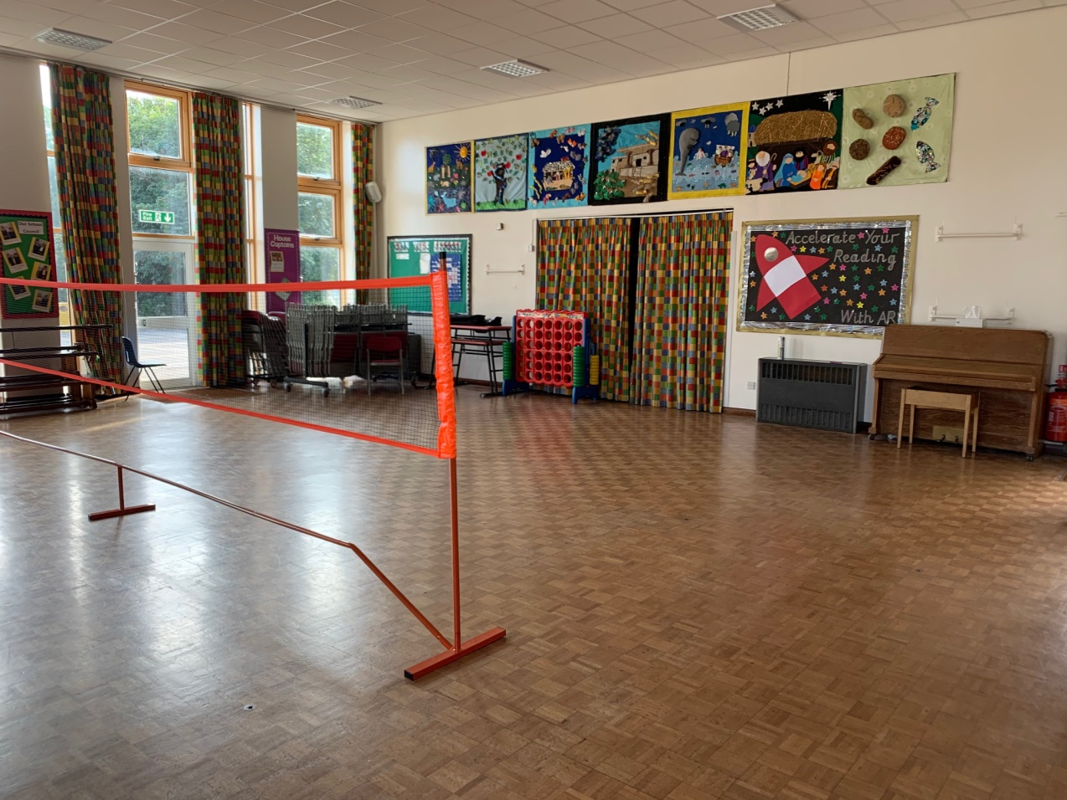
Here is the Hall
You eat your lunch here.
You might have PE lessons in here.
What sport do you think the children will be playing today?

Slide 9
Here are some other people you might see…….

Slide 10
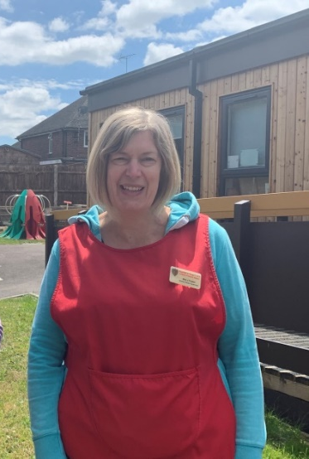
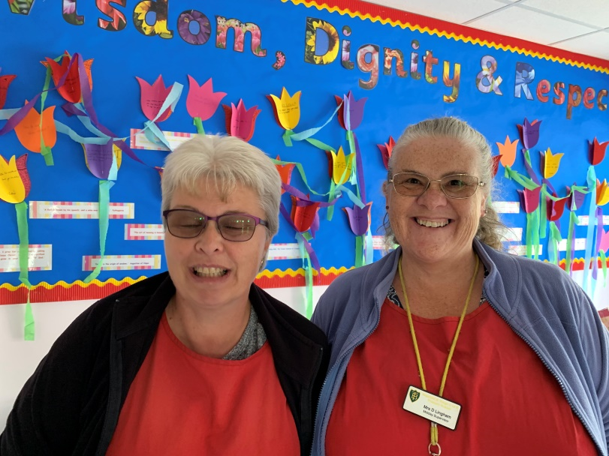
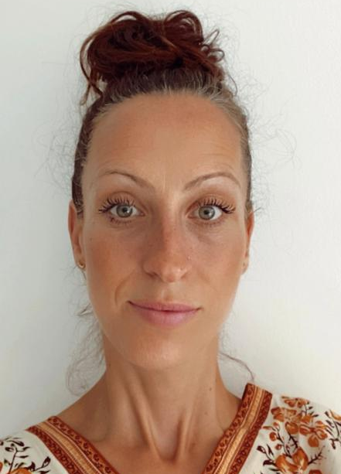
Mrs Foster
Mrs Mitchell and Mrs Lingham
They also run Breakfast Club if you come in early. They make great toast!
Mrs Osei
At Lunch time these ladies will look after you…

Slide 11
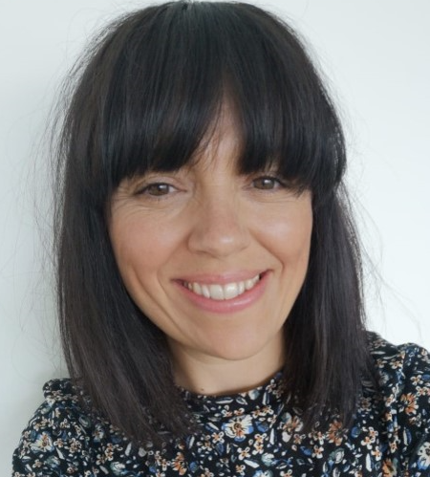
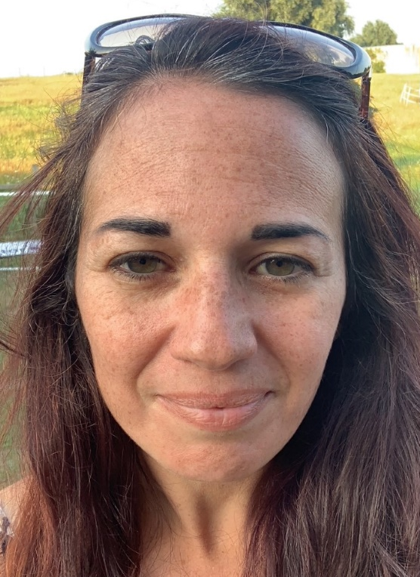
This is Mrs Long, our Wellbeing Leader
She is good at listening if someone is worried about something.
Mrs Gambell
She is our SENCO and works hard to make sure everyone feels included in our school.

Slide 12
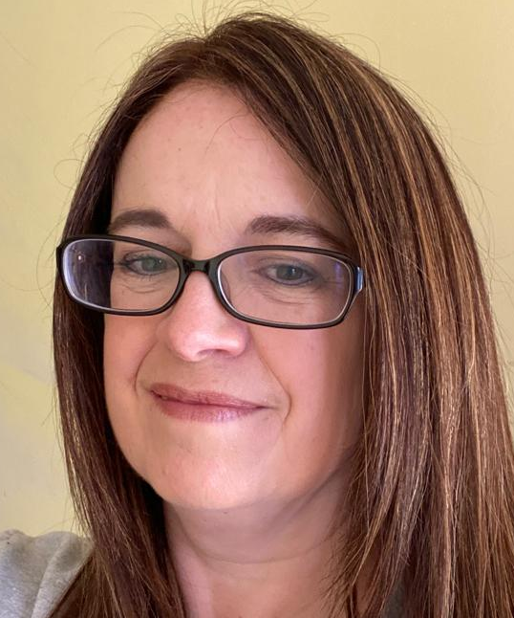
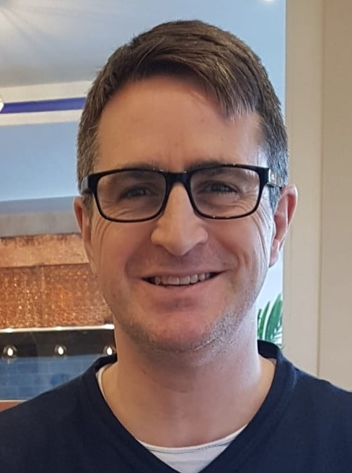
Mrs Julier
She is our Music teacher.
Rev Simon
He is our School Chaplain

Slide 13
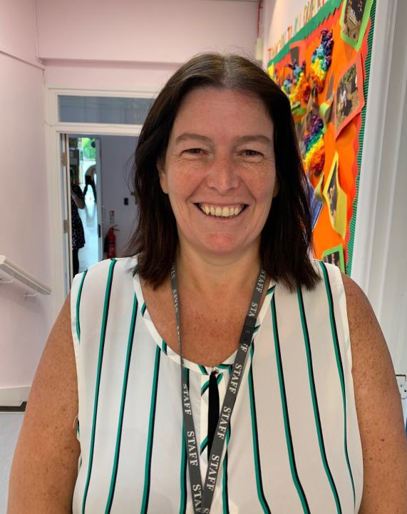
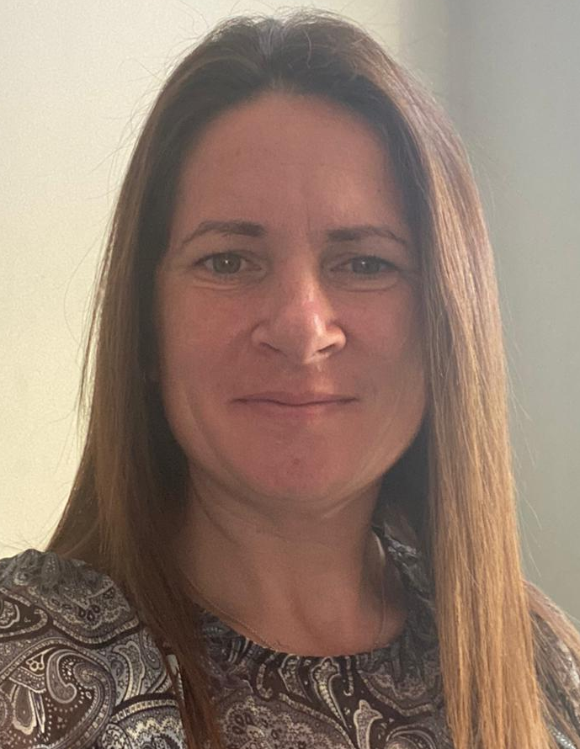
You will see these lovely ladies every day when you go to the office, or walk to the Hall…
Mrs Smedley
She helps out at lunch time, and she also works in Year R too. What a busy lady!
Mrs Barwick
She is the Office Manager and is in charge of the registers and the glue sticks!

Slide 14
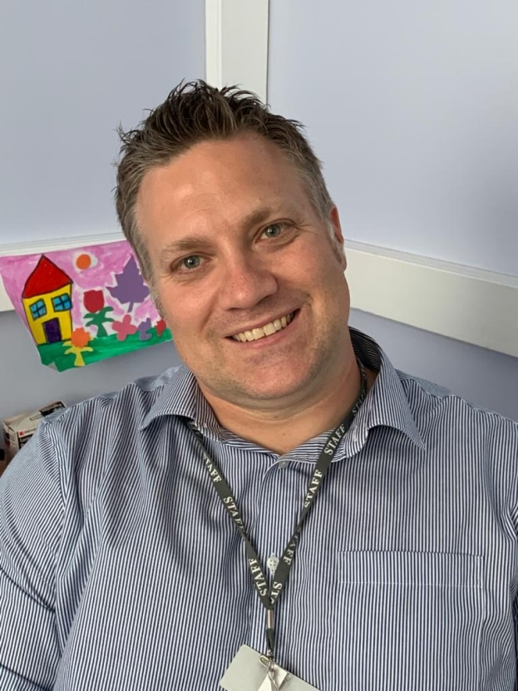
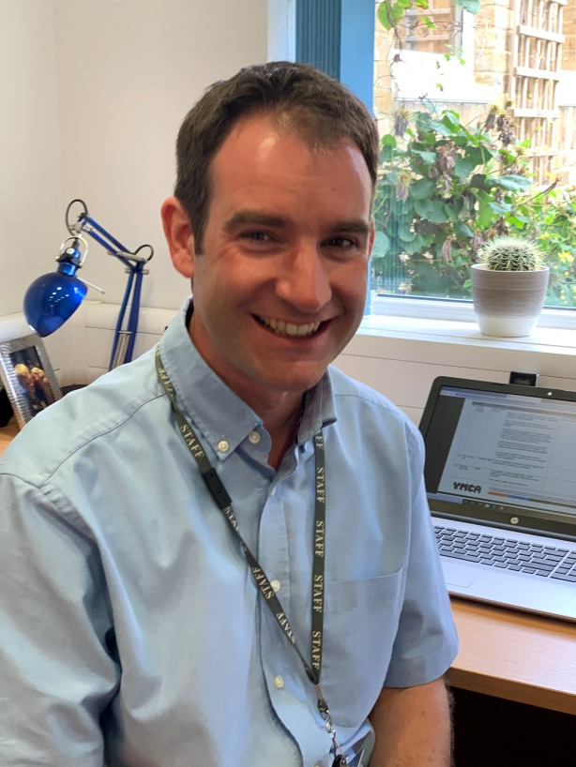
Mr Kelly
He is our Headteacher.
You will see him during your day. He can’t wait to have all the children back in school.
Mr Smiley
He is our Deputy Headteacher
He also teaches Year 5 and does the Ribbon Dance.

Slide 15
We are looking forward to seeing you in September!
Have a lovely summer holiday.
From all of us at Bapchild School

