Slide 1

Home Learning
Year 2 Term 6 Week 7

Slide 2
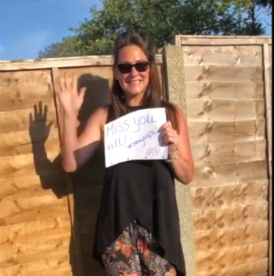
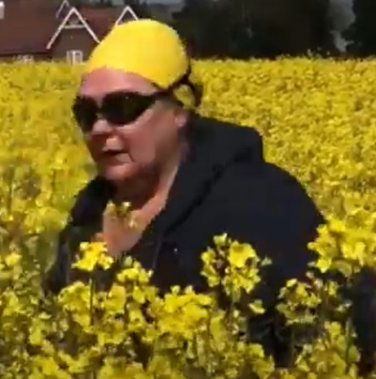
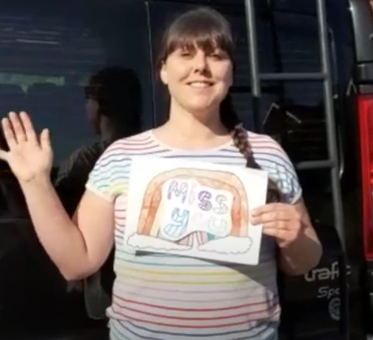
Message from the class teacher
Hello Year 2 and welcome to the final week of this academic year! We hope to see some of you this Tuesday (14th) and I hope many of you can make your transition session the following Monday (20th) with your new teacher. We feel really sad when we think about this year, especially of all of things we have missed as a class together, all of the wonderful topics we missed out on learning about and all of those memories we missed out on making together. However, when we do start to feel sad we can think back to the amazing 4 terms we had together. We remember starting off the year with the harvest festival and being so proud of you watching from the audience. We remember learning about the Great Fire of London and how excited you all were. We will never forget our class worship about Neil Armstrong and making the coolest slo- mo clip EVER! Most of all we will remember watching you all in the Nativity and thinking how incredible each and every one you were! We will never forget our class of 2020 ☺ and we will see each other again very soon! We wish you all so much luck going into Year 3. We know you will be fantastic and we will always stay in touch and find out how you are doing with your new teachers. Take care, stay safe and enjoy your summer holidays!
Love Mrs Unsworth, Mrs Clark and Mrs Bradley xxx

Slide 3

Reading
Hopefully you have access to books at home, but we have sent home extra books with your child.
Accelerated Reading
Home quizzing is not always recommended but in this case we have adjusted the settings to allow quizzing to happen at home.
If your child wants to read a book from home, please check that there is a quiz available for the book and that the book level (BL) is within or near to your child’s reading range. Also take note of the quiz number for future reference.
To check books please visit: https://www.arbookfind.co.uk/
Go to the next page for how to quiz.

Slide 4



AR quizzing at home.
To log into AR to take a quiz please visit: https://ukhosted27.renlearn.co.uk/2240835/
Your child should know what to do from here and should know their login details. If they are not aware, most details are written in their reading record.
Click on Accelerated reader.
Type in the name the book or the quiz number.
We advise students complete quizzes unaided. If parents/carers wish to support their child, they can do so in the following ways:
Discuss the book with your child as the book is being read
Ask your child to read the question out loud
Re-word questions for your child, if necessary
Ask your child which answers are not correct

Slide 5

Visit http://readon.myon.co.uk

Slide 6

Choose an area that interests you or use the search option.

Slide 7


Using My Maths
Children should know their way round My Maths but here are some reminders on how access the lessons. Visit: www.mymaths.co.uk
bapchild
divide162

Slide 8

Using My Maths
Access any lesson based on what your child is learning in class or search the topic in the search bar.
Use the login portal to access specific homework and lessons that your teacher has set.

Slide 9

Maths – White Rose Home Learning
In school we follow the White Rose scheme of learning. Their website has put together free lessons and resources that link to the learning taking place in school. Please visit: https://whiterosemaths.com/homelearning/

Slide 10



TT Rockstars
To access TT Rockstars please visit: https://play.ttrockstars.com/auth/school
Start typing in the school name or the post code (ME99NL)
Pupils type in their username and password, usually written in their reading record.
Pupils can practice all tables but Year 2 should be practicing 2, 5, and 10’s
Year 3: 2,5,10,3,4,8’s
Year 4,5,6: all tables

Slide 11

Accessing Twinkl
Many educational content providers are offering free access to their resources. Twinkl is a website that we use from time to time to resource our lessons to aid in teacher input and pupil activities.
We will be able to direct you towards activities and learning via this website based on lessons that may be missed due to absence. To access Twinkl please visit: www.twinkl.co.uk/offer
You will have to sign up and put in the offer code: UKTWINKLHELPS

Slide 12
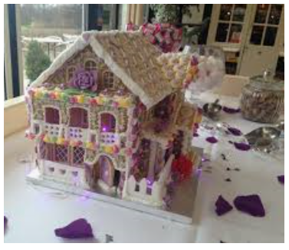
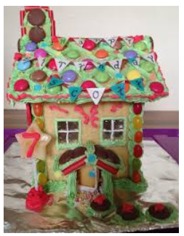
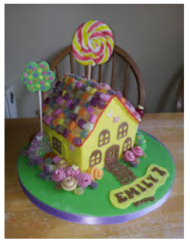
English Learning
Activity 1: In the story Hansel and Gretel the two children come across a house made of sweets and treats. Think about how amazing that would be. What would you make a sweetie house from? What favourite treats would you include? You are going to design your own sweetie house. You can use the template on the next slide to help you but you might want to use bigger sheet. Make it as creative as you can. You could even use real sweets to stick onto your design. Think about what you would make the walls from. How would you stick the tiles on the roof? What are the beds made from? You can add as many labels and descriptions as you can.
As an extra challenge why not make your sweetie house 3D with a cardboard box. You could add rooms to the inside and even stairs!

Slide 13
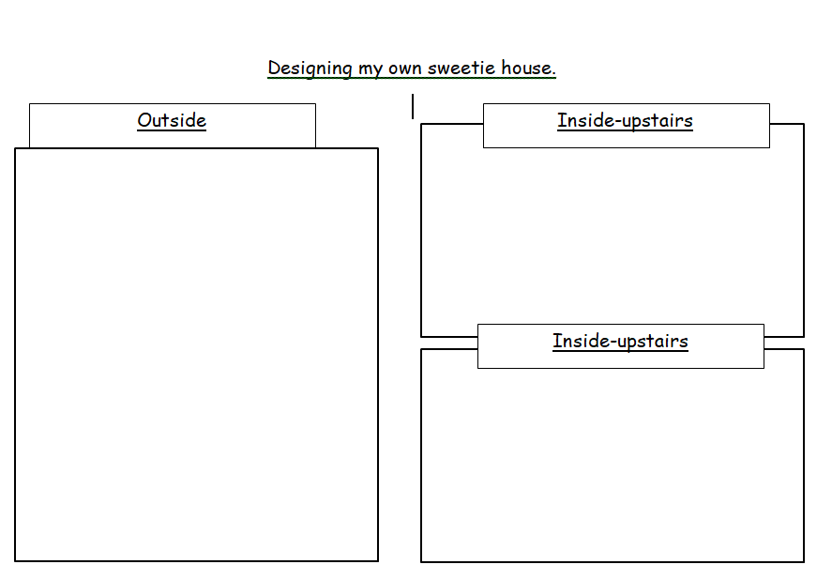

Slide 14

Activity 2: Now you have designed your dream sweetie house you are going to imagine that you are an estate agent and you are going to sell the house to a new owner.
Q: What is an estate agent?
A: Someone whose job it is to sell houses.
Estate Agents are very good at using words to persuade someone to buy a house. This means they exaggerate the good things about the house to make it sound as good as possible.
Have a look at the powerpoint that is on the home learning next to this one. It will tell you more about how estate agents use words and phrases to persuade the customer to buy the house. Have a go at the quiz.

Slide 15
Activity 3: Now you are going to write your own Estate Agent advert for your sweetie house. You need to try and persuade someone to buy the house so use some of the phrases from the powerpoint that you used in activity 2. The next few slides will help you with how to write your advert and there is a couple of templates for you to either print out or use it to help you create your own advert.
Have a look online at some estate agent websites to see some houses fro sale to give you some more ideas for your advert.

Slide 16
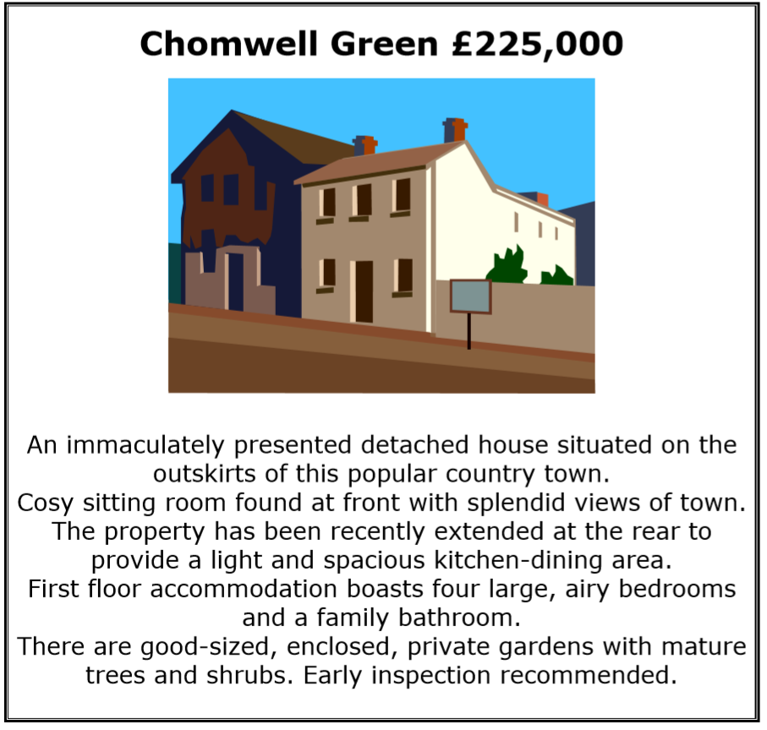
Example of an estate agent advert.

Slide 17
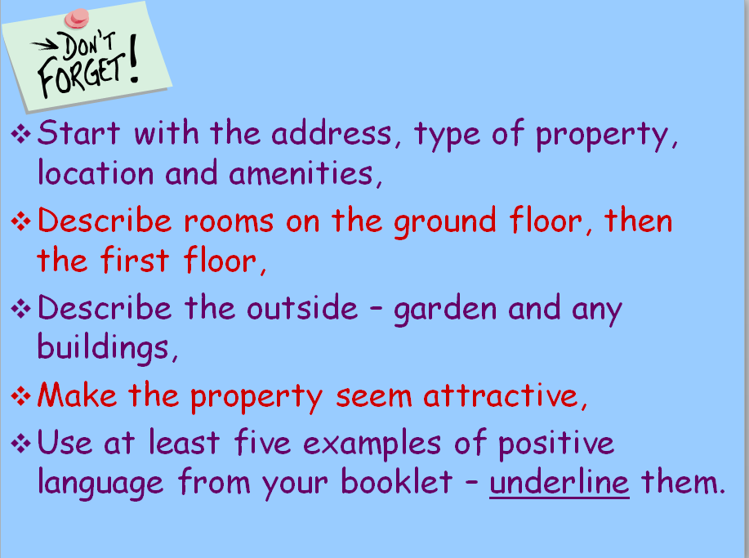
Amenities means things like electricity and water.

Slide 18
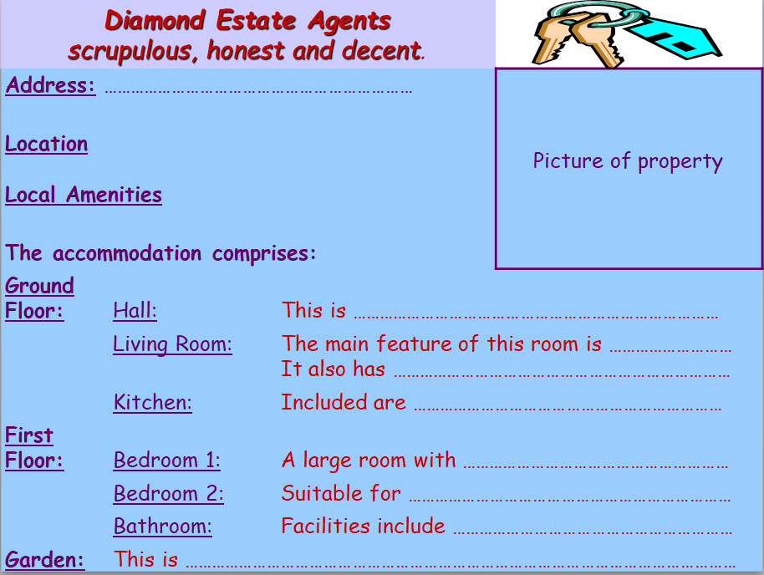

Slide 19
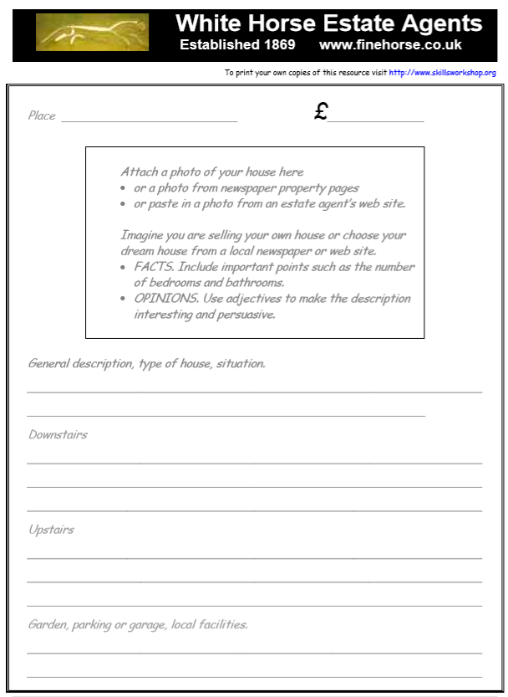

Slide 20

Maths Learning
This week we will continue working following the scheme of work from the white rose website. However, I would direct you this week to follow the learning videos and activities from the BBC bitesize website. https://www.bbc.co.uk/bitesize/tags/z7s22sg/year-2-and-p3-lessons
For each lesson there is a link to a work sheet recommended.
Activity 1 – BBC Bitesize→ Year 2 → 24th June →Solving problems involving length and height
https://bam.files.bbci.co.uk/bam/live/content/z6vm8hv/pdf
Activity 2 – BBC Bitesize→ Year 2 → 25th June →Comparing Mass
https://bam.files.bbci.co.uk/bam/live/content/z2ky6g8/pdf
Activity 3 – BBC Bitesize→ Year 2 → 29th June → Measuring Mass in grams
https://bam.files.bbci.co.uk/bam/live/content/zn43hcw/pdf
For each lesson on the BBC website there are 2 learning videos which you should watch first. There are also sometimes 3 activities to complete. I have put a link above for the one activity to be completed. However, if you want to complete the other activities and play the game feel free to explore the website. ☺
Could you help mum of dad with some cooking this week and help weigh out the ingredients ?

Slide 21

Extra Activities
Thank you letters
I think it would be nice to write a thank you letter to the people who have worked extremely hard over these past few months. You can write letters to the NHS, teachers, key workers, parents that have taken time off to look after them or anyone in your family that has helped you get through these challenging times.
Memories of Year 2
Perhaps you could write down some of your favourite memories from Year 2. You could write them down in a letter to us both or you could write them in a list. You could also bring them with you to your transition session and they will be passed onto us.
Lockdown Portrait
Who have you spent lockdown with? Can you create a family picture of your lockdown team. ☺

Slide 22

P.E.
It is important to keep your children active. If it is safe to do so, ensure they have some time outside throughout the day. Please visit Joe Wicks YouTube channel (https://www.youtube.com/channel/UCAxW1XT0iEJo0TYlRfn6rYQ), which has lots of exercise videos for children. He will also be hosting a live P.E. lessons Monday to Friday at 9:00am.

Slide 23

Classroom Secrets
The site classroom secrets https://classroomsecrets.co.uk/free-home-learning-packs/ has free class packs which provide some great additional ideas and resources you can use.

