Slide 1
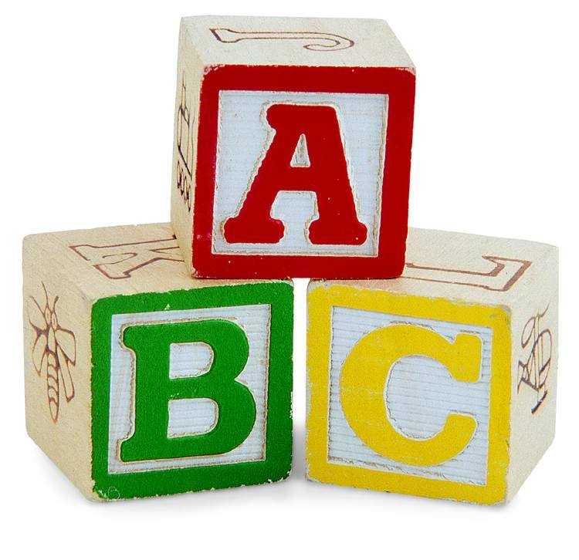
Parent Phonics Workshop

Slide 2
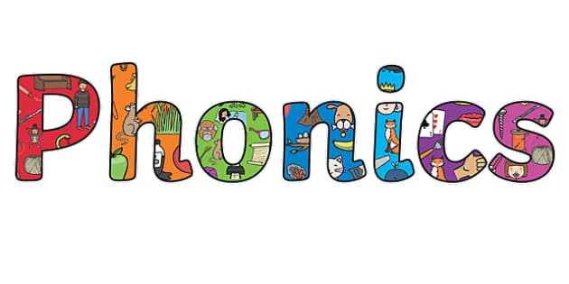
What is phonics and how can I help my child at home?

Slide 3
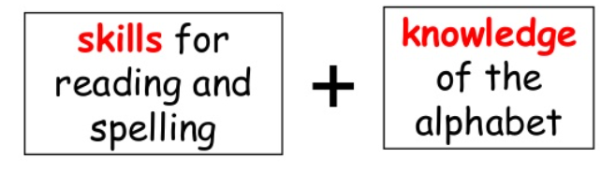
Phonics is…
Phonics are the sounds that letters or clusters of letters make in words. Learning phonics helps your child become a better reader and writer.

Slide 4
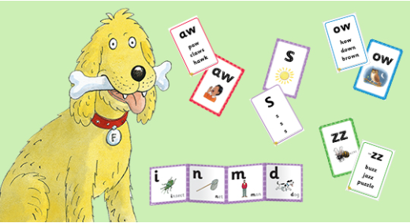
Phonics at Bapchild & Tonge Primary School.
In Reception and Year 1 – Children learn phonics through the programme Floppy’s Phonics. Children are supported at their pace and learning is systematic.
In year 2 and KS2 – pupils continue to learn phonics along side spelling rules and patterns through phonics international.

Slide 5
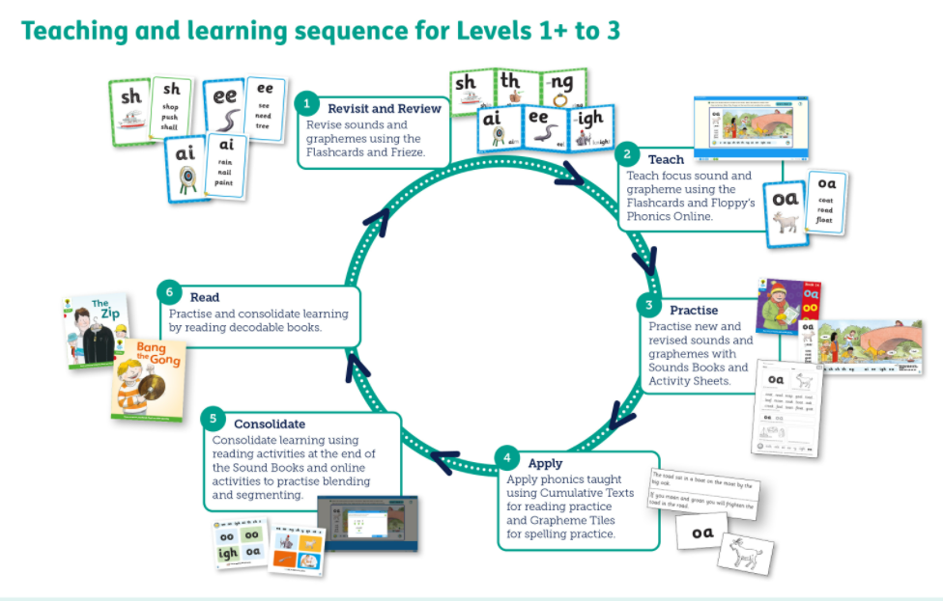

Slide 6
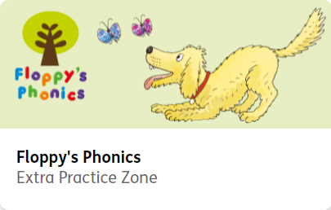

https://www.oxfordowl.co.uk/for-pupils/pupil-home

Slide 7
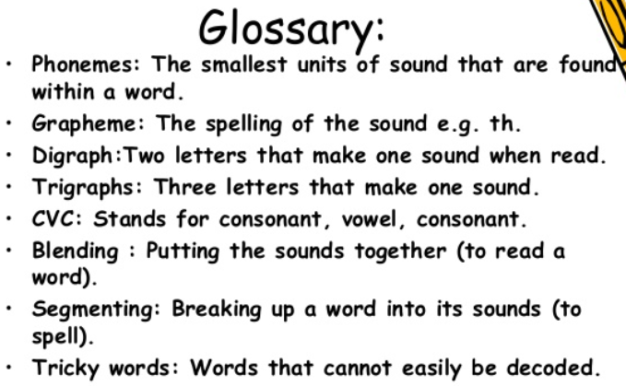

Slide 8
How to help at home
Read every day – repetition is key to developing confident readers.
Magic Fingers (counting phonemes on your fingers) – you say b-u-s then you child blends and says ‘bus’
Sing nursery rhymes
Play eye-spy
Segmenting and blending
Use the sounds from your child’s sound books to build real and nonsense words.
Look on the class website for useful links

