Slide 1

Home Learning
Year 2 Term 6 Week 6

Slide 2

Message from the class teacher
Hello Year 2 and welcome to week 6. I hope those of you who came in for the two hour session with Mrs Clark had a wonderful time and those of you who didn’t I hope you have had a great week. I am teaching on Monday and I am very excited to see those of you coming in. I am hoping we can have a quick catch up and then get down to some learning together. It will be wonderful teaching my own class again!
This week I have been a little lazy! On the rainy days Teddy and I spent some time indoors whilst Ronnie was at school. When we had some sunshine we made it over to King Georges Park, Teddy loves to look at the chickens over there!
Have a great week everybody! Cant wait to see you and if I haven't seen you I hope you know that I miss you as always. Mrs Unsworth x
Hello Year 2 and welcome to another week. It was fantastic to see some of you this week and continue to chat to others on the phone. You are continuing to do us all proud with how positive and resilient you are being. It has also been lovely to chat to some of your parents and carers who all commented on how well you have coped. I would also like to add a massive thank you to all your parents and carers who have persevered with the home learning and supported you all with your work. I hope those coming in on Monday have a fun time with Mrs Unsworth and you all continue to have a great week.
Lots of love Mrs Clark xx

Slide 3

Reading
Hopefully you have access to books at home, but we have sent home extra books with your child.
Accelerated Reading
Home quizzing is not always recommended but in this case we have adjusted the settings to allow quizzing to happen at home.
If your child wants to read a book from home, please check that there is a quiz available for the book and that the book level (BL) is within or near to your child’s reading range. Also take note of the quiz number for future reference.
To check books please visit: https://www.arbookfind.co.uk/
Go to the next page for how to quiz.

Slide 4



AR quizzing at home.
To log into AR to take a quiz please visit: https://ukhosted27.renlearn.co.uk/2240835/
Your child should know what to do from here and should know their login details. If they are not aware, most details are written in their reading record.
Click on Accelerated reader.
Type in the name the book or the quiz number.
We advise students complete quizzes unaided. If parents/carers wish to support their child, they can do so in the following ways:
Discuss the book with your child as the book is being read
Ask your child to read the question out loud
Re-word questions for your child, if necessary
Ask your child which answers are not correct

Slide 5

Visit http://readon.myon.co.uk

Slide 6

Choose an area that interests you or use the search option.

Slide 7


Using My Maths
Children should know their way round My Maths but here are some reminders on how access the lessons. Visit: www.mymaths.co.uk
bapchild
divide162

Slide 8

Using My Maths
Access any lesson based on what your child is learning in class or search the topic in the search bar.
Use the login portal to access specific homework and lessons that your teacher has set.

Slide 9

Maths – White Rose Home Learning
In school we follow the White Rose scheme of learning. Their website has put together free lessons and resources that link to the learning taking place in school. Please visit: https://whiterosemaths.com/homelearning/

Slide 10



TT Rockstars
To access TT Rockstars please visit: https://play.ttrockstars.com/auth/school
Start typing in the school name or the post code (ME99NL)
Pupils type in their username and password, usually written in their reading record.
Pupils can practice all tables but Year 2 should be practicing 2, 5, and 10’s
Year 3: 2,5,10,3,4,8’s
Year 4,5,6: all tables

Slide 11

Accessing Twinkl
Many educational content providers are offering free access to their resources. Twinkl is a website that we use from time to time to resource our lessons to aid in teacher input and pupil activities.
We will be able to direct you towards activities and learning via this website based on lessons that may be missed due to absence. To access Twinkl please visit: www.twinkl.co.uk/offer
You will have to sign up and put in the offer code: UKTWINKLHELPS

Slide 12
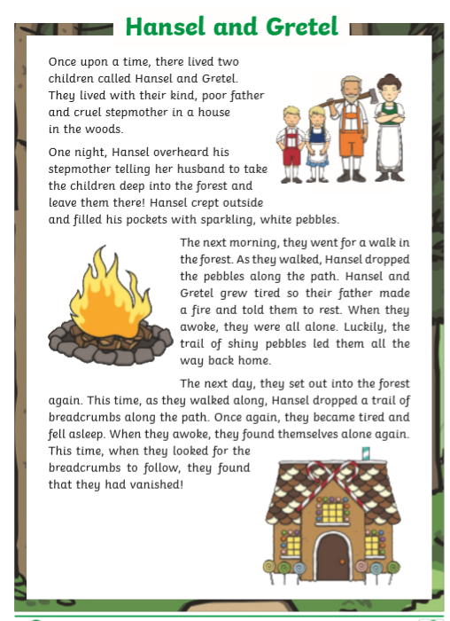
English Learning
We will spend the last two weeks of term looking at the traditional tale, Hansel and Gretal.
Activity 1: Reading comprehension. Read this version of the story of Hansel and Gretal over the next 2 slides and then answer the questions on slide 3 in FULL sentences.

Slide 13
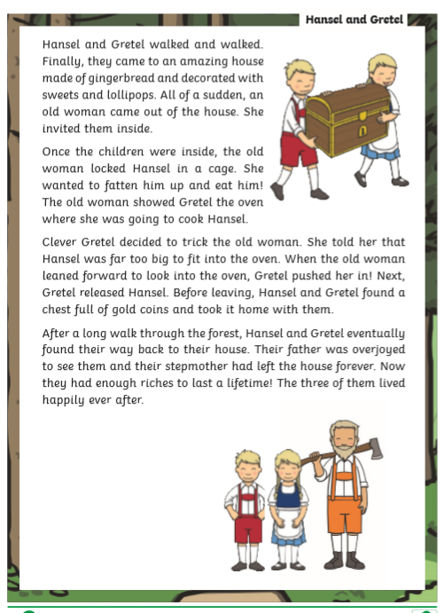

Slide 14
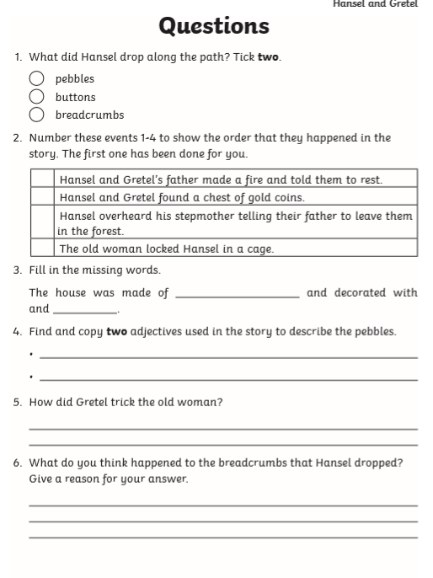
You could print this page out and complete it but for an extra challenge write out the answer for yourself in full sentences.
So for Q1 write
Hansel dropped __________ and __________ along the path.

Slide 15
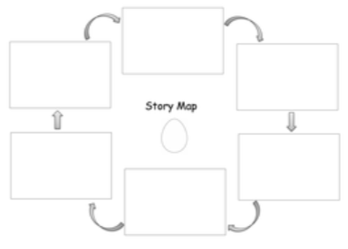
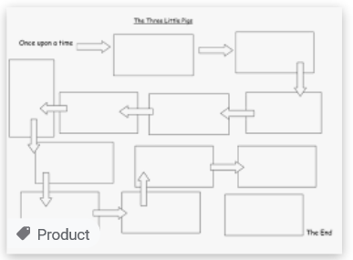
Activity 2: Watch this video of the story of Hansel and Gretal being told by clicking the link below.
https://www.youtube.com/watch?v=wDQib9yeEn0
Then create a story map of the story. Look at the templates on this page to give you an idea of how you can set it out. Use boxes and arrows to re-tell the story in your own words. Draw a picture and if you can write a sentence for each part of the story. Make sure you tell the story in the correct order. You can make as many boxes as you like but do at least 6. It might take you more than one piece of paper.

Slide 16
Activity 3:
You will find on the school website this week, along side this home learning PowerPoint, a second PowerPoint called past and present tense for English Activity 3.
For this activity go through the PowerPoint and complete the activities practicing past and present tense verbs. Once you have had a go you can reveal the answers on each page.
This activity will be good practice for a piece of written work we will do about Hansel and Gretal next week.

Slide 17

Maths Learning
This week we will continue working following the scheme of work from the white rose website. However, I would direct you this week to follow the learning videos and activities from the BBC bitesize website. https://www.bbc.co.uk/bitesize/tags/z7s22sg/year-2-and-p3-lessons
For each lesson there is a link to a work sheet recommended.
Activity 1 – BBC Bitesize→ Year 2 → 18th June →Shape Patterns
https://bam.files.bbci.co.uk/bam/live/content/zhnjmyc/pdf
Activity 2 – BBC Bitesize→ Year 2 → 22nd June →Measuring length and height
https://bam.files.bbci.co.uk/bam/live/content/zvgts4j/pdf
Activity 3 – BBC Bitesize→ Year 2 → 23rd June → Comparing length and height
https://bam.files.bbci.co.uk/bam/live/content/zc3796f/pdf
For each lesson on the BBC website there are 2 learning videos which you should watch first. There are also sometimes 3 activities to complete. I have put a link above for the one activity to be completed. However, if you want to complete the other activities and play the game feel free to explore the website. ☺
Can you extend your learning by measuring and comparing objects in your home?

Slide 18
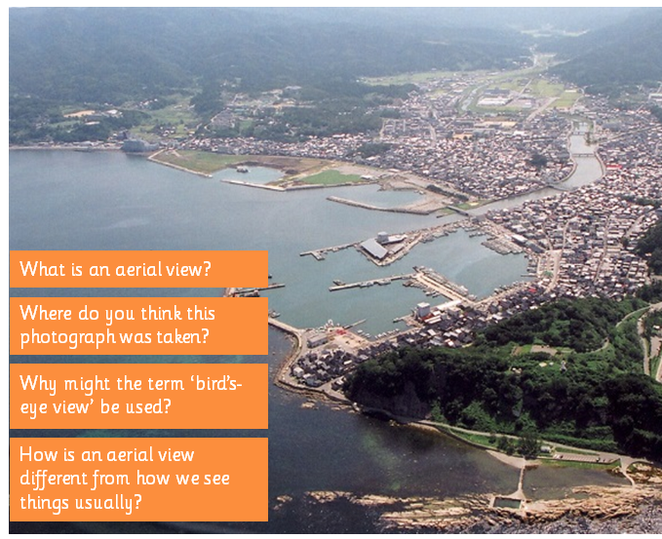
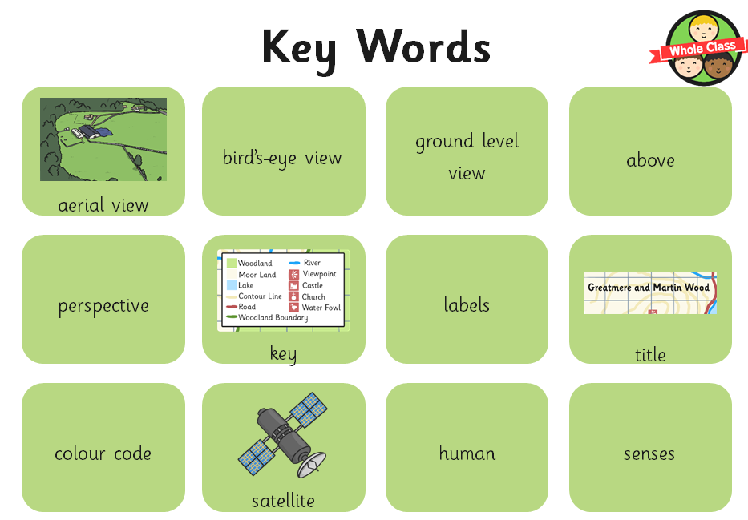
Topic – Aerial Views
This week we will be looking at amazing aerial views! Look at the aerial view below and discuss the questions asked in orange. Have a look through your key words, are there any you don’t know the meaning of? Can you look them up to find out what they mean?

Slide 19

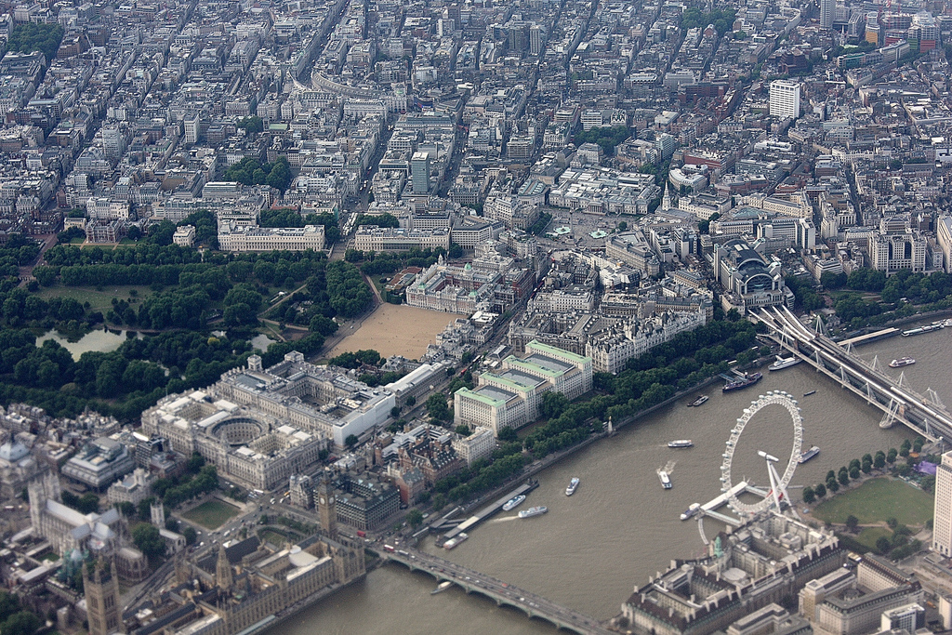
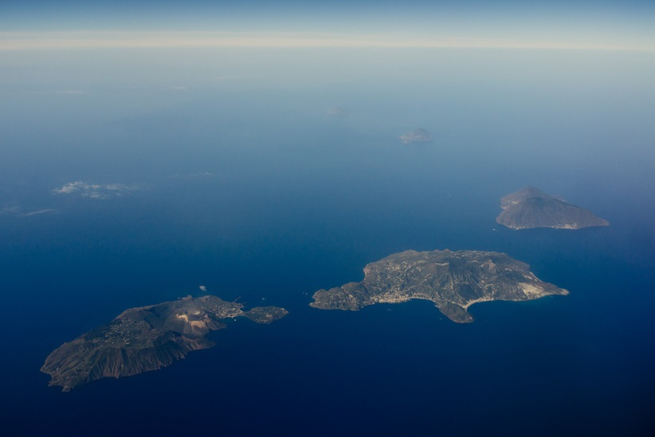
Look at these amazing aerial views! Can you guess where they are? Are there any clues to help?

Slide 20
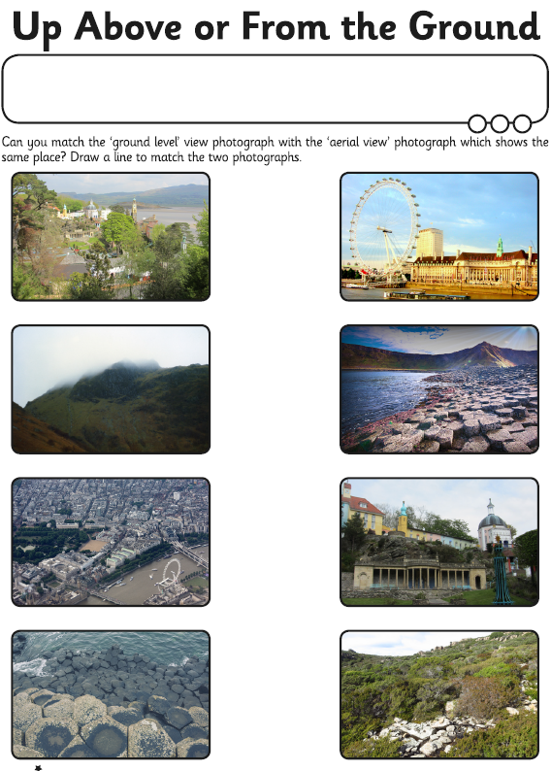
Activity 1 – Can you complete the following sheet and work out which photograph is taken from up above and which is taken from the ground?

Slide 21

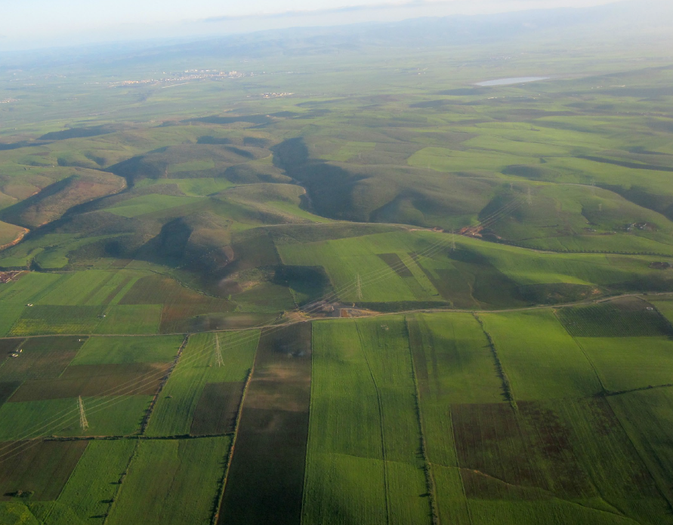


Activity 2 – Look at the following aerial views. Imagine yourself being in the photographs. What can you see, hear, smell even taste? How does this place make you feel? Complete the sheet on the next slide

Slide 22
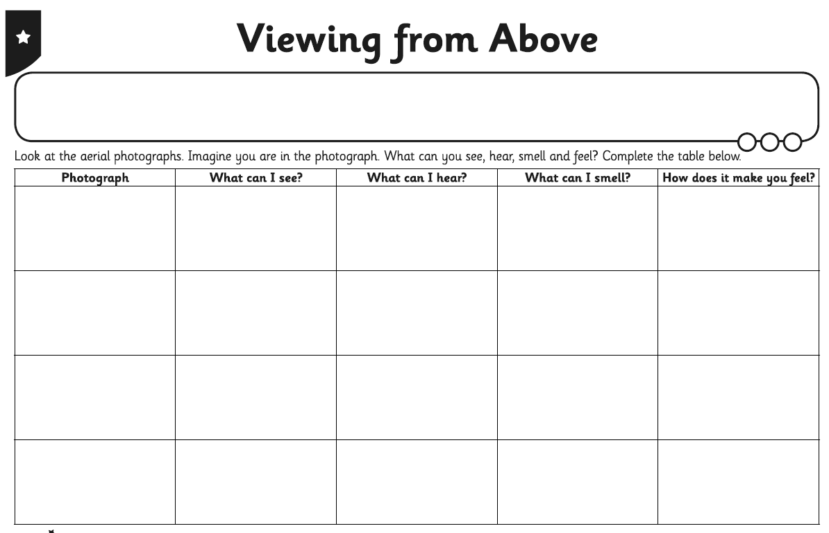
Use the pictures on the previous slide to help you complete this activity.
Challenge – can you find an aerial photograph of Bapchild school?

Slide 23

P.E.
It is important to keep your children active. If it is safe to do so, ensure they have some time outside throughout the day. Please visit Joe Wicks YouTube channel (https://www.youtube.com/channel/UCAxW1XT0iEJo0TYlRfn6rYQ), which has lots of exercise videos for children. He will also be hosting a live P.E. lessons Monday to Friday at 9:00am.

Slide 24

Classroom Secrets
The site classroom secrets https://classroomsecrets.co.uk/free-home-learning-packs/ has free class packs which provide some great additional ideas and resources you can use.

