Slide 1

Home Learning
Year 2 Term 6 Week 5

Slide 2

Message from the class teacher
Hello Year 2 and welcome to week 5. I hope you enjoyed the wonderful weather we had last week. I spent some time in school teaching Year 1 and it was super hot in the classroom. We all wished there was a paddling pool in the playground! I had my first swim in the sea and it was lovely, although very cold. George, Charlie and Arthur don’t feel it though, they jump straight in. I have really enjoyed speaking to some of you on the phone. It was so lovely to hear your voices and find out what you have been up to. Have a wonderful week Year 2 and enjoy the home learning. Miss you as always, love Mrs Clark xx
Hello Year 2, I hope you are all safe and well.
I have had a very unproductive week and I have mostly been moaning about hot it is and just living in the paddling pool. I was a little bit frightened the other morning hearing that very loud thunderstorm!
I am so pleased some of you will be in this week for your 2 hour session with Mrs Clark and I cannot wait to see you the following week!
Take care and see you very soon, Mrs Unsworth x

Slide 3

Reading
Hopefully you have access to books at home, but we have sent home extra books with your child.
Accelerated Reading
Home quizzing is not always recommended but in this case we have adjusted the settings to allow quizzing to happen at home.
If your child wants to read a book from home, please check that there is a quiz available for the book and that the book level (BL) is within or near to your child’s reading range. Also take note of the quiz number for future reference.
To check books please visit: https://www.arbookfind.co.uk/
Go to the next page for how to quiz.

Slide 4



AR quizzing at home.
To log into AR to take a quiz please visit: https://ukhosted27.renlearn.co.uk/2240835/
Your child should know what to do from here and should know their login details. If they are not aware, most details are written in their reading record.
Click on Accelerated reader.
Type in the name the book or the quiz number.
We advise students complete quizzes unaided. If parents/carers wish to support their child, they can do so in the following ways:
Discuss the book with your child as the book is being read
Ask your child to read the question out loud
Re-word questions for your child, if necessary
Ask your child which answers are not correct

Slide 5

Visit http://readon.myon.co.uk

Slide 6

Choose an area that interests you or use the search option.

Slide 7


Using My Maths
Children should know their way round My Maths but here are some reminders on how access the lessons. Visit: www.mymaths.co.uk
bapchild
divide162

Slide 8

Using My Maths
Access any lesson based on what your child is learning in class or search the topic in the search bar.
Use the login portal to access specific homework and lessons that your teacher has set.

Slide 9

Maths – White Rose Home Learning
In school we follow the White Rose scheme of learning. Their website has put together free lessons and resources that link to the learning taking place in school. Please visit: https://whiterosemaths.com/homelearning/

Slide 10



TT Rockstars
To access TT Rockstars please visit: https://play.ttrockstars.com/auth/school
Start typing in the school name or the post code (ME99NL)
Pupils type in their username and password, usually written in their reading record.
Pupils can practice all tables but Year 2 should be practicing 2, 5, and 10’s
Year 3: 2,5,10,3,4,8’s
Year 4,5,6: all tables

Slide 11

Accessing Twinkl
Many educational content providers are offering free access to their resources. Twinkl is a website that we use from time to time to resource our lessons to aid in teacher input and pupil activities.
We will be able to direct you towards activities and learning via this website based on lessons that may be missed due to absence. To access Twinkl please visit: www.twinkl.co.uk/offer
You will have to sign up and put in the offer code: UKTWINKLHELPS

Slide 12
English Learning
Back in Term 5 we looked at a story by the author and poet Michael Rosen. This week we are going to look at more of his work and concentrate on his poem.
Activity 1: We are going to compare two of Michael Rosen’s poems. They are called Chocolate Cake and Down By The Dustbin. Below is a link to a video of Michael Rosen reading Chocolate Cake for you to listen to and on the next slide is a copy of Down by the Dustbin for you to read yourself. When you have listened to and read both poems write a comparison by answering the following questions.
https://www.bing.com/videos/search?q=michael+rosen+poetry+youtube&view=detail&mid=D7C607BAD7CF64C60C9DD7C607BAD7CF64C60C9D&FORM=VIRE
What is each poem about?
Chocolate Cake is a quite long and Down by the dustbin is short. Do you think it they both sound like poems? What makes you think this?
Do both the poems rhyme? How do you know? Give examples of rhyming.
Which is your favourite poem? Why ?

Slide 13
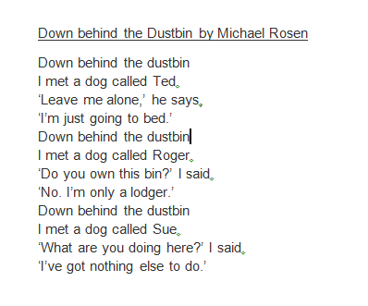

Slide 14
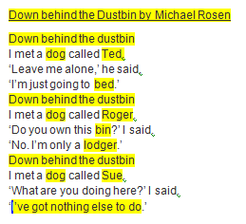
Activity 2: Look again at the poem Down behind the Dustbin on the previous slide. For this activity you are going to write your own version of the poem. You will have noticed from the last activity that some of the words in this poem are rhyming so you will have to get your thinking caps on to think of some different rhyming pairs. Below is a copy of the poem. All the parts highlighted in yellow are the parts you have to change.
Firstly you will have to think of your title for example ‘Just around the corner’ or ‘At the bottom of my garden’. This will also be line 1 of the poem and will be repeated 3 times in the poem.
For line 2 you have to chose a different animal to meet with a different name. For example ‘I met a snail called Paul’.
Line 3 can stay the same and for line 4 the last word must rhyme with the name. For example ‘I’m crawling on this wall.’
So the beginning of my poem is:
At the bottom of my Garden by Mrs Clark
At the bottom of my garden
I met a snail called Paul
Leave me alone, he said,
I’m crawling on this wall.
Start with your first 4 lines and then repeat the pattern but with different rhyming words for lines 4-8 and 9-12.

Slide 15
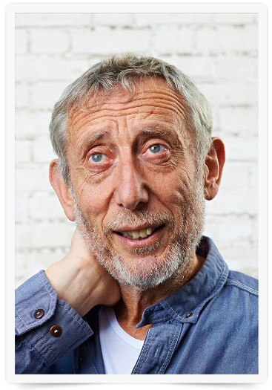
Activity 3: Now you are going to research the author and poet Michael Rosen. Click on the link below and read the autobiography that he has written about himself. Then write as many facts and interesting things about him as you can. Try to do at least 10. You could also print a picture of him to stick with your writing or try and draw a picture of him yourself.
https://www.michaelrosen.co.uk/about/

Slide 16
Maths Learning
This week we will continue working from the scheme of work from the white rose website. For each lesson there is a link to a work sheet recommended from BBC bitesize link on the white rose website.
Activity 1 – White rose home learning → Summer Term – Week 7 (w/c 8th June)
Lesson 4 – Finding a quarter – complete activity 1 and 2 on BBC Bitesize then play the game in the link below.
https://www.bbc.co.uk/bitesize/topics/zjkphbk/articles/zf4sscw
Activity 2 – White Rose Home Learning → Summer Term – Week 8 (w/c 15th June) →
Lesson 1 – Count sides and vertices on 2d shapes
There are 4 simple activities to complete on BBC website if you follow the link below
https://www.bbc.co.uk/bitesize/articles/zq6p7yc
Activity 3 – White Rose Home Learning → Summer Term – Week 8 (w/c 15th June)
Lesson 2 – Count faces, edges and vertices on 3D shapes
https://bam.files.bbci.co.uk/bam/live/content/z7j3c7h/pdf

Slide 17
P.H.S.E.
This week we are going to take some time to reflect on this very unusual and unpredictable time that we have been living through in the last three months. You have all done a fantastic job with your families in what has been a difficult time . Although there may have been some worrying times and things we were unsure of let’s focus now on the positive things.
Activity 1: My favourite memory of lockdown. Think of your favourite memory, this could be a particular day, a particular activity, an outing, a visit, anything. You can record this memory in any way you like, a piece of writing, some photos, a collage, a poster or a program on the computer.
Activity 2: A new thing I have learned. What new skill have you learned during lockdown? Have you learned to ride a bike? Have you cooked a meal? Do you know a new game? Have you taught your brother or sister something new? You could write down a set instructions with pictures to explain your new skill. Or write a recipe for something you have cooked? Include photos or pictures of yourself doing this.
Activity 3: Who have I helped and who has helped me? Set up a piece of paper divide it into two. On one side think of all the ways that you have helped someone. Have you helped around the house? Have you helped look after your siblings? Have you smiled at your neighbour and said hello? On the other side think of people who has helped you. Have your parents and carers worked hard to look after you? Has someone got shopping for you if you can’t go out? Have you had video calls with you grandparents? What about the NHS and people working in the shops?

Slide 18

P.E.
It is important to keep your children active. If it is safe to do so, ensure they have some time outside throughout the day. Please visit Joe Wicks YouTube channel (https://www.youtube.com/channel/UCAxW1XT0iEJo0TYlRfn6rYQ), which has lots of exercise videos for children. He will also be hosting a live P.E. lessons Monday to Friday at 9:00am.

Slide 19

Classroom Secrets
The site classroom secrets https://classroomsecrets.co.uk/free-home-learning-packs/ has free class packs which provide some great additional ideas and resources you can use.

