Slide 1


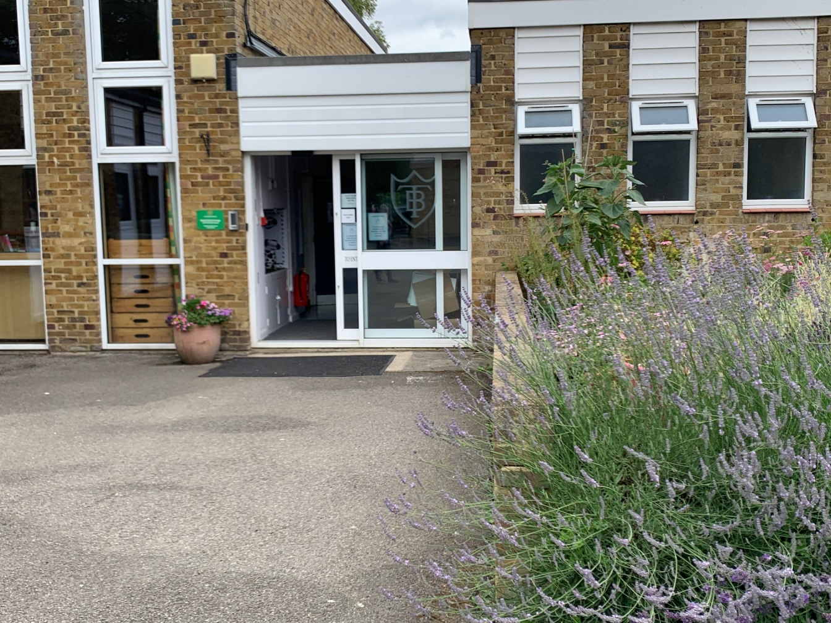
Welcome Back To School!

Slide 2
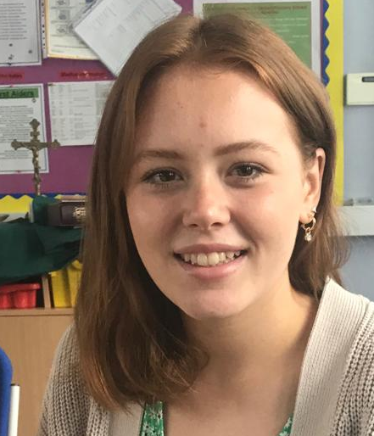
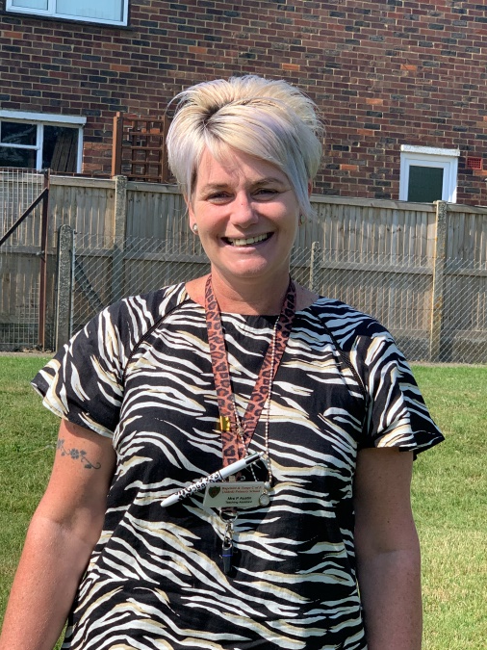
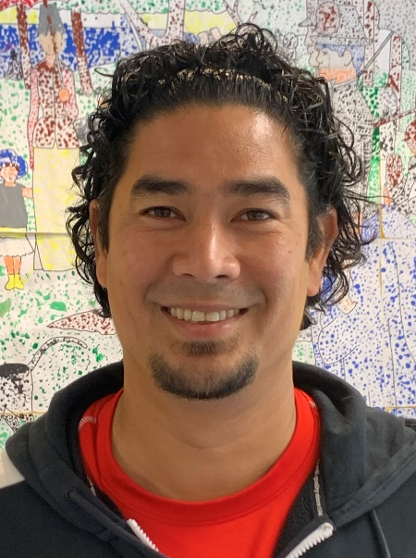
Year 1 Team
Miss White
Year 1 Teacher
Mrs Austin
Year 1 Class TA
(full time)
Mr Affonso
Year 1 Support Staff (mornings and 2 afternoons)

Slide 3
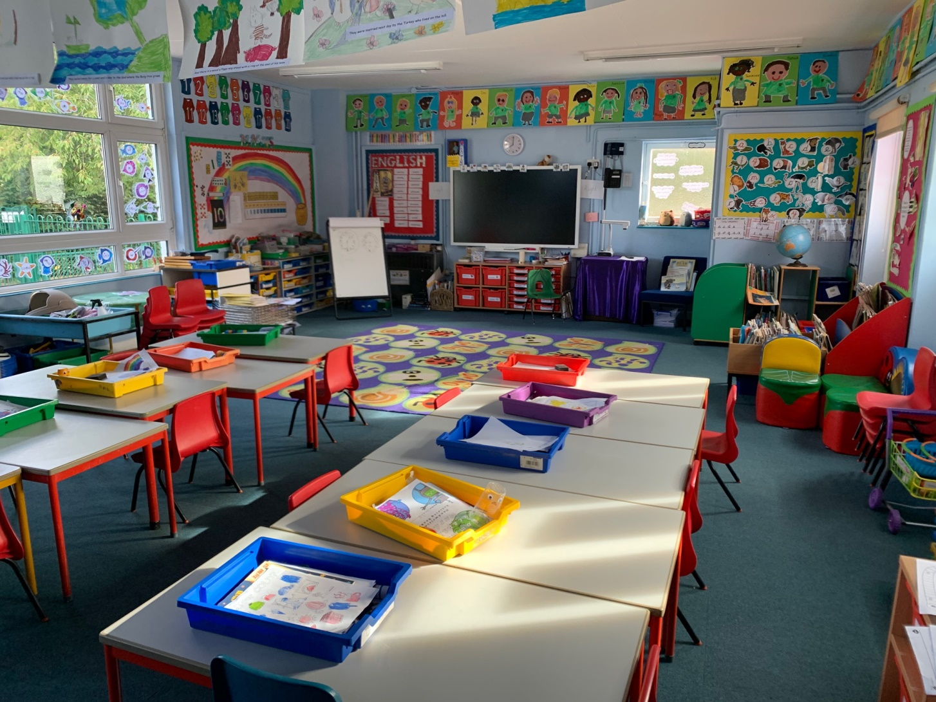
Here is your new classroom!
This is Year 1

Slide 4
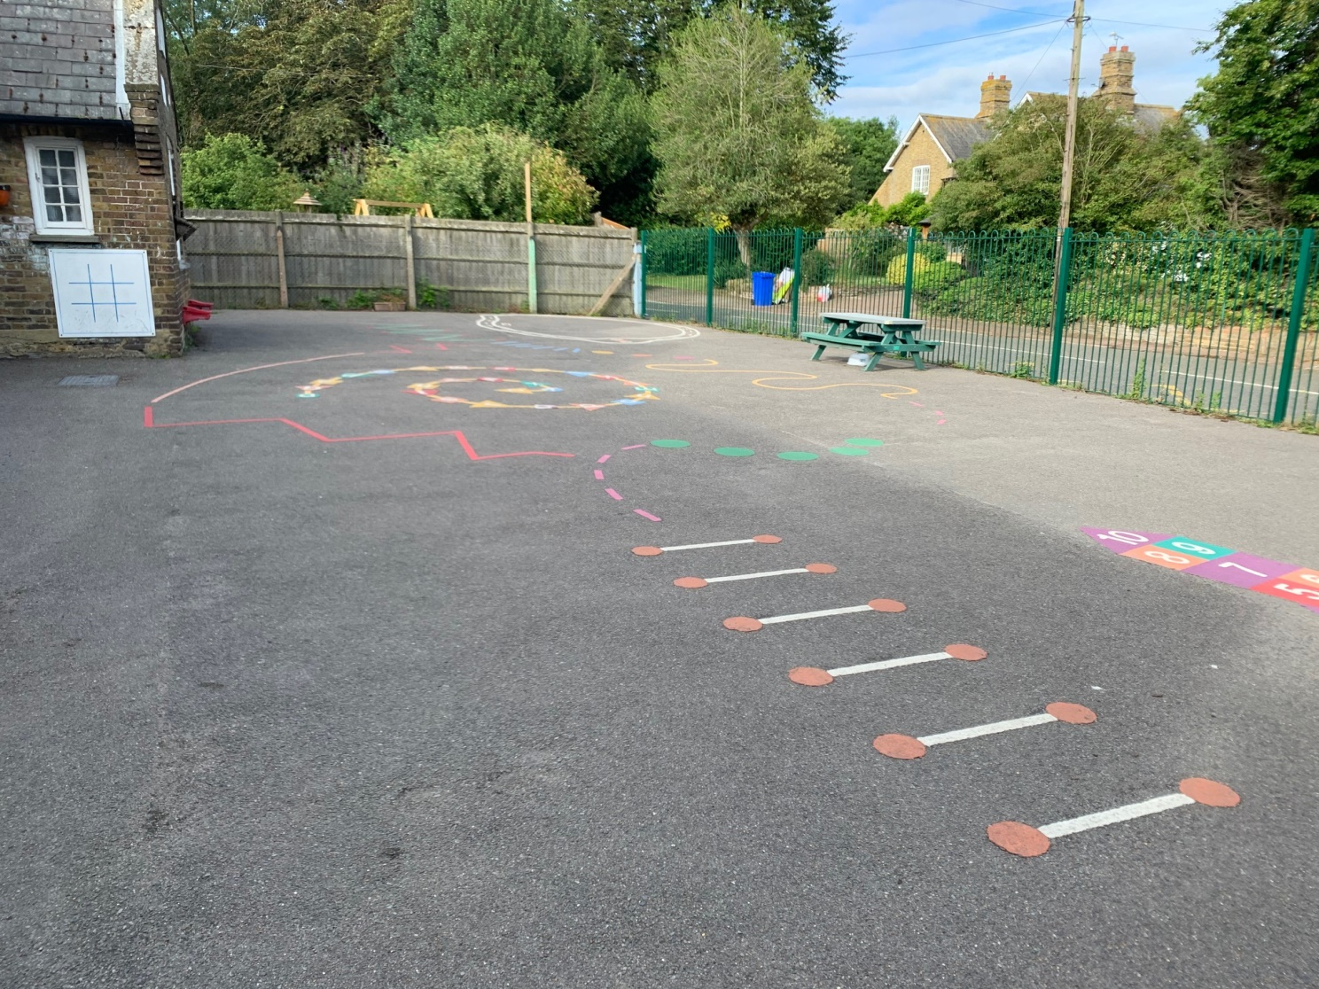
This is the playground for Year R, 1 and 2

Slide 5
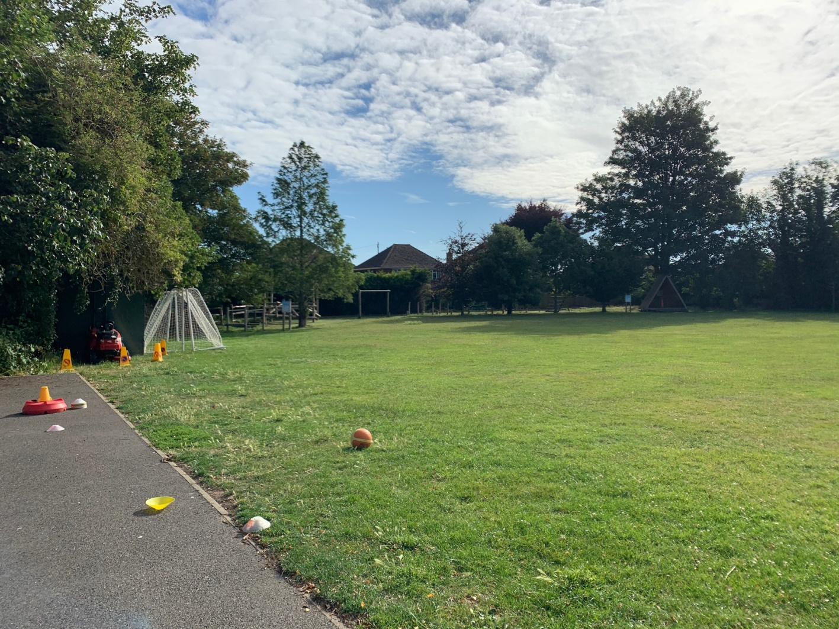
Here is the field where we join the ‘big children’ at lunchtimes if the weather is sunny.

Slide 6
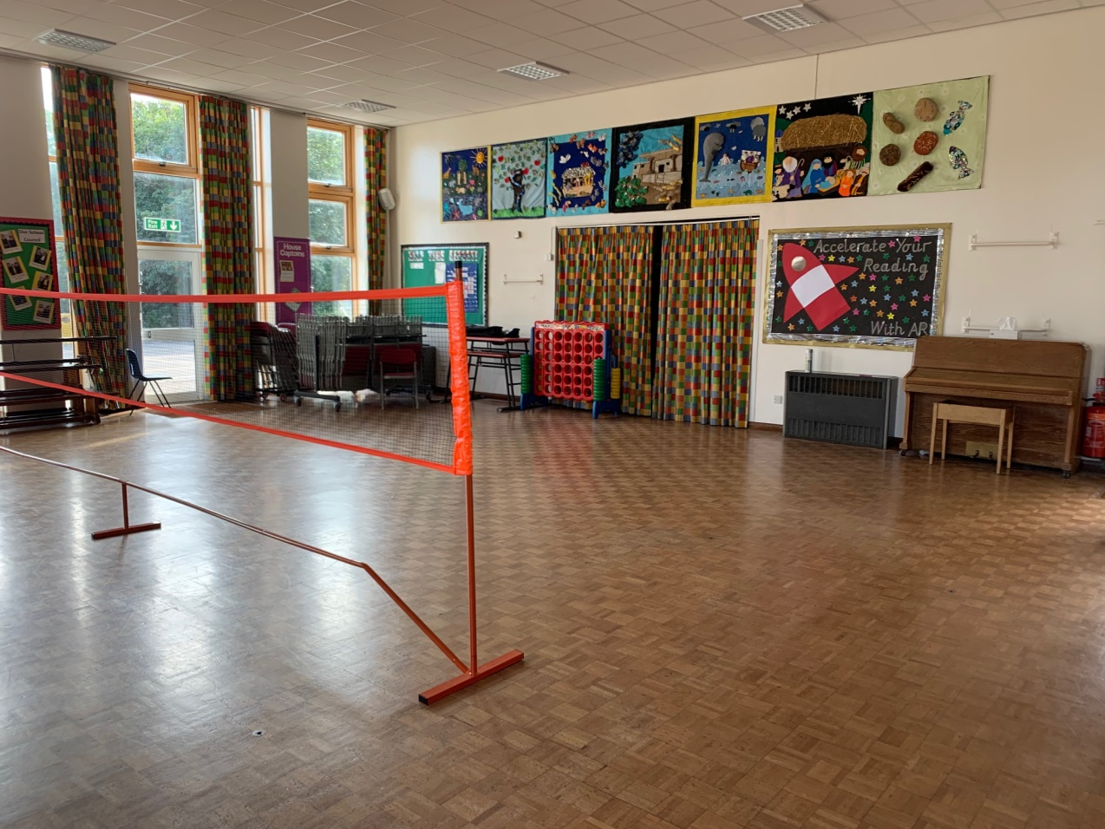
Here is the Hall
You eat your lunch here.
You might have PE lessons in here.
What sport do you think the children will be playing today?

Slide 7
Here are some other people you might see…….

Slide 8
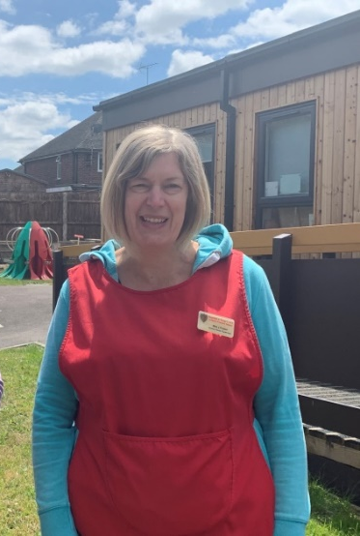
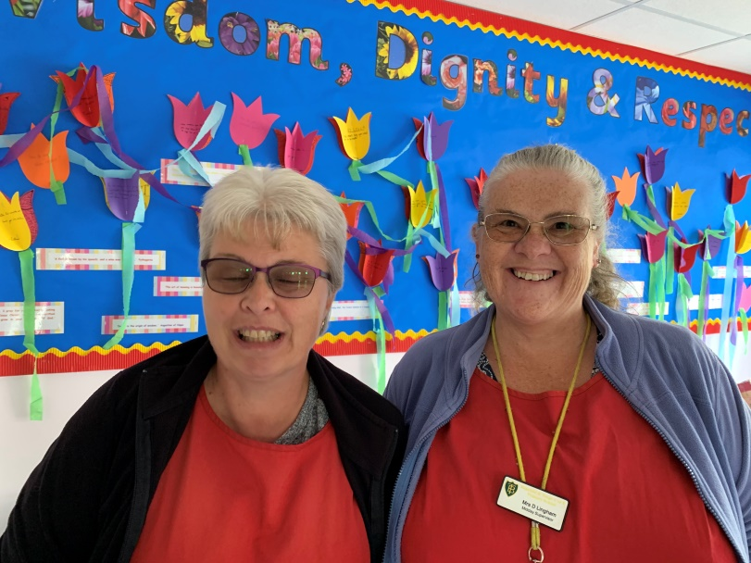
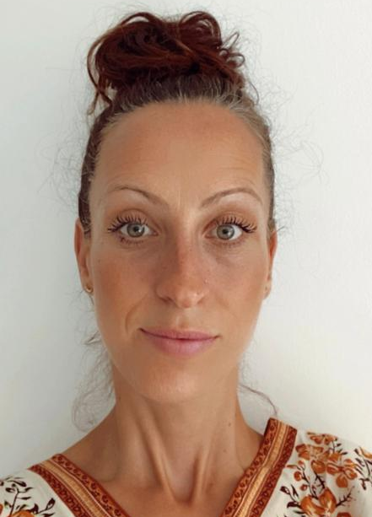
Mrs Foster
Mrs Mitchell and Mrs Lingham
They also run Breakfast Club if you come in early. They make great toast!
Mrs Osei
At Lunch time these ladies will look after you…

Slide 9
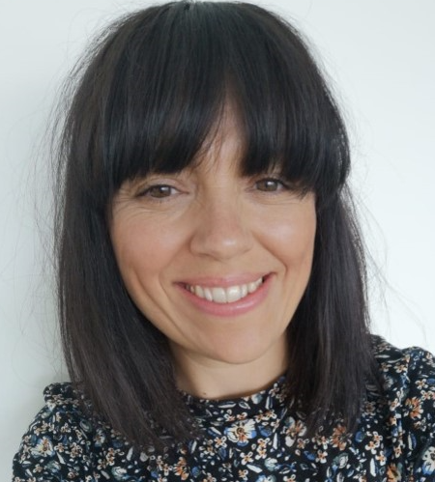
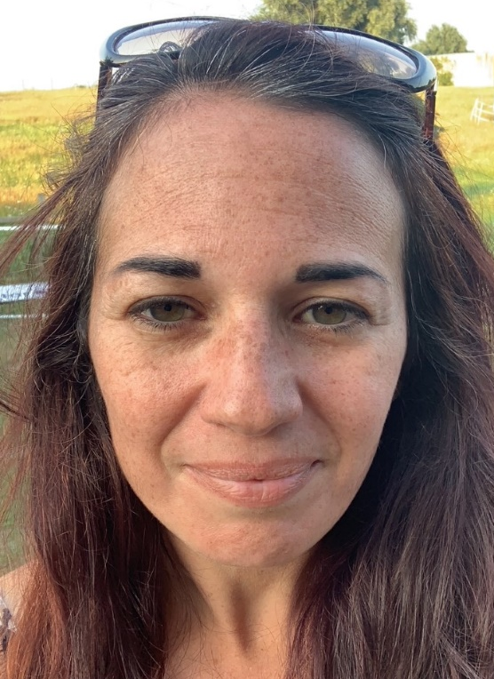
This is Mrs Long, our Wellbeing Leader
She is good at listening if someone is worried about something.
Mrs Gambell
She is our SENCO and works hard to make sure everyone feels included in our school.

Slide 10
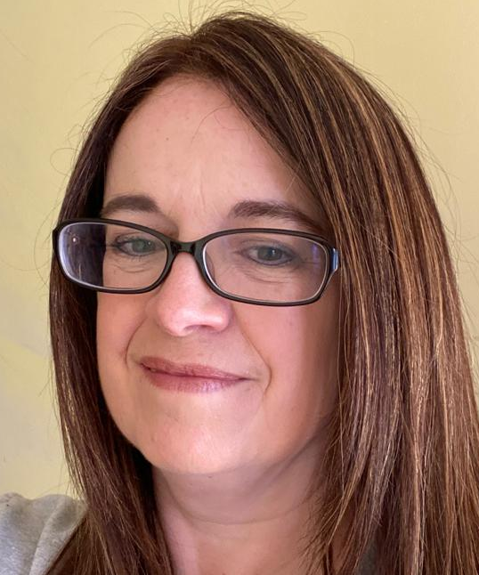
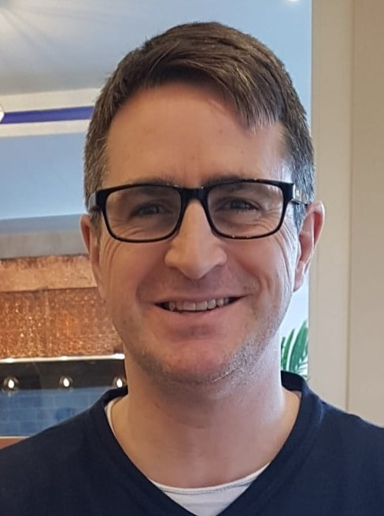
Mrs Julier
She is our Music teacher.
Rev Simon
He is our School Chaplain

Slide 11
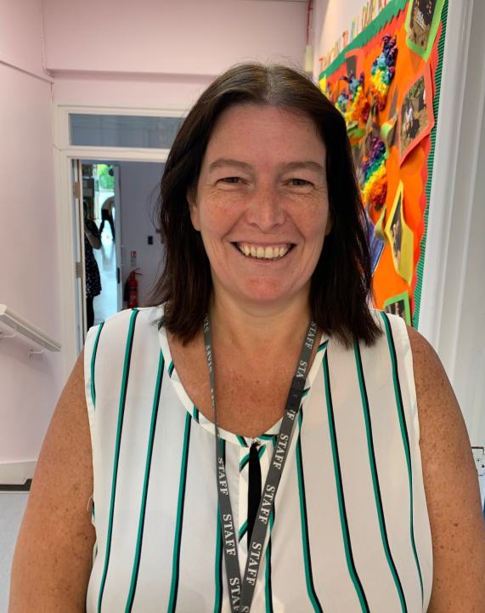
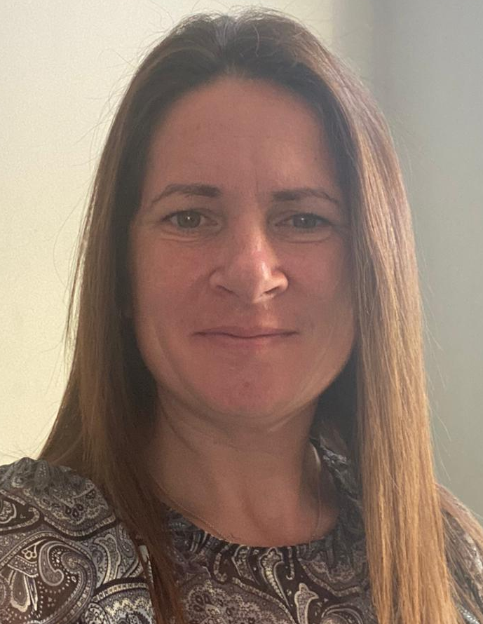
You will see these lovely ladies every day when you go to the office, or walk to the Hall…
Mrs Smedley
She helps out at lunch time, and she also works in Year R too. What a busy lady!
Mrs Barwick
She is the Office Manager and is in charge of the registers and the glue sticks!

Slide 12
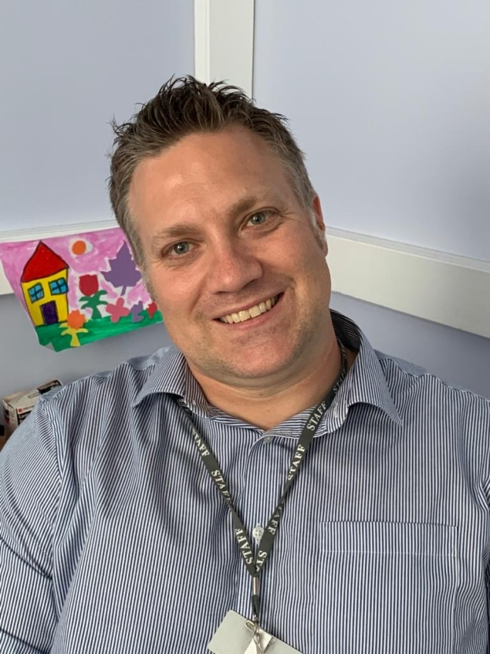
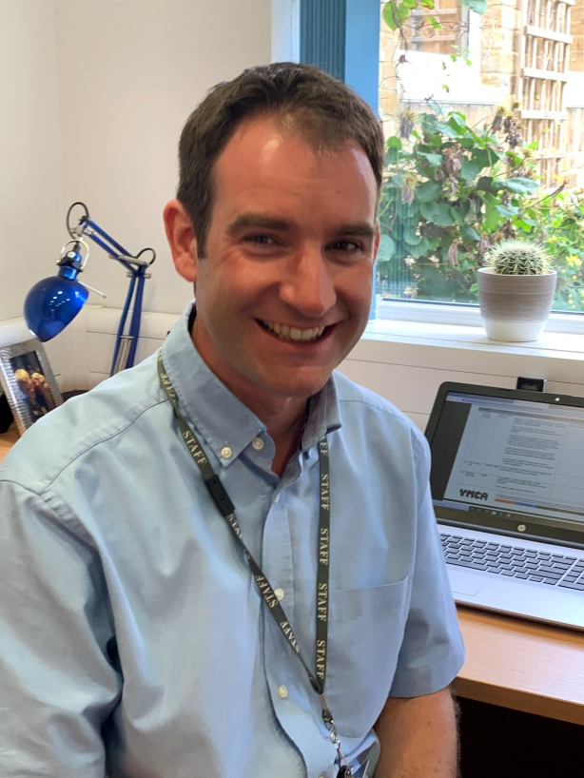
Mr Kelly
He is our Headteacher.
You will see him during your day. He can’t wait to have all the children back in school.
Mr Smiley
He is our Deputy Headteacher
He also teaches Year 5 and does the Ribbon Dance.

Slide 13
We are looking forward to seeing you in September!
Have a lovely summer holiday.
From all of us at Bapchild School

