Slide 1

Home Learning
Year 2 Term 6 Week 4

Slide 2

Message from the class teacher
Hello once again Year 2. I hope you have had another successful week. We are already in Week 4 of Term 6 and summer is definitely here. Did you know that Sunday 21st June was Summer Solstice? This means it was the longest day of the year with the most sunlight hours. It won’t be getting dark until 10pm!! This week is set to be a very hot week so enjoy the sun but remember to stay safe with sun lotion, sun hats and lots of water. Have a lovely week, missing your smiling faces.
Love Mrs Clark xx
Hello Year 2. I hope you are all well. It has been lovely speaking to some of you on the phone and we will be making more phone calls home this week! It has been wonderful hearing what you have been up to! Hopefully you all received the letter this week about retuning to school for the last 3 weeks of term. We hope that you can all make it and we cant wait to see your faces! How wonderful that there is a chance for us to be together again before you go up to Year 3! Take care, see you soon ☺ Mrs Unsworth x

Slide 3

Reading
Hopefully you have access to books at home, but we have sent home extra books with your child.
Accelerated Reading
Home quizzing is not always recommended but in this case we have adjusted the settings to allow quizzing to happen at home.
If your child wants to read a book from home, please check that there is a quiz available for the book and that the book level (BL) is within or near to your child’s reading range. Also take note of the quiz number for future reference.
To check books please visit: https://www.arbookfind.co.uk/
Go to the next page for how to quiz.

Slide 4



AR quizzing at home.
To log into AR to take a quiz please visit: https://ukhosted27.renlearn.co.uk/2240835/
Your child should know what to do from here and should know their login details. If they are not aware, most details are written in their reading record.
Click on Accelerated reader.
Type in the name the book or the quiz number.
We advise students complete quizzes unaided. If parents/carers wish to support their child, they can do so in the following ways:
Discuss the book with your child as the book is being read
Ask your child to read the question out loud
Re-word questions for your child, if necessary
Ask your child which answers are not correct

Slide 5

Visit http://readon.myon.co.uk

Slide 6

Choose an area that interests you or use the search option.

Slide 7


Using My Maths
Children should know their way round My Maths but here are some reminders on how access the lessons. Visit: www.mymaths.co.uk
bapchild
divide162

Slide 8

Using My Maths
Access any lesson based on what your child is learning in class or search the topic in the search bar.
Use the login portal to access specific homework and lessons that your teacher has set.

Slide 9

Maths – White Rose Home Learning
In school we follow the White Rose scheme of learning. Their website has put together free lessons and resources that link to the learning taking place in school. Please visit: https://whiterosemaths.com/homelearning/

Slide 10



TT Rockstars
To access TT Rockstars please visit: https://play.ttrockstars.com/auth/school
Start typing in the school name or the post code (ME99NL)
Pupils type in their username and password, usually written in their reading record.
Pupils can practice all tables but Year 2 should be practicing 2, 5, and 10’s
Year 3: 2,5,10,3,4,8’s
Year 4,5,6: all tables

Slide 11

Accessing Twinkl
Many educational content providers are offering free access to their resources. Twinkl is a website that we use from time to time to resource our lessons to aid in teacher input and pupil activities.
We will be able to direct you towards activities and learning via this website based on lessons that may be missed due to absence. To access Twinkl please visit: www.twinkl.co.uk/offer
You will have to sign up and put in the offer code: UKTWINKLHELPS

Slide 12
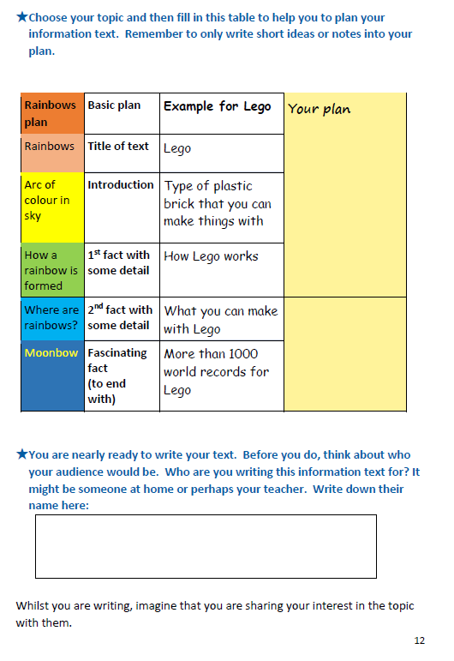
English Learning
Activity 1
Welcome to a new week of English. Hopefully at the end of last week you made a list of all the topics you know lots about or are interested in. Now is the time to write about your fascinating topic (you can use the topic you researched in your reading challenge last week or a new one). Once you have researched your topic and know lots about it, then you need to plan how you are going to write your non-fiction piece. Opposite is an example of a planning table that has been used for Lego. Have a go at drawing out a planning table for your topic. Remember to include who you are writing it for.

Slide 13
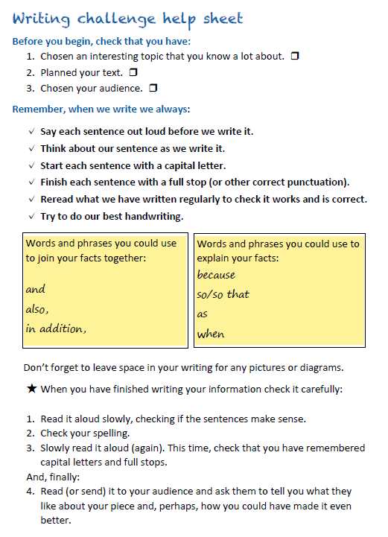
Activity 2
Now it is time to write your non-fiction piece, including all the wonderful facts and details you have found. Opposite is a very useful checklist of things to remember when you are writing. There are also some interesting vocabulary words you could include and a reminder to leave space for any diagrams and pictures you want to include. When you have finished writing also read through the checklist at the bottom to check and edit you work.
Have fun with your fascinating facts!!

Slide 14
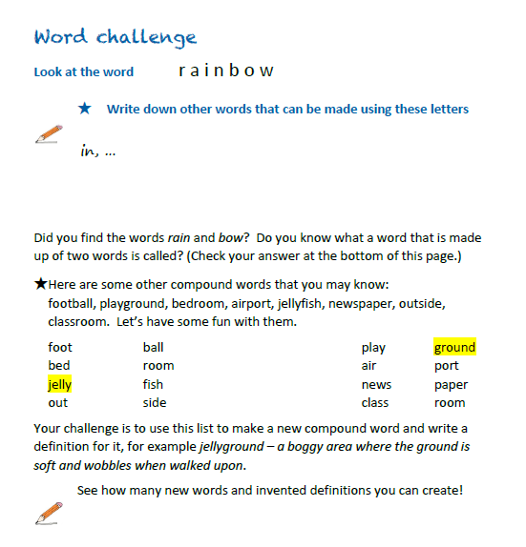

Activity 3
Your last challenge this week is a fun word challenge after all that writing you’ve done! So have a go at the activity opposite, making new compound words out of existing ones and making up funny definitions for your new words.

Slide 15
Maths Learning
This week we will continue working from the scheme of work from the white rose website. For each lesson there is a link to a work sheet recommended from BBC bitesize link on the white rose website.
Activity 1 – White rose home learning → Summer Term – Week 7 (w/c 8th June)
Lesson 1 – Unit Fractions
https://bam.files.bbci.co.uk/bam/live/content/zv2g9mn/pdf
Activity 2 – White Rose Home Learning → Summer Term – Week 7 (w/c 8th June) →
Lesson 2 - Non – Unit fractions
https://bam.files.bbci.co.uk/bam/live/content/zd3mhg8/pdf
Activity 3 – White Rose Home Learning → Summer Term – Week 7 (w/c 8th June)
Lesson 3 – Finding a half
See Practical activities on BBC bitesize website
Alternatively you can watch the BBC bitesize videos before completing the worksheet. There are some great practical activities on the BBC website for this unit and some more examples to help gain a deeper understanding of fractions.

Slide 16
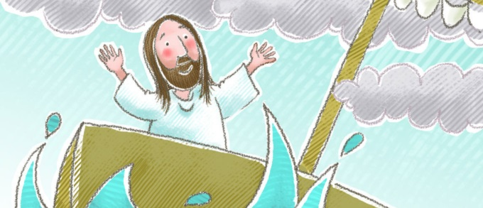
R.E.
Jesus calms the storm Mark 4:35-41
This week we are reflecting on an important story from the bible, you can watch it here if you do not have a bible at home.
https://www.youtube.com/watch?v=uYLHqdSO9OY
This story places emphasis on our school Christian value of trust. Have you ever had a problem you couldn’t fix? What do you do? Like the disciples, we are all afraid sometimes. In this story they learned to trust God to help them even when it seemed impossible.
Possible activities:
Write a prayer . What can you ask God to help you with today? What are you thankful for?
Who do you trust? Could you create a trust tree filled with the names of all of the people you trust. Draw a tree and on the leaves/branches you could write the names of the people you trust and why.
Oil and Water Experiment - Gather a clear plastic cup and two small paper or foam cups. Put 2 inches of white vinegar in the clear cup, 1 tablespoon of baking soda in one of the paper cups, and 1 tablespoon of cooking oil in the other paper cup. Let’s try this experiment to see what happens when we let Jesus take care of our fears. Let’s pretend that the clear cup represents you. The white powder represents the things that scare us. The oil in the other cup represents Jesus. Sprinkle the white powder into the plastic cup. While you watch what happens, think about how you feel when you’re scared. Then pour in the oil. Watch what happens and think about Jesus. The fizz of the baking soda and vinegar represents our fears and the calming effect of the oil represents Jesus.

Slide 17

P.E.
It is important to keep your children active. If it is safe to do so, ensure they have some time outside throughout the day. Please visit Joe Wicks YouTube channel (https://www.youtube.com/channel/UCAxW1XT0iEJo0TYlRfn6rYQ), which has lots of exercise videos for children. He will also be hosting a live P.E. lessons Monday to Friday at 9:00am.

Slide 18

Classroom Secrets
The site classroom secrets https://classroomsecrets.co.uk/free-home-learning-packs/ has free class packs which provide some great additional ideas and resources you can use.

