Slide 1

Home Learning
Year 2 Term 6 Week 3

Slide 2

Message from the class teacher
Hello Year 2. I hope you’ve had a great week and have continued to have fun with your families. We have had a busy week in my house, continuing with home-schooling, lots of bike rides and having a visit with my parents (from the end of their path). This week I would like to say a massive thank you to your parents and carers. They have all done a fantastic job looking after you during this lockdown. Give them all a clap from me. Take care, miss you all, love Mrs Clark xx
Hi Year 2, I have had a very busy week as it has been my first week returning back to work in Year 1. We have been doing lots of fun things and we have had chicks to look after…that’s been eventful ☺.
Over the next 2-3 weeks Mrs Clark and I will be making phone calls to home to touch base with parents to check how you all are. If we could we would like to speak to you too. We have made some phone calls already and its been great to catch up. As always, we miss you all. Mrs Unsworth x

Slide 3

Reading
Hopefully you have access to books at home, but we have sent home extra books with your child.
Accelerated Reading
Home quizzing is not always recommended but in this case we have adjusted the settings to allow quizzing to happen at home.
If your child wants to read a book from home, please check that there is a quiz available for the book and that the book level (BL) is within or near to your child’s reading range. Also take note of the quiz number for future reference.
To check books please visit: https://www.arbookfind.co.uk/
Go to the next page for how to quiz.

Slide 4



AR quizzing at home.
To log into AR to take a quiz please visit: https://ukhosted27.renlearn.co.uk/2240835/
Your child should know what to do from here and should know their login details. If they are not aware, most details are written in their reading record.
Click on Accelerated reader.
Type in the name the book or the quiz number.
We advise students complete quizzes unaided. If parents/carers wish to support their child, they can do so in the following ways:
Discuss the book with your child as the book is being read
Ask your child to read the question out loud
Re-word questions for your child, if necessary
Ask your child which answers are not correct

Slide 5

Visit http://readon.myon.co.uk

Slide 6

Choose an area that interests you or use the search option.

Slide 7


Using My Maths
Children should know their way round My Maths but here are some reminders on how access the lessons. Visit: www.mymaths.co.uk
bapchild
divide162

Slide 8

Using My Maths
Access any lesson based on what your child is learning in class or search the topic in the search bar.
Use the login portal to access specific homework and lessons that your teacher has set.

Slide 9

Maths – White Rose Home Learning
In school we follow the White Rose scheme of learning. Their website has put together free lessons and resources that link to the learning taking place in school. Please visit: https://whiterosemaths.com/homelearning/

Slide 10



TT Rockstars
To access TT Rockstars please visit: https://play.ttrockstars.com/auth/school
Start typing in the school name or the post code (ME99NL)
Pupils type in their username and password, usually written in their reading record.
Pupils can practice all tables but Year 2 should be practicing 2, 5, and 10’s
Year 3: 2,5,10,3,4,8’s
Year 4,5,6: all tables

Slide 11

Accessing Twinkl
Many educational content providers are offering free access to their resources. Twinkl is a website that we use from time to time to resource our lessons to aid in teacher input and pupil activities.
We will be able to direct you towards activities and learning via this website based on lessons that may be missed due to absence. To access Twinkl please visit: www.twinkl.co.uk/offer
You will have to sign up and put in the offer code: UKTWINKLHELPS

Slide 12
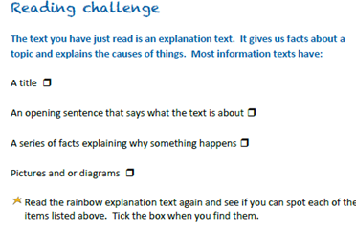

English Learning
We will carry on our unit on Rainbows this week in English. We will concentrate on identifying the features of a non-fiction information text.
Activity 1: This reading challenge uses the information text about rainbows that was used in last week’s activities which can be found on the next slide.
Copy out the list of features above and tick them off as you spot them.

Slide 13
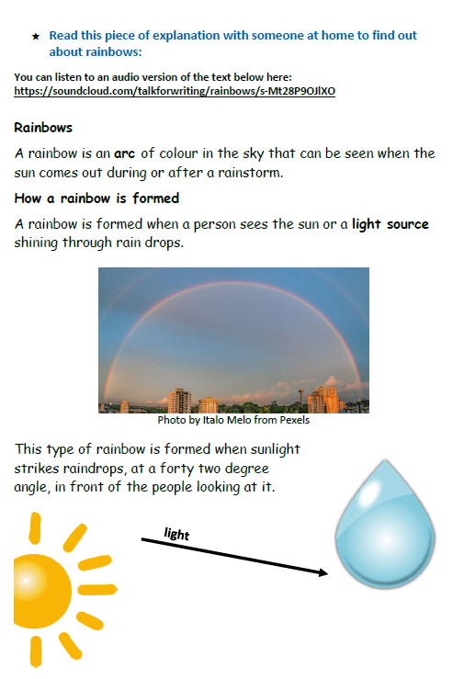
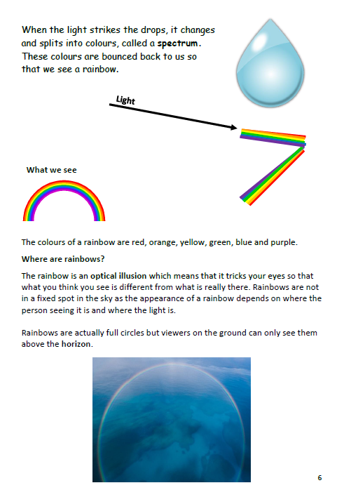
Activity 1
https://soundcloud.com/talkforwriting/rainbows/s-Mt28P9OJlXO

Slide 14
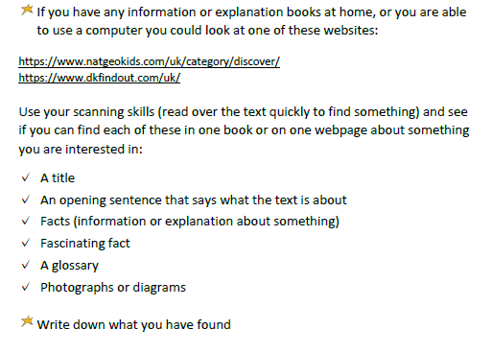

Activity 2
Reading Challenge: For this activity use a topic that you are interested in or want to know more about. Use any information book you have at home or try one of the websites below.
https://www.dkfindout.com/uk/
https://www.natgeokids.com/uk/category/discover/
Use the template on the next slide to help you.

Slide 15
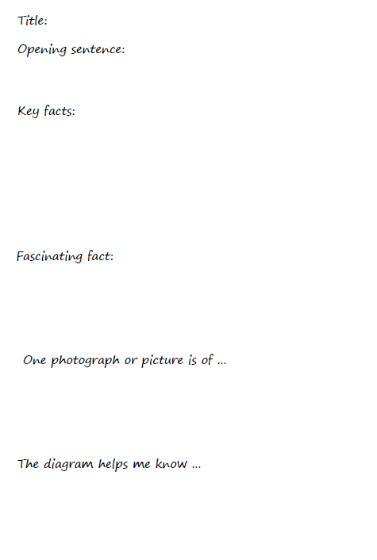
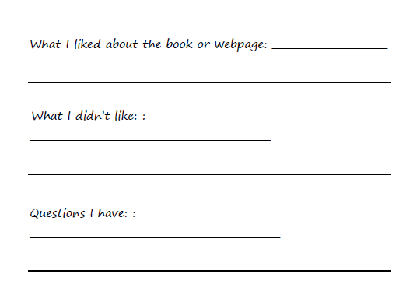

Slide 16
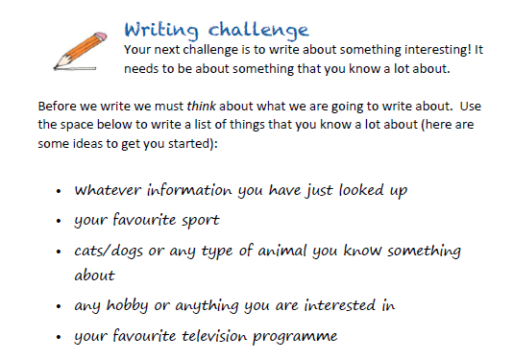
Activity 3
Next week we will be writing our own piece of non-fiction text. Your last task this week is to make a list of things you are interested in or know a lot about that you could write about. There are some ideas below. Next week you will be choosing one to write about.

Slide 17
Maths Learning
This week we will continue working from the scheme of work from the white rose website. For each lesson there is a link to a work sheet recommended from BBC bitesize link on the white rose website. This week we are continuing with our learning of multiplication and division. If you could continue to practise the 2x, 5x, and 10x tables that would be great!
Activity 1 – White rose home learning → Summer Term – Week 6 (w/c 1st June)
Lesson 2 – Sharing
https://bam.files.bbci.co.uk/bam/live/content/zhnvrqt/pdf
Activity 2 – White Rose Home Learning → Summer Term – Week 6 (w/c 1st June) →
Lesson 3 - Grouping
https://bam.files.bbci.co.uk/bam/live/content/z7xs3dm/pdf
Activity 3 – White Rose Home Learning → Summer Term – Week 6 (w/c 1st June)
Lesson 4 – Odd and Evens numbers
https://bam.files.bbci.co.uk/bam/live/content/z42b42p/pdf
Alternatively you can watch the BBC bitesize videos before completing the worksheet. For this week’s home learning links there are practise activities on the bitesize website too! All videos are found at https://www.bbc.co.uk/bitesize/dailylessons

Slide 18
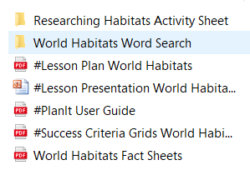
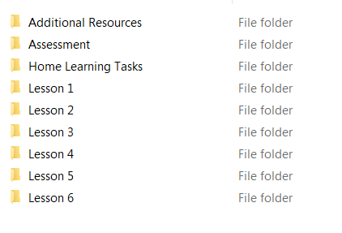
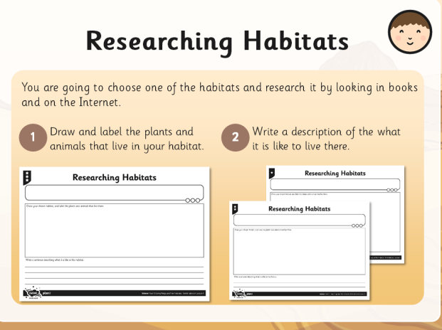
Science
We are continuing with our topic on living things and their habitats. This weeks work is about comparing different types of habitats around the world and how animals survive there. Click on the link below and download the unit.
https://www.twinkl.co.uk/resource/tp-sc-050-planit-science-year-2-living-things-and-their-habitats-unit-pack
Click on lesson 4
Click on the world habitat powerpoint
Activity 1
Read the powerpoint up to slide 15 and then stop. Complete the activity Researching Habitats using one of the World Habitats from the powerpoint. You can either print out the worksheet of create one of your own.
Then look at slides 16-20 and get somebody at home to ask the questions and you have to answer them from the information you have found out. HINT: maybe your siblings could help.

Slide 19
Activity 2 Now look at slides 21-the end which are all about how animals survive in each world habitat. Each slide asks a question and then gives the answers. Try to answer each question before you reveal the answers. You could even do a bit of research before you reveal them. DON’T CHEAT!
Activity 3: Using the information you have learned in activities 1 and 2 create a colourful and informative poster about one of the world habitats. You should include a big, bold heading, pictures (either drawn or print photos) and facts about the habitat and how living things survive there. Have fun!

Slide 20

P.E.
It is important to keep your children active. If it is safe to do so, ensure they have some time outside throughout the day. Please visit Joe Wicks YouTube channel (https://www.youtube.com/channel/UCAxW1XT0iEJo0TYlRfn6rYQ), which has lots of exercise videos for children. He will also be hosting a live P.E. lessons Monday to Friday at 9:00am.

Slide 21

Classroom Secrets
The site classroom secrets https://classroomsecrets.co.uk/free-home-learning-packs/ has free class packs which provide some great additional ideas and resources you can use.

