Slide 1

Home Learning
Year 2 Term 6 Week 2

Slide 2
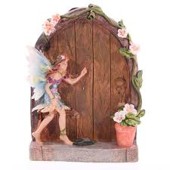
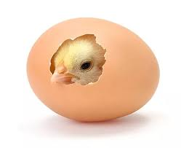
Message from the class teacher
Hello Year 2, I hope you all enjoyed your first week back of home learning! Some children have returned to school in Year R , 1 and 6. We can’t wait for the day we can all return!
This week I have been busy walking everywhere, trying to build up 15,000 steps a day. I walked down to Bapchild to see how many fairy doors I could find with Teddy whilst Ronnie was at school. It a lovely little village hunt and I think you would enjoy it. We managed to find 8!
Have a great week of home learning, miss you as always! Mrs Unsworth x
Hello Year 2, I hope you have had a good week. Last week felt very different for me. My son George went back to school as he is in Year 6 and then I returned to school and taught Year 1 for a couple of days. It was so lovely to return to Bapchild and see some of the children. But shall I let you into a secret? I wish I could also see my lovely Year 2s. The Year 1 children had some eggs delivered and the children have been very excited to see them hatch into chicks. Have a lovely week and enjoy your activities. Miss you lots, love Mrs Clark x

Slide 3

Reading
Hopefully you have access to books at home, but we have sent home extra books with your child.
Accelerated Reading
Home quizzing is not always recommended but in this case we have adjusted the settings to allow quizzing to happen at home.
If your child wants to read a book from home, please check that there is a quiz available for the book and that the book level (BL) is within or near to your child’s reading range. Also take note of the quiz number for future reference.
To check books please visit: https://www.arbookfind.co.uk/
Go to the next page for how to quiz.

Slide 4



AR quizzing at home.
To log into AR to take a quiz please visit: https://ukhosted27.renlearn.co.uk/2240835/
Your child should know what to do from here and should know their login details. If they are not aware, most details are written in their reading record.
Click on Accelerated reader.
Type in the name the book or the quiz number.
We advise students complete quizzes unaided. If parents/carers wish to support their child, they can do so in the following ways:
Discuss the book with your child as the book is being read
Ask your child to read the question out loud
Re-word questions for your child, if necessary
Ask your child which answers are not correct

Slide 5

Visit http://readon.myon.co.uk

Slide 6

Choose an area that interests you or use the search option.

Slide 7


Using My Maths
Children should know their way round My Maths but here are some reminders on how access the lessons. Visit: www.mymaths.co.uk
bapchild
divide162

Slide 8

Using My Maths
Access any lesson based on what your child is learning in class or search the topic in the search bar.
Use the login portal to access specific homework and lessons that your teacher has set.

Slide 9

Maths – White Rose Home Learning
In school we follow the White Rose scheme of learning. Their website has put together free lessons and resources that link to the learning taking place in school. Please visit: https://whiterosemaths.com/homelearning/

Slide 10



TT Rockstars
To access TT Rockstars please visit: https://play.ttrockstars.com/auth/school
Start typing in the school name or the post code (ME99NL)
Pupils type in their username and password, usually written in their reading record.
Pupils can practice all tables but Year 2 should be practicing 2, 5, and 10’s
Year 3: 2,5,10,3,4,8’s
Year 4,5,6: all tables

Slide 11

Accessing Twinkl
Many educational content providers are offering free access to their resources. Twinkl is a website that we use from time to time to resource our lessons to aid in teacher input and pupil activities.
We will be able to direct you towards activities and learning via this website based on lessons that may be missed due to absence. To access Twinkl please visit: www.twinkl.co.uk/offer
You will have to sign up and put in the offer code: UKTWINKLHELPS

Slide 12
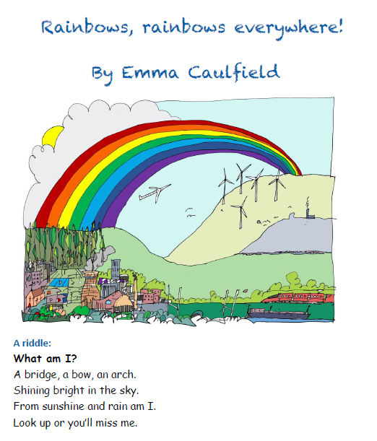
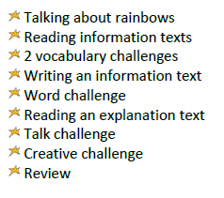
English Learning
During lockdown we have got used to seeing many images of rainbows as a symbol of hope. Over the next few weeks we will complete a topic in our English work on the theme of rainbows. We will look at non-fiction texts and use our English skills to find out the science of rainbows. We will explore the symbolism of rainbows and get creative with our writing.

Slide 13
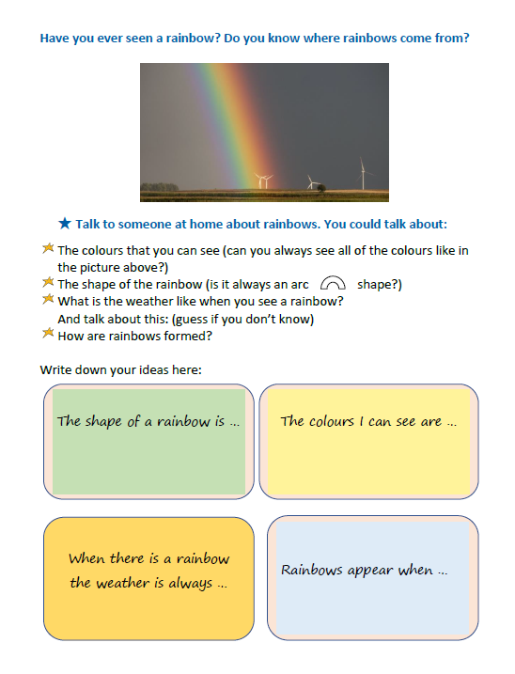
Activity 1
Have a go at completing these sentences from what you already know.

Slide 14
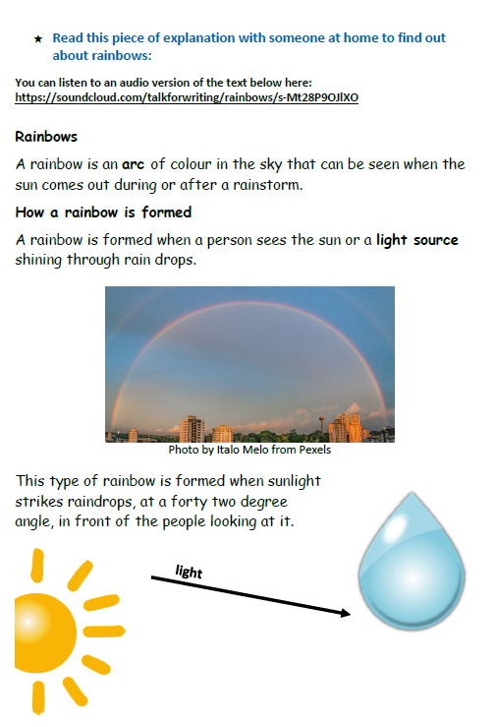
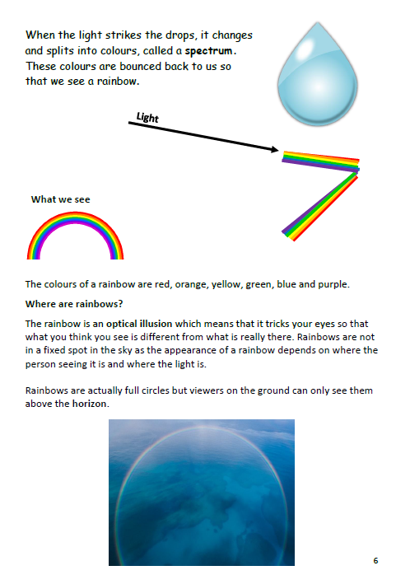
Activity 2
https://soundcloud.com/talkforwriting/rainbows/s-Mt28P9OJlXO

Slide 15
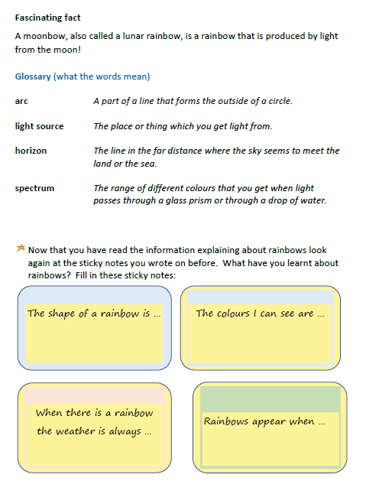

Activity 2
Now that you have read the information have another go at completing these sentences with as much detail as you can.

Slide 16
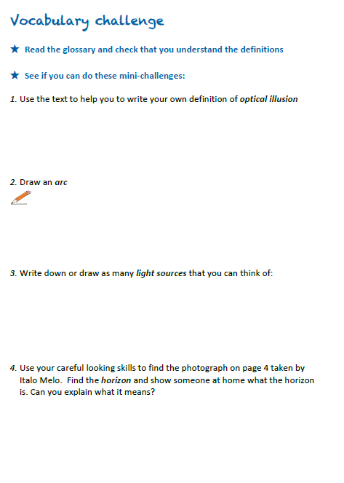

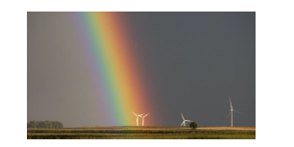
Activity 2
Look carefully at this photograph

Slide 17
Maths Learning
This week we will continue working from the scheme of work from the white rose website. For each lesson there is a link to a work sheet recommended from BBC bitesize link on the white rose website. Please watch the learning video and complete the set activity. You do not need to print the sheet if you are not able to you can write out some examples of the questions. The activities this week we have previously been covered in Year 2 but we are revisiting them for consolidation of these topics.
Activity 1 – White rose home learning → Summer Term – Week 4 (w/c 11th May)
Lesson 4 – Bonds to 100
https://bam.files.bbci.co.uk/bam/live/content/zkkxhbk/pdf
Activity 2 – White Rose Home Learning → Summer Term – Week 5 (w/c 18th May) → Lesson 1 - Multiplication sentences using the x symbol
https://bam.files.bbci.co.uk/bam/live/content/zddybdm/pdf
Activity 3 – White Rose Home Learning → Summer Term – Week 5 (w/c 18th May) Lesson 2 – Use arrays
https://bam.files.bbci.co.uk/bam/live/content/z49pf4j/pdf
Alternatively you can watch the BBC bitesize videos before completing the worksheet. For this week’s home learning links there are practise activities on the bitesize website too! All videos are found at https://www.bbc.co.uk/bitesize/dailylessons
Instructions for how to find the links is on the next slide. ☺

Slide 18
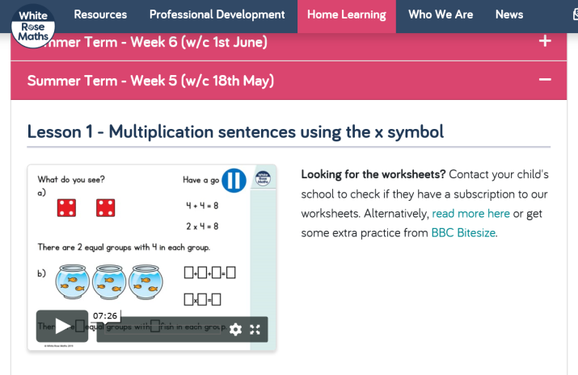
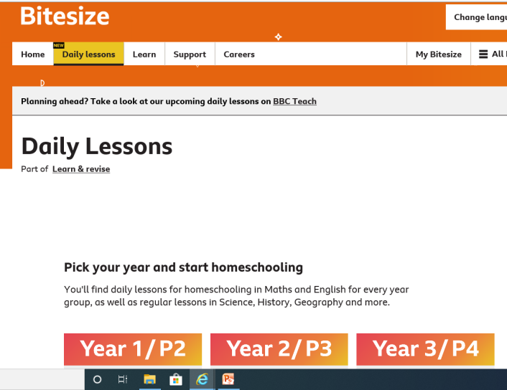
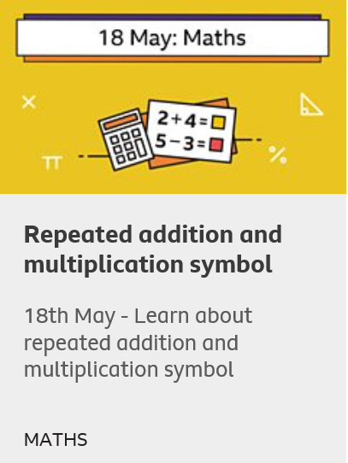
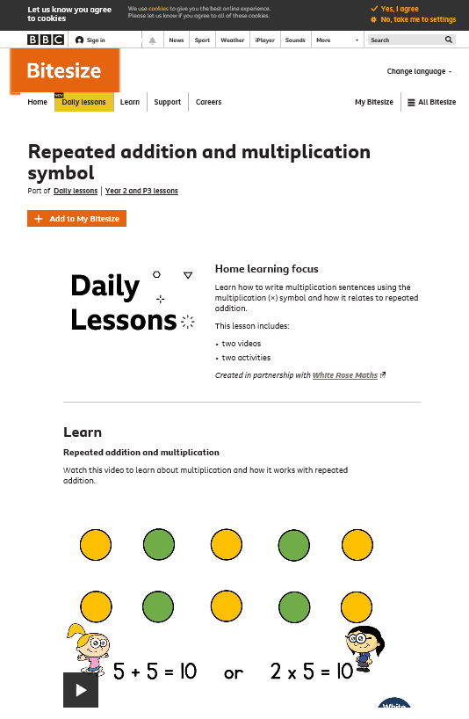
Maths Learning
Here you will find another learning video and the link for the worksheet recommended. We are working through 14th May , 18th May and 19th May.

Slide 19
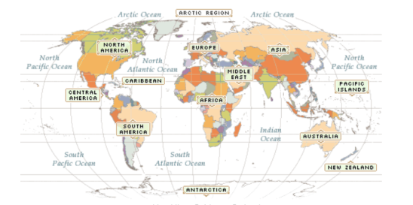

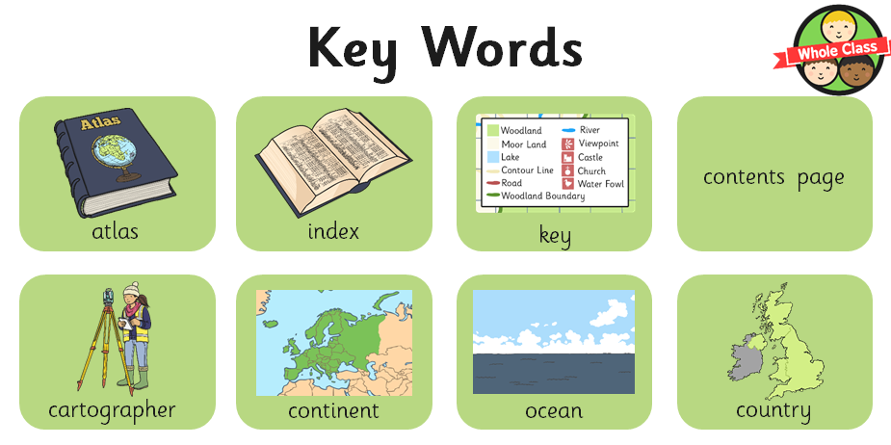
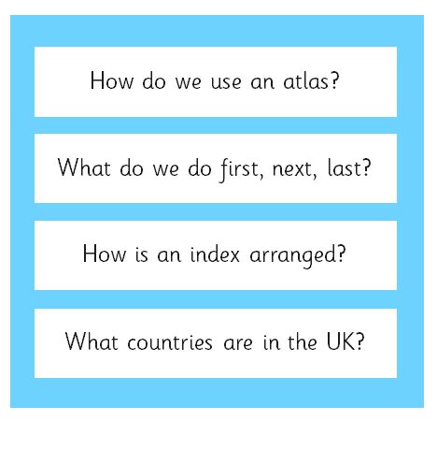
Topic
This week will be looking at Atlas skills and in particular looking at different Oceans and Continents. If you have an atlas at home that would be great for you too look through to locate different oceans and continents. Alternatively, you can use the internet and an online atlas.
Some Key words and Key Questions to think about and explore:

Slide 20
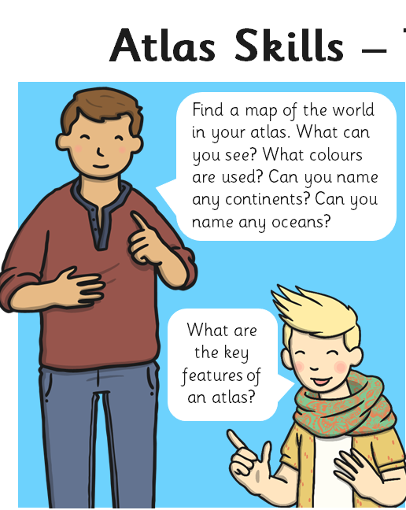
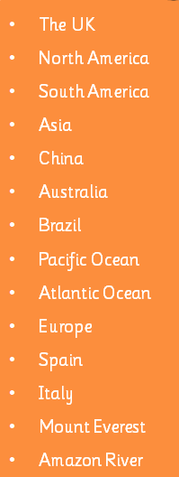
Activity 1 -
Can you have a go at using your Atlas or online Atlas to locate these places.
Were they easy to find?

Slide 21

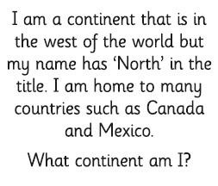
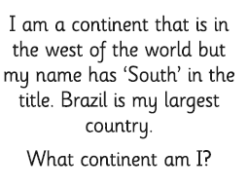
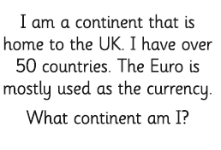
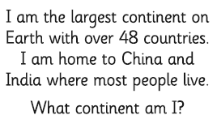
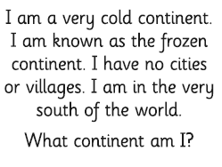
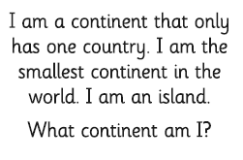
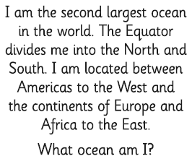
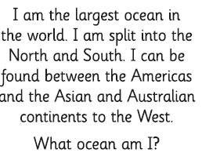
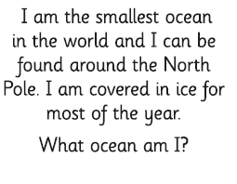
Activity 2: Using your Atlas can you work the answers the these riddles?

Slide 22
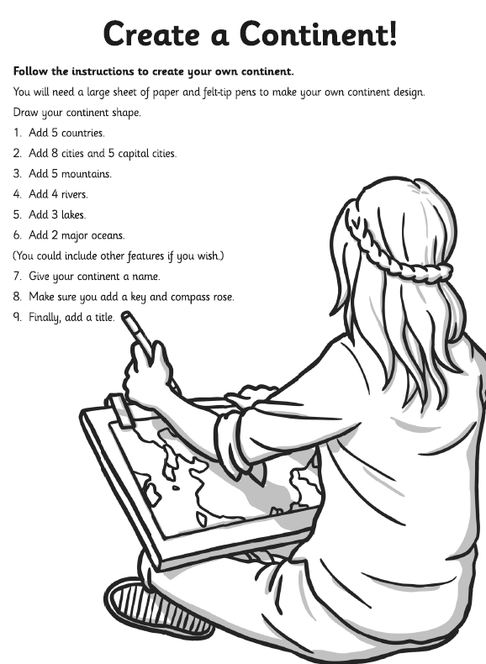
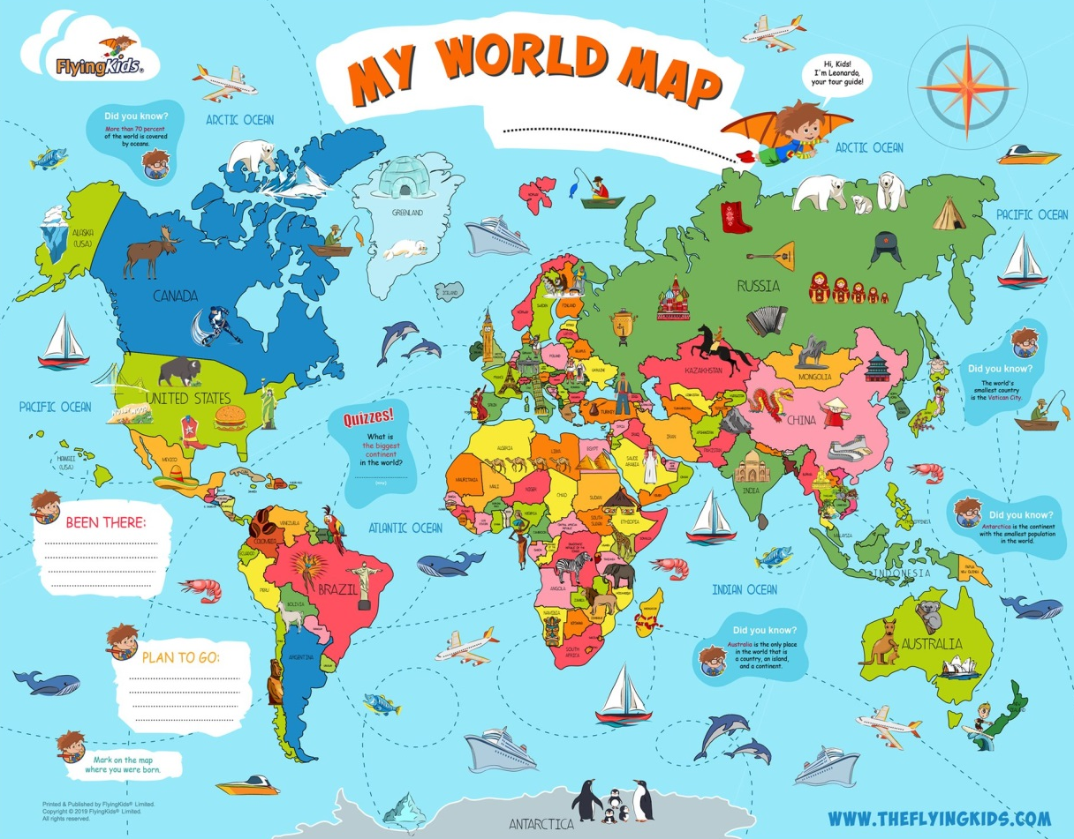
Activity 3 –
A little extra activity if you want to complete and if you’re feeling creative!

Slide 23

P.E.
It is important to keep your children active. If it is safe to do so, ensure they have some time outside throughout the day. Please visit Joe Wicks YouTube channel (https://www.youtube.com/channel/UCAxW1XT0iEJo0TYlRfn6rYQ), which has lots of exercise videos for children. He will also be hosting a live P.E. lessons Monday to Friday at 9:00am.

Slide 24

Classroom Secrets
The site classroom secrets https://classroomsecrets.co.uk/free-home-learning-packs/ has free class packs which provide some great additional ideas and resources you can use.

