Slide 1

Home Learning
Year 2 Term 6 Week 1

Slide 2

Message from the class teacher
Hello Year 2 and welcome to Term 6. I hope you have had a wonderful half term, we have been lucky with the weather haven’t we? I feel very fortunate to live in Whitstable as I have spent some time at the beach with my boys. We like to go later in the day when it isn’t busy so we can enjoy it but stay safe. I hope you and your families are safe and well and you are still smiling. It seems a long time since we’ve seen each other now but you continue to be our class and we are in this together.
Miss you as always, Love Mrs Clark
Hi Year 2. I cannot believe we are in Term 6! I hope you all had a wonderful half term. So here we are week 1 of term 6, I feel sad that we are not sharing this last term together and want you to know we miss all of you dearly.
I had a very relaxed half term and we spent a lot of time in the garden. My favourite day was my brothers birthday for two reasons…1. I got to make and cake and then eat a very large slice. 2. I got see my beautiful niece Lahna. I am patiently waiting for my first cuddle but we are all becoming very good a social distancing! Have a great week, love Mrs Unsworth x

Slide 3

Reading
Hopefully you have access to books at home, but we have sent home extra books with your child.
Accelerated Reading
Home quizzing is not always recommended but in this case we have adjusted the settings to allow quizzing to happen at home.
If your child wants to read a book from home, please check that there is a quiz available for the book and that the book level (BL) is within or near to your child’s reading range. Also take note of the quiz number for future reference.
To check books please visit: https://www.arbookfind.co.uk/
Go to the next page for how to quiz.

Slide 4



AR quizzing at home.
To log into AR to take a quiz please visit: https://ukhosted27.renlearn.co.uk/2240835/
Your child should know what to do from here and should know their login details. If they are not aware, most details are written in their reading record.
Click on Accelerated reader.
Type in the name the book or the quiz number.
We advise students complete quizzes unaided. If parents/carers wish to support their child, they can do so in the following ways:
Discuss the book with your child as the book is being read
Ask your child to read the question out loud
Re-word questions for your child, if necessary
Ask your child which answers are not correct

Slide 5

Visit http://readon.myon.co.uk

Slide 6

Choose an area that interests you or use the search option.

Slide 7


Using My Maths
Children should know their way round My Maths but here are some reminders on how access the lessons. Visit: www.mymaths.co.uk
bapchild
divide162

Slide 8

Using My Maths
Access any lesson based on what your child is learning in class or search the topic in the search bar.
Use the login portal to access specific homework and lessons that your teacher has set.

Slide 9

Maths – White Rose Home Learning
In school we follow the White Rose scheme of learning. Their website has put together free lessons and resources that link to the learning taking place in school. Please visit: https://whiterosemaths.com/homelearning/

Slide 10



TT Rockstars
To access TT Rockstars please visit: https://play.ttrockstars.com/auth/school
Start typing in the school name or the post code (ME99NL)
Pupils type in their username and password, usually written in their reading record.
Pupils can practice all tables but Year 2 should be practicing 2, 5, and 10’s
Year 3: 2,5,10,3,4,8’s
Year 4,5,6: all tables

Slide 11

Accessing Twinkl
Many educational content providers are offering free access to their resources. Twinkl is a website that we use from time to time to resource our lessons to aid in teacher input and pupil activities.
We will be able to direct you towards activities and learning via this website based on lessons that may be missed due to absence. To access Twinkl please visit: www.twinkl.co.uk/offer
You will have to sign up and put in the offer code: UKTWINKLHELPS

Slide 12
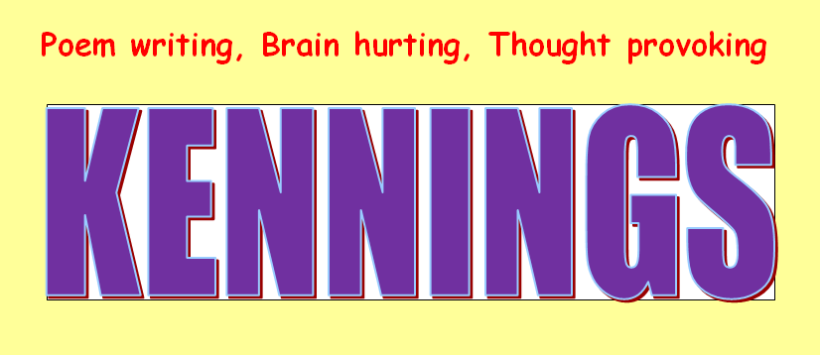
English Learning
This week for English we are going to look at a fun way of writing poetry by learning about and writing Kennings poems. Kennings poem are a type of riddle where you describe something without saying what it is and the reader has to guess what you are writing about. The poems have short 3 word lines and use verbs to describe what the poem is about.
Activity 1: To begin with have a look through the following slides and learn about what a Kennings poem is and how they are written. Have fun!

Slide 13
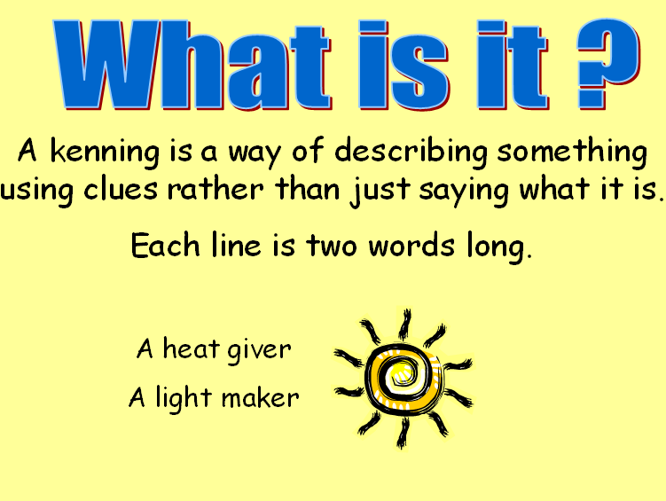
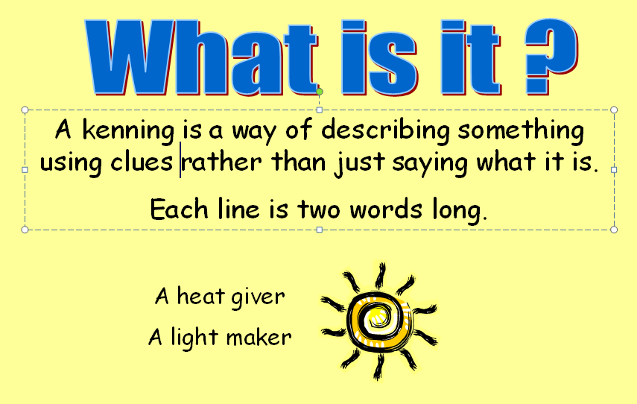

Slide 14
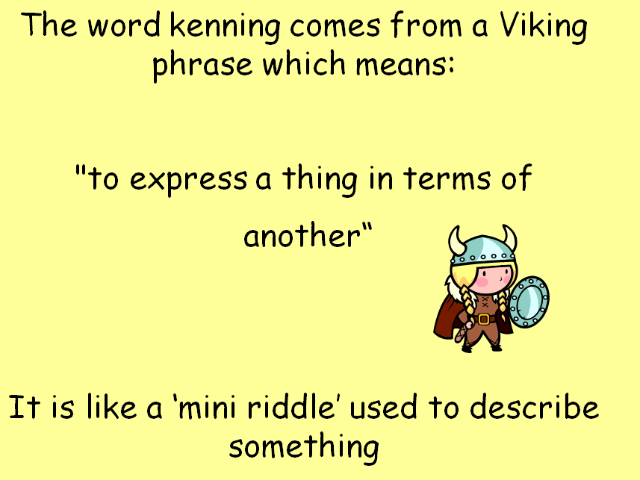

Slide 15
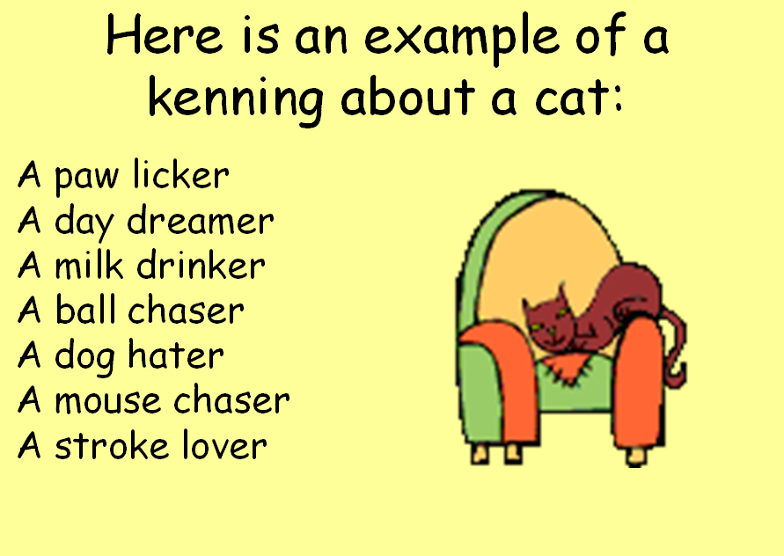

Slide 16
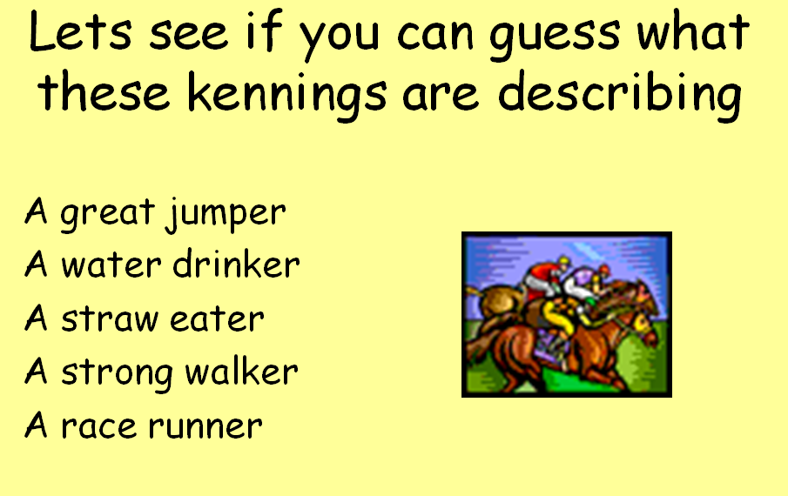

Slide 17
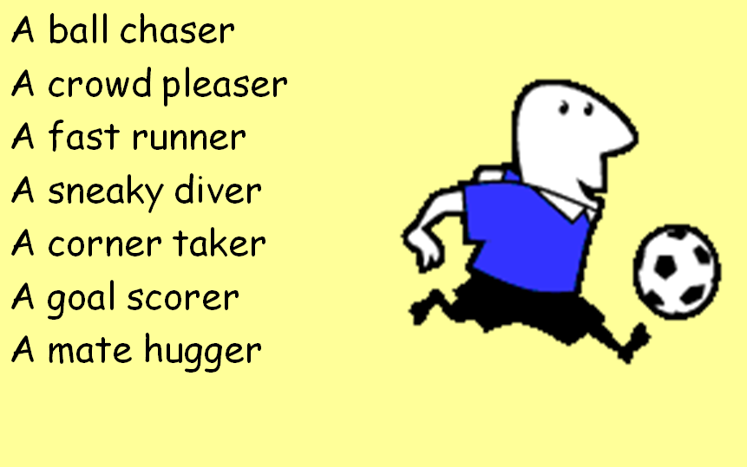

Slide 18
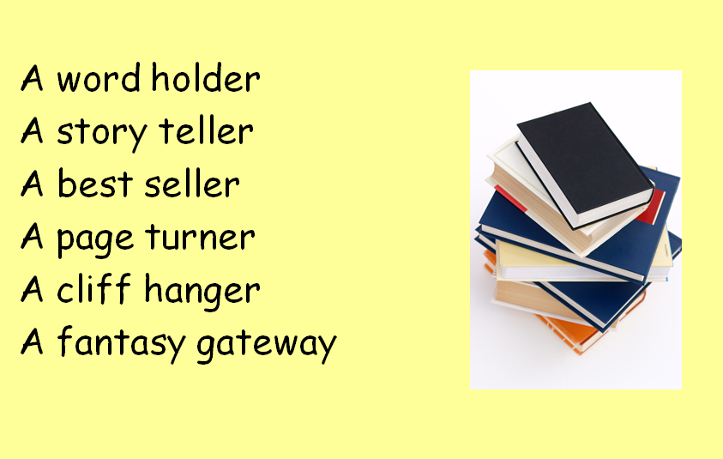

Slide 19
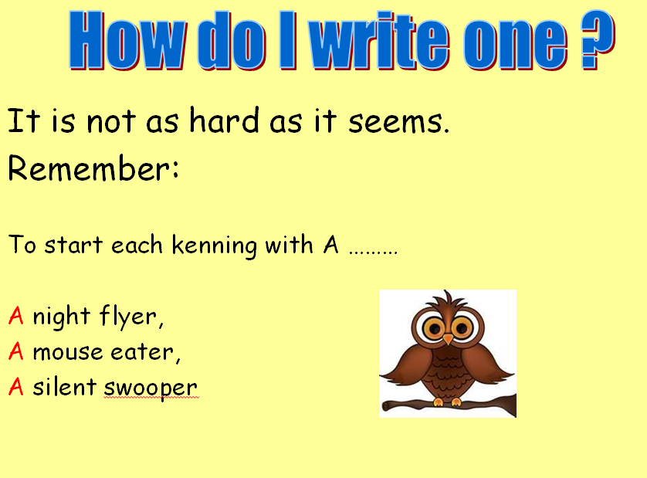

Slide 20
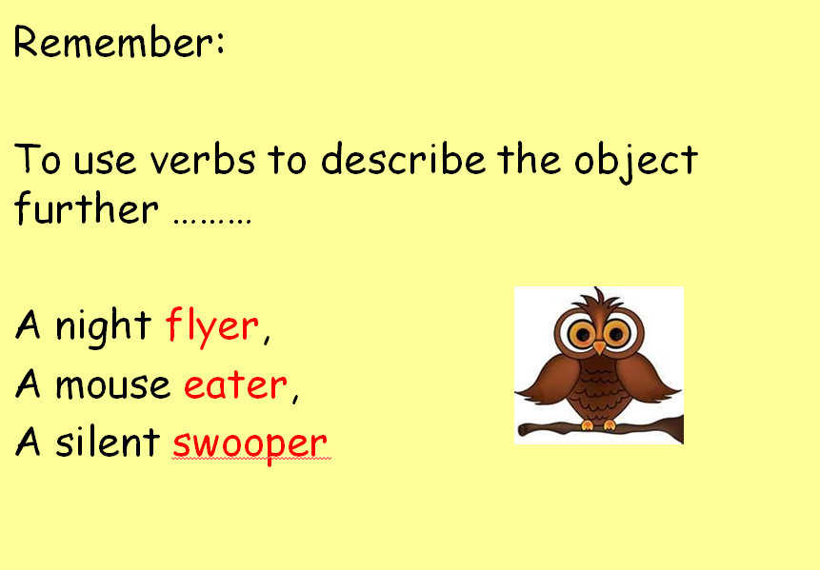

Slide 21
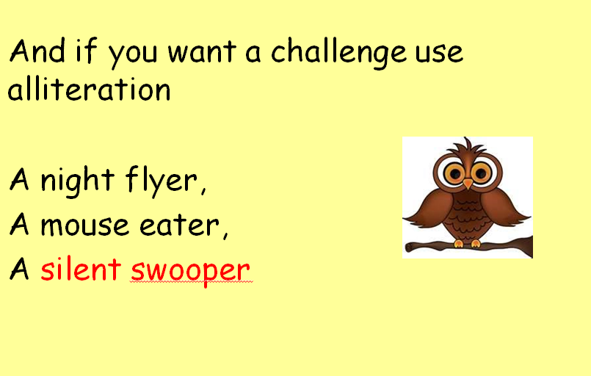

Slide 22
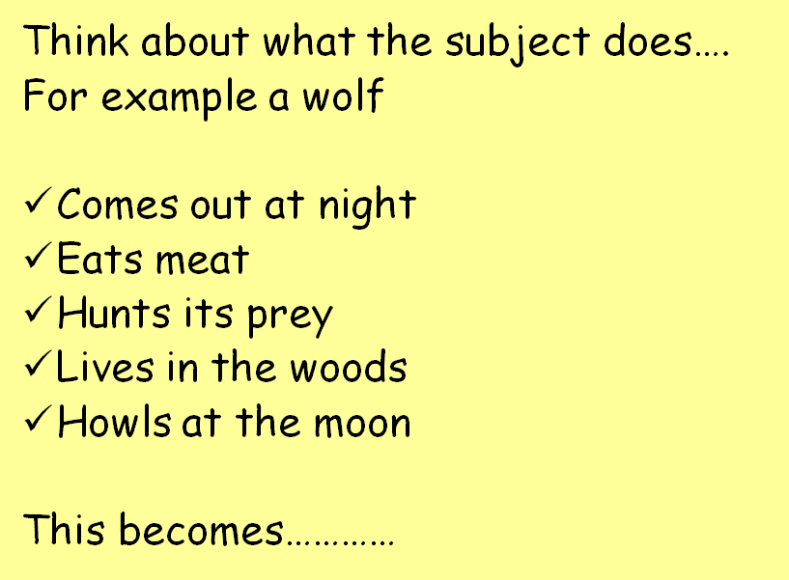

Slide 23
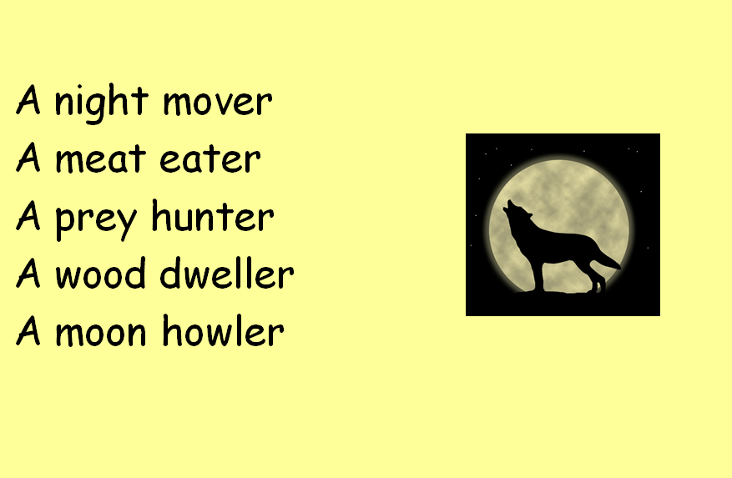

Slide 24
Activity 2: Now that you have seen how to write a kennings poem, have a go yourself. Use the example of the wolf kennings poem to help you. Firstly think of something you want to write about. It could be your favourite animal, book, sport, season or person. Then write down a list of things that describe that thing. Then turn each description into a line of the poem. So with the wolf the description ‘comes out at night’ became ‘A night mover’ in the poem.
Remember
Each line begins with A and then has 2 more words.
Your poem should be about 5-6 lines.
Each line of the poem starts on a new line of your page.
To use verbs to explain what your chosen thing does.
If you can try and write more than one Kennings Poem about different things.
Activity 3: Write your poem or poems into your best handwriting and add an illustration. Then read your poem to someone in your house and see if they can guess what it is about. You could maybe even call or video call someone in another house, for example your grandparents, and see if they can guess. Good luck!

Slide 25
Maths Learning
This week we will continue working from the scheme of work from the white rose website. We are no longer able to access the online worksheets, however, for each lesson there is a link to a work sheet recommended from BBC bitesize link on the white rose website. Please watch the white rose learning video and complete the set activity. You do not need to print the sheet if you are not able to you can write out some examples of the questions.
Activity 1 – White rose home learning → Summer Term – Week 4 (w/c 11th May)
Lesson 1 – Adding and subtracting tens
https://bam.files.bbci.co.uk/bam/live/content/zvnhnrd/pdf
Activity 2 – White Rose Home Learning → Summer Term – Week 4 (w/c 11th May) → Lesson 2 - Add 2-digit numbers
https://bam.files.bbci.co.uk/bam/live/content/z6xsvk7/pdf
Activity 3 – White Rose Home Learning → Summer Term – Week 4 (w/c 11th May) Lesson 3 – Subtracting 2-digit numbers
https://bam.files.bbci.co.uk/bam/live/content/zk348xs/pdf
Alternatively you can watch the BBC bitesize videos before completing the worksheet, or you can watch these for extra practise and further consolidation. All videos are found at https://www.bbc.co.uk/bitesize/tags/z7s22sg/year-2-and-p3-lessons/1
Instructions for how to find the links is on the next slide. ☺

Slide 26
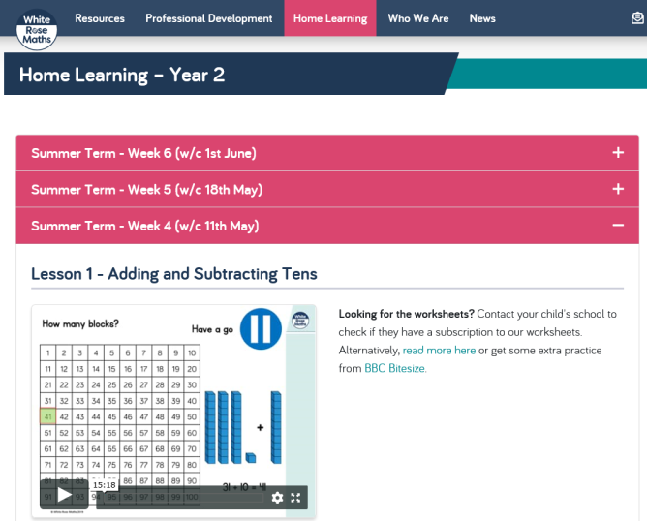
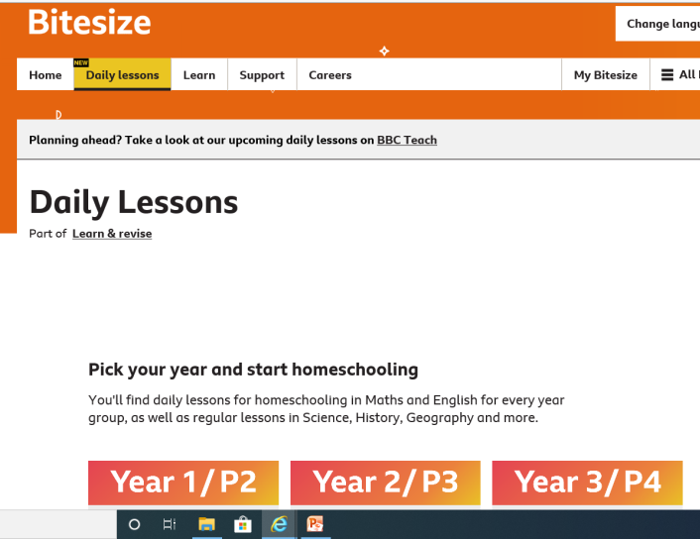
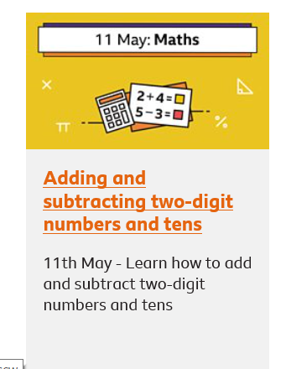
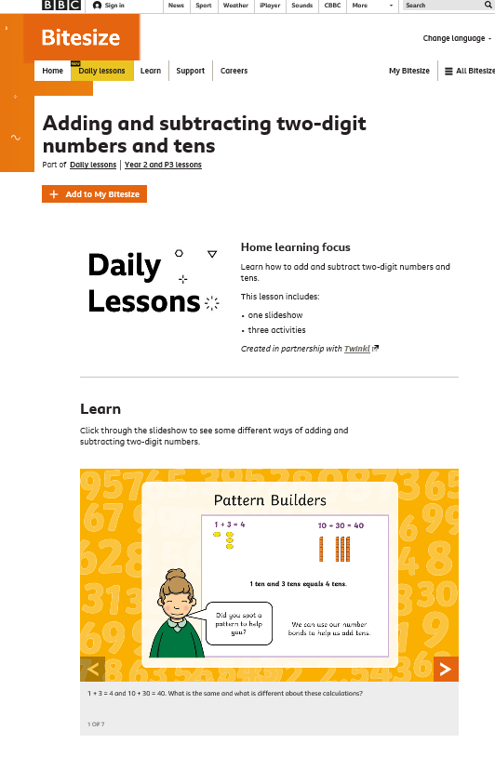
Maths Learning
Here you will find another learning video and the link for the worksheet recommended. We are working through 11th May , 12th May and 13th May. We are currently working through these weeks as we have already covered some of the topics coming later in Term 6.

Slide 27

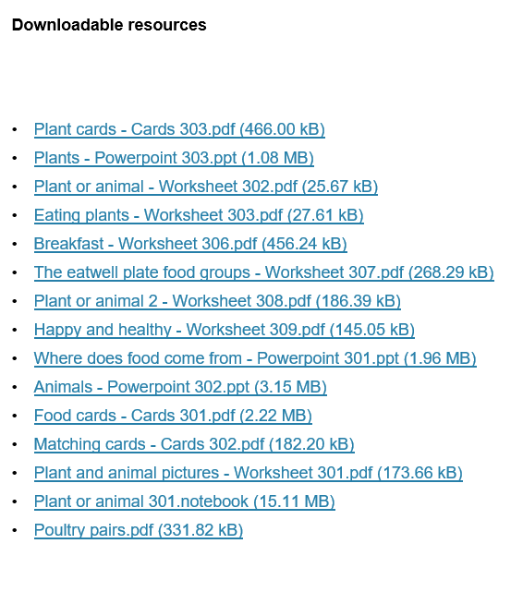
Design Technology
Our DT topic this term asks the question Where does our food come from? The activities this week come from a brilliant website called Food: A fact of life. As well as the activities here feel free to explore this website with a grown up as it has lots of ideas for healthy eating and learning about how to grow your own food.
Activity 1: Click on the link below, scroll down to the bottom of the page and click on Where does food come from? Powerpoint 301.
https://archive.foodafactoflife.org.uk/Sheet.aspx?siteId=14&sectionId=63&contentId=144
Watch the powerpoint, complete the interactive questions and learn all about where our food comes from.

Slide 28
Activity 2: Now it is time to sort foods into whether they have come from an animal or a plant. Using the link from the previous slide and scrolling down to the bottom to find the activities shown below:
You can either use the food cards and the worksheet, print them out and stick the food cards on the right place on the worksheet
Or use the notebook to play an interactive game sorting the food.
Remember some foods are more tricky! Think about products such a milk that come from an animal or foods that are made from part of a plant. Are there any foods that come from both? What about a strawberry yoghurt?

Slide 29
Activity 3: On a large sheet of paper draw a plate with your favourite meal on, remember to include a drink and a pudding. Then label all of the different foods you have included. Next to each label write whether that piece of food comes from a plant or an animal. Remember some foods are tricky. A pizza has flour in the base that comes from a wheat plant, tomato in the sauce which comes from a tomato plant and cheese on top which is made from milk, which comes from a cow!!
Feel free to explore any other bits of information on the website and perhaps use it to help you with activity 3.
https://www.foodafactoflife.org.uk/5-7-years/where-food-comes-from/

Slide 30

P.E.
It is important to keep your children active. If it is safe to do so, ensure they have some time outside throughout the day. Please visit Joe Wicks YouTube channel (https://www.youtube.com/channel/UCAxW1XT0iEJo0TYlRfn6rYQ), which has lots of exercise videos for children. He will also be hosting a live P.E. lessons Monday to Friday at 9:00am.

Slide 31

Classroom Secrets
The site classroom secrets https://classroomsecrets.co.uk/free-home-learning-packs/ has free class packs which provide some great additional ideas and resources you can use.

