Slide 1

Home Learning
Year 2 Half Term

Slide 2
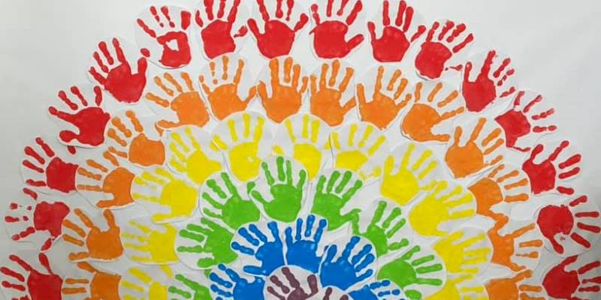
Message from the class teacher
Hello Year 2!
HAPPY HALF TERM!! Well done for completing Term 5 in lockdown!
A huge thank you to all those super parents who have been helping complete the home learning, we hope you have enjoyed it.
Let’s hope the sunshine comes back for next week! We hope you have a lovely break and enjoy some quality time with your family.
We have set a little task for your child to complete if they wish to continue with some learning. It would be fantastic if you could continue with reading, AR quizzes and TT Rockstars.
We hope to see you all soon, and hope you are all staying safe and well during this uncertain time. Remember the positives …. You are the heroes of 2020! #childrenoflockdown2020.
Love from Mrs Unsworth, Mrs Clark and Mrs Bradley x

Slide 3
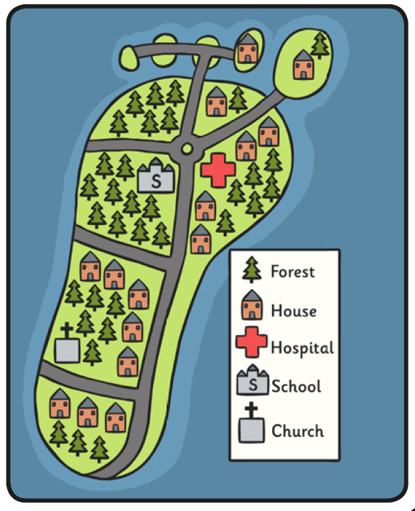
Topic
Barefoot Island – Making a map
Recently you have been looking around and recording key features of your local area. You have carefully drawn a map of your route to school and thought about the key places in Bapchild.
Its time to create a map of your own Barefoot Island! Carefully draw around your foot to form the shape of the island. Can your island include houses, a post office, roads, a school, a park, a doctors surgery and other features you would like to add. Can you add a key to your map and a compass rose.

