Slide 1

Home Learning
Year 2 Term 5 Week 6

Slide 2

Message from the class teacher
Hello Year 2 and welcome to the last week of Term 5. I hope you are continuing to stay safe and are enjoying time with your families. This week George, Charlie and Arthur have enjoyed lots of time reading and have discovered watching drawing tutorials on YouTube. They have created some brilliant Star Wars art. This Friday (22nd) is not only the last day of term but also my birthday (I’m not telling you how old I am but it rhymes with naughty!!) so I’m hoping the boys and Mr Clark spoil me with some presents, some yummy food and maybe some time to relax. Enjoy the activities we have sent you this week. We continue to be so proud of you all. Miss you as always, Love Mrs Clark
Hello Year 2! I hope you have a had a great week! This week me and my two boys have spent time researching different science experiments we can do. We are excited to make a coke and mentos rocket. It looks really cool. We have also been watching many video clips of Michael Rosen. In particular we liked ‘Chocolate Cake’. Ronne and Teddy were lucky enough to have some chocolate cake from my nephews birthday. Have a great week of learning. Love Mrs Unsworth x

Slide 3

Reading
Hopefully you have access to books at home, but we have sent home extra books with your child.
Accelerated Reading
Home quizzing is not always recommended but in this case we have adjusted the settings to allow quizzing to happen at home.
If your child wants to read a book from home, please check that there is a quiz available for the book and that the book level (BL) is within or near to your child’s reading range. Also take note of the quiz number for future reference.
To check books please visit: https://www.arbookfind.co.uk/
Go to the next page for how to quiz.

Slide 4



AR quizzing at home.
To log into AR to take a quiz please visit: https://ukhosted27.renlearn.co.uk/2240835/
Your child should know what to do from here and should know their login details. If they are not aware, most details are written in their reading record.
Click on Accelerated reader.
Type in the name the book or the quiz number.
We advise students complete quizzes unaided. If parents/carers wish to support their child, they can do so in the following ways:
Discuss the book with your child as the book is being read
Ask your child to read the question out loud
Re-word questions for your child, if necessary
Ask your child which answers are not correct

Slide 5

Visit http://readon.myon.co.uk

Slide 6

Choose an area that interests you or use the search option.

Slide 7


Using My Maths
Children should know their way round My Maths but here are some reminders on how access the lessons. Visit: www.mymaths.co.uk
bapchild
divide162

Slide 8

Using My Maths
Access any lesson based on what your child is learning in class or search the topic in the search bar.
Use the login portal to access specific homework and lessons that your teacher has set.

Slide 9

Maths – White Rose Home Learning
In school we follow the White Rose scheme of learning. Their website has put together free lessons and resources that link to the learning taking place in school. Please visit: https://whiterosemaths.com/homelearning/

Slide 10



TT Rockstars
To access TT Rockstars please visit: https://play.ttrockstars.com/auth/school
Start typing in the school name or the post code (ME99NL)
Pupils type in their username and password, usually written in their reading record.
Pupils can practice all tables but Year 2 should be practicing 2, 5, and 10’s
Year 3: 2,5,10,3,4,8’s
Year 4,5,6: all tables

Slide 11

Accessing Twinkl
Many educational content providers are offering free access to their resources. Twinkl is a website that we use from time to time to resource our lessons to aid in teacher input and pupil activities.
We will be able to direct you towards activities and learning via this website based on lessons that may be missed due to absence. To access Twinkl please visit: www.twinkl.co.uk/offer
You will have to sign up and put in the offer code: UKTWINKLHELPS

Slide 12
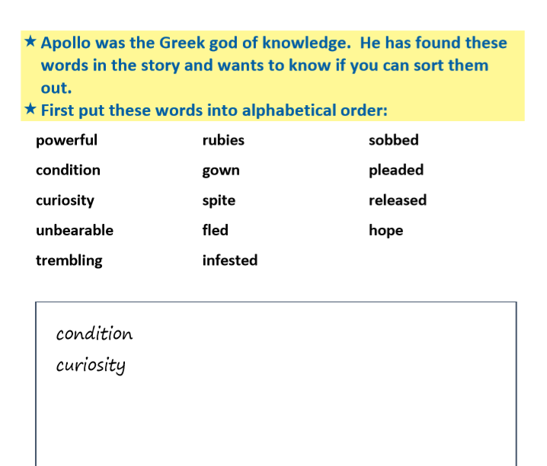
English Learning
Our English this week are some Spelling and Punctuation activities based on the examples from the Ancient Greek myth Pandora’s Box.
Activity 1: Read the words found in the myth and write them in alphabetical order (the first 2 have been done for you).

Slide 13
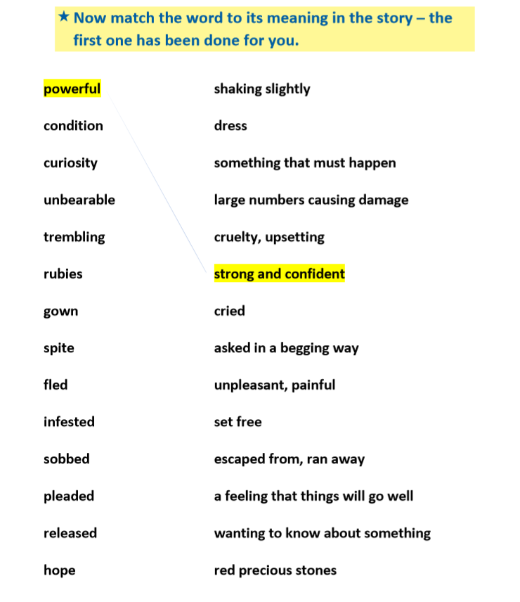
Activity 2: Match each word to it’s definition. A definition is a description of what a word means. Copy each word and write the correct definition next to it. Some of these are tricky so either get an adult to help you, use a dictionary or ask google to help.
One has been done for you.

Slide 14
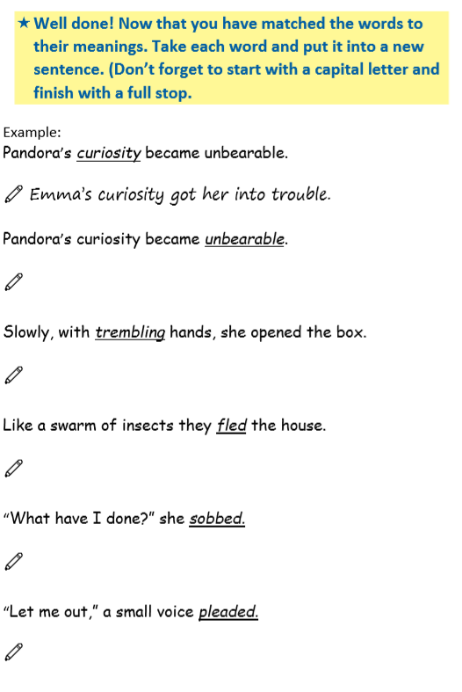
Activity 3: Now that you know what each word means, re-read the sentences from the myth and write a new sentence using the underlined word.

Slide 15
Maths Learning
This week we will continue working from the white rose website. As we are currently a week behind we are still able to access the online activities. So we will continue to use the given activity sheets.
Activity 1 – White rose home learning → Summer Term – Week 3 (w/c 4th May)
Lesson 3 – Related facts
Activity 2 – White Rose Home Learning → Summer Term – Week 3 (w/c 4th May) → Lesson 4 - add and subtract ones
Activity 3 – White Rose Home Learning → Summer Term – Week 3 (w/c 4th May) Lesson 5 – Friday Challenge – this weeks activity is all about symmetry. It would be great if you could make your own pizza symmetrical. You could even use a tortilla wrap as your pizza base!
Extension – https://www.twinkl.co.uk/resource/year-2-diving-into-mastery-related-facts-activity-cards-t-m-3727 Here is the link to some related facts activity cards. Similar to the extension the last week these are great activities to challenge your child's understanding. The question prompts allow your child to gain a deeper and understanding and vocalise their reasoning.

Slide 16
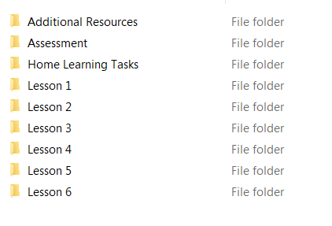
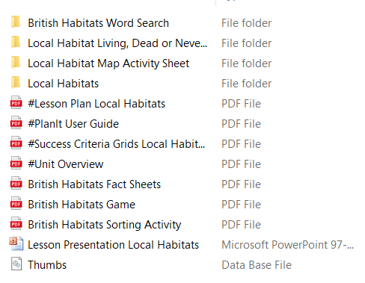
Science
We are continuing with our topic on living things and their habitats. This weeks work is about comparing different types of habitats. Click on the link below
https://www.twinkl.co.uk/resource/tp-sc-050-planit-science-year-2-living-things-and-their-habitats-unit-pack
Click on the local habitats Powerpoint and use it to learn about different habitats.
Click on lesson 2
Activity 1
Once you have watched the Powerpoint complete the sorting activity matching the living things to their habitat. Either print it out, cut out and stick or use the sheets as a template to draw the habitats and living things yourself.

Slide 17
Activity 2
For this activity you will need to visit a local habitat. This can be your garden, a place you can stop at on a walk (e.g. an area of wood, a pond or a field) or you can research one online. Then draw a map of the local habitat and label everything you find there whether alive or not. You can print this out or use it as a template and draw your own.
Activity 3
Using all the things you have found in activity 2 complete the table saying whether the things you have found are alive (e.g. a bird), dead (anything that used to be part of a living thing such as a fallen leaf) or never been alive (such as a stone or a brick). You can print this out or use it as a template and draw your own table.
If you get a chance have a go at the word search too.

Slide 18

P.E.
It is important to keep your children active. If it is safe to do so, ensure they have some time outside throughout the day. Please visit Joe Wicks YouTube channel (https://www.youtube.com/channel/UCAxW1XT0iEJo0TYlRfn6rYQ), which has lots of exercise videos for children. He will also be hosting a live P.E. lessons Monday to Friday at 9:00am.

Slide 19

Classroom Secrets
The site classroom secrets https://classroomsecrets.co.uk/free-home-learning-packs/ has free class packs which provide some great additional ideas and resources you can use.

