Slide 1

Home Learning
Year 2 Term 5 Week 5

Slide 2
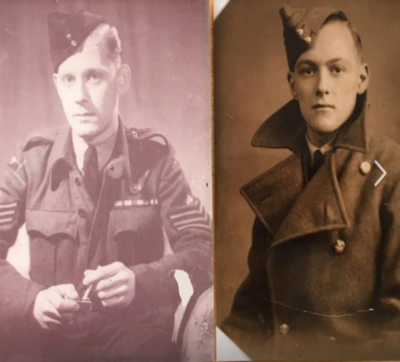

Message from the class teacher
Hello Year 2, I hope you have enjoyed the weather this bank holiday weekend. Did any of you take part in any VE Day celebrations on Friday? In my road a few people had cream teas on their front lawns and my boys made some bunting to put outside the house. This photo is of my two grandads, the one on the left (George) flew for RAF Bomber Command and the one on the right (Roy) was stationed in Burma. Both were very brave men and I am very proud of them. I hope you have a lovely week and enjoy the learning we have given you. Miss you all very much, Love Mrs Clark
Hi Year 2, how have you all been this week? It is lovely to have some sunshine back! This week me and the boys have been going on bike rides everyday! Although it’s only me and Ronnie doing the hard work as Teddy has a seat attached to my bike. We managed 10k on Friday. On Saturday morning I got nominated to run 5k by my brother and then donate £5 to ‘NHS charities covid-19 urgent appeal.’ I managed to do it in 34 minutes but I was so hot and bothered after I jumped into the paddling pool even with my trainers on! Have a great week! Missing you all, Mrs Unsworth x

Slide 3

Reading
Hopefully you have access to books at home, but we have sent home extra books with your child.
Accelerated Reading
Home quizzing is not always recommended but in this case we have adjusted the settings to allow quizzing to happen at home.
If your child wants to read a book from home, please check that there is a quiz available for the book and that the book level (BL) is within or near to your child’s reading range. Also take note of the quiz number for future reference.
To check books please visit: https://www.arbookfind.co.uk/
Go to the next page for how to quiz.

Slide 4



AR quizzing at home.
To log into AR to take a quiz please visit: https://ukhosted27.renlearn.co.uk/2240835/
Your child should know what to do from here and should know their login details. If they are not aware, most details are written in their reading record.
Click on Accelerated reader.
Type in the name the book or the quiz number.
We advise students complete quizzes unaided. If parents/carers wish to support their child, they can do so in the following ways:
Discuss the book with your child as the book is being read
Ask your child to read the question out loud
Re-word questions for your child, if necessary
Ask your child which answers are not correct

Slide 5

Visit http://readon.myon.co.uk

Slide 6

Choose an area that interests you or use the search option.

Slide 7


Using My Maths
Children should know their way round My Maths but here are some reminders on how access the lessons. Visit: www.mymaths.co.uk
bapchild
divide162

Slide 8

Using My Maths
Access any lesson based on what your child is learning in class or search the topic in the search bar.
Use the login portal to access specific homework and lessons that your teacher has set.

Slide 9

Maths – White Rose Home Learning
In school we follow the White Rose scheme of learning. Their website has put together free lessons and resources that link to the learning taking place in school. Please visit: https://whiterosemaths.com/homelearning/

Slide 10



TT Rockstars
To access TT Rockstars please visit: https://play.ttrockstars.com/auth/school
Start typing in the school name or the post code (ME99NL)
Pupils type in their username and password, usually written in their reading record.
Pupils can practice all tables but Year 2 should be practicing 2, 5, and 10’s
Year 3: 2,5,10,3,4,8’s
Year 4,5,6: all tables

Slide 11

Accessing Twinkl
Many educational content providers are offering free access to their resources. Twinkl is a website that we use from time to time to resource our lessons to aid in teacher input and pupil activities.
We will be able to direct you towards activities and learning via this website based on lessons that may be missed due to absence. To access Twinkl please visit: www.twinkl.co.uk/offer
You will have to sign up and put in the offer code: UKTWINKLHELPS

Slide 12
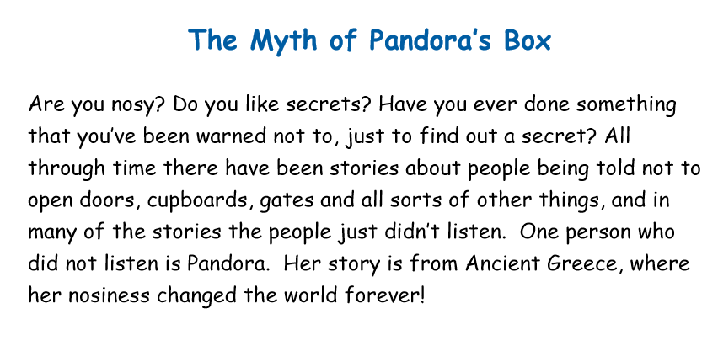
English Learning
Our English Activities this week are based on a myth from Ancient Greece called Pandora’s Box.
Activity 1: Read the story to yourself or with a grown up, as you read you will be asked to stop and do a task before you carry on with the story.
Activity 2: Read a description Zeus, one of the characters in the story, and draw a picture of him.
Activity 3: Answer questions about the story to make sure you have really understood what you have read.
Have fun!

Slide 13
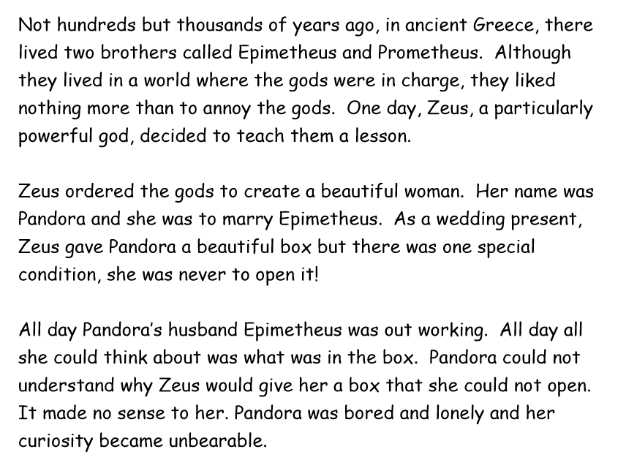
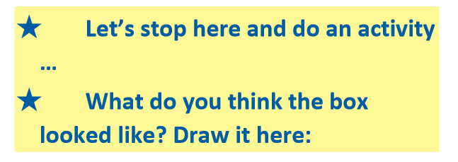

Activity 1

Slide 14
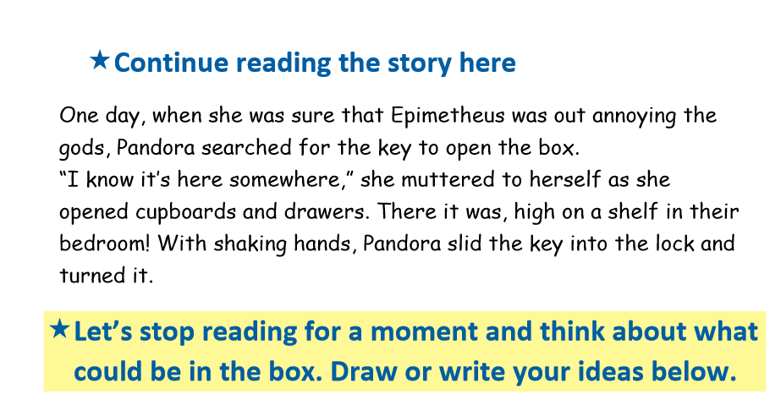
Activity 1

Slide 15
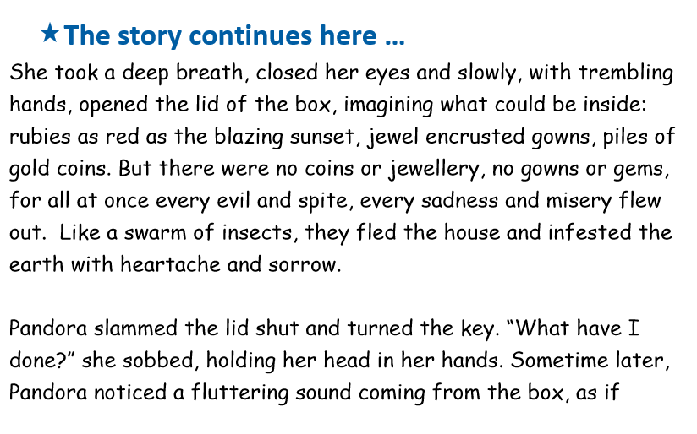
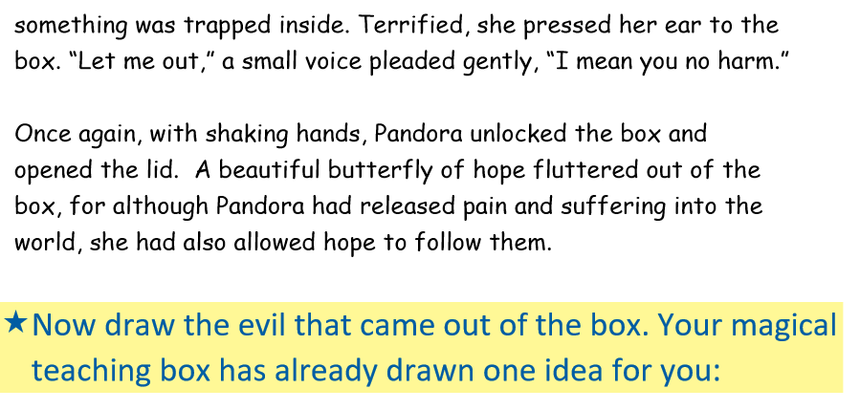
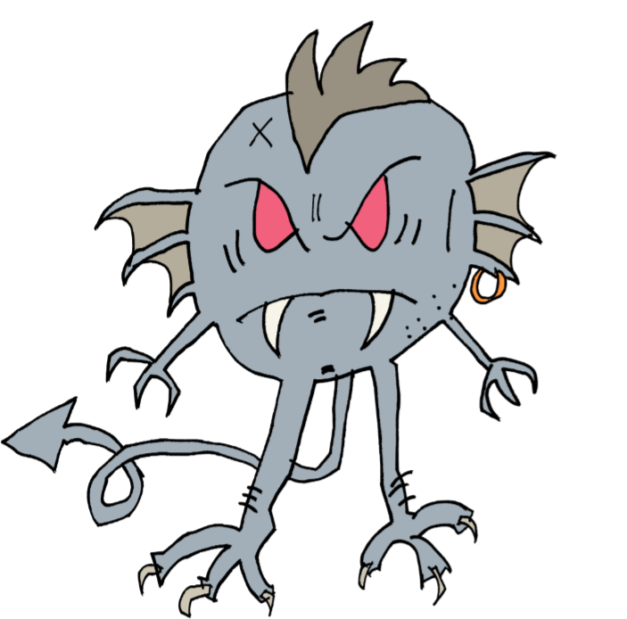
Activity 1

Slide 16
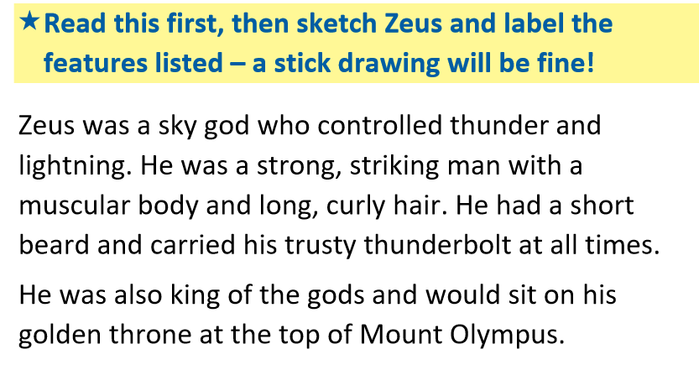
Activity 2

Slide 17
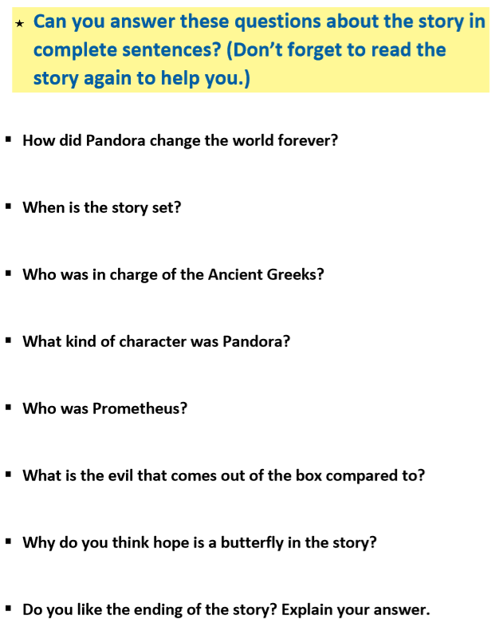
Activity 3

Slide 18
Maths Learning
This week we will continue working from the white rose website. As we are currently a week behind we are still able to access the online activities. So we will continue to use the given activity sheets.
Activity 1 – White rose home learning →Summer Term – Week 2 (w/c 27th April) → Lesson 4 Problem Solving.
Activity 2 – White Rose Home Learning → Summer Term – Week 3 (w/c 4th May) → Lesson 1 Fact Families (bonds to 20)
Activity 3 – White Rose Home Learning → Summer Term – Week 3 (w/c 4th May)
Lesson 2 – Compare number sentences
Extension – Here is a link to some activity cards for fact families (bonds to 20). There are 3 cards and you do not have to complete them all. They will require your child to reason and problem solve . The question prompts are really important to ask your child during the activity to help develop their understanding.
https://www.twinkl.co.uk/resource/year-2-diving-into-mastery-fact-families-addition-and-subtraction-bonds-to-20-activity-cards-t-m-3674

Slide 19
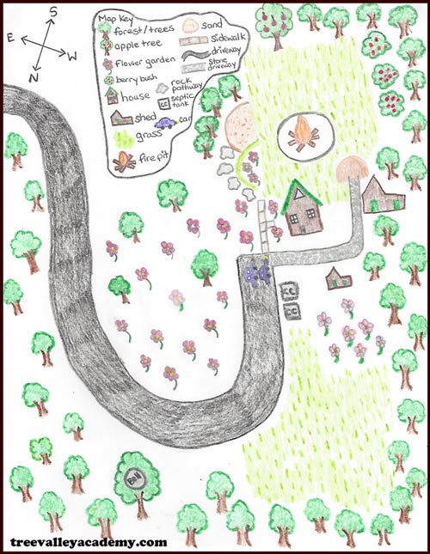

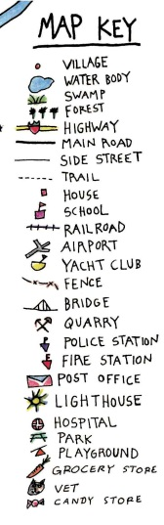
Topic – Mapping a route
This week I would like you to map your route to school. Can you draw your house and your journey to school? What places do you past? Can you add these to your map? Could you add a key to your map of significant places you pass?
Extension:
Can you write the directions you take to get to school. Can you use key vocabulary like: left, right, turn, after, past, before, destination, between, next, then, cross the road.

Slide 20

P.E.
It is important to keep your children active. If it is safe to do so, ensure they have some time outside throughout the day. Please visit Joe Wicks YouTube channel (https://www.youtube.com/channel/UCAxW1XT0iEJo0TYlRfn6rYQ), which has lots of exercise videos for children. He will also be hosting a live P.E. lessons Monday to Friday at 9:00am.

Slide 21

Classroom Secrets
The site classroom secrets https://classroomsecrets.co.uk/free-home-learning-packs/ has free class packs which provide some great additional ideas and resources you can use.

