Slide 1
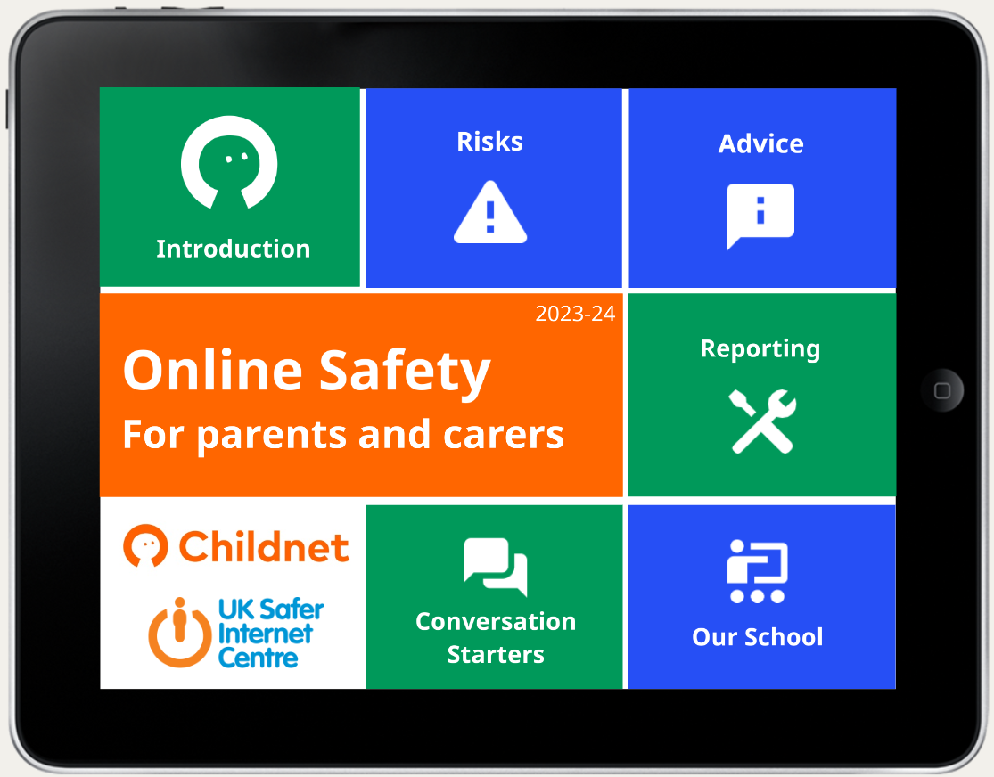

Slide 2
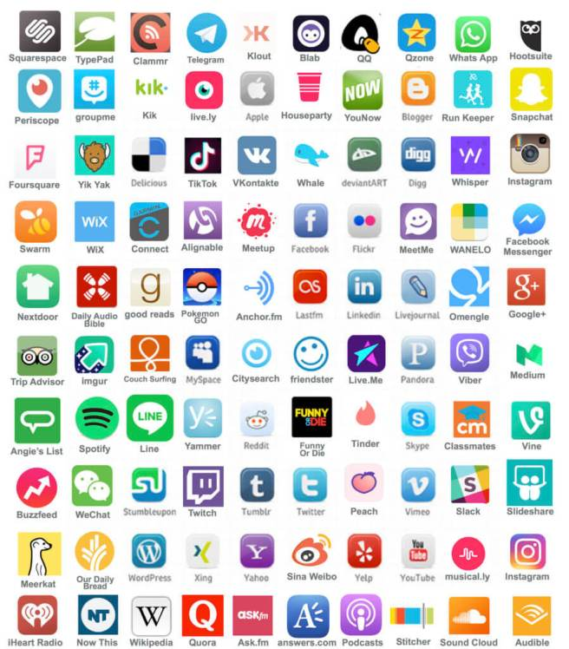

Slide 3
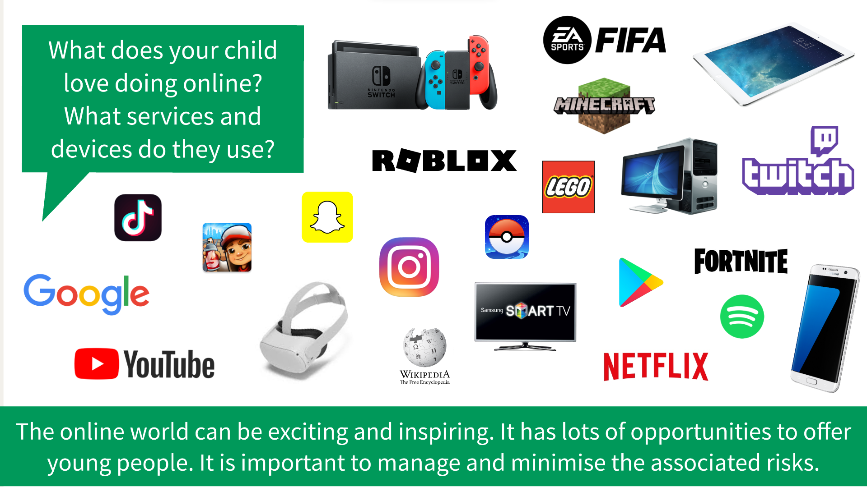

Slide 4

What are the risks online?
The 4 Cs
Content
Contact
Conduct
Commerce
Don’t forget the benefits!

Slide 5
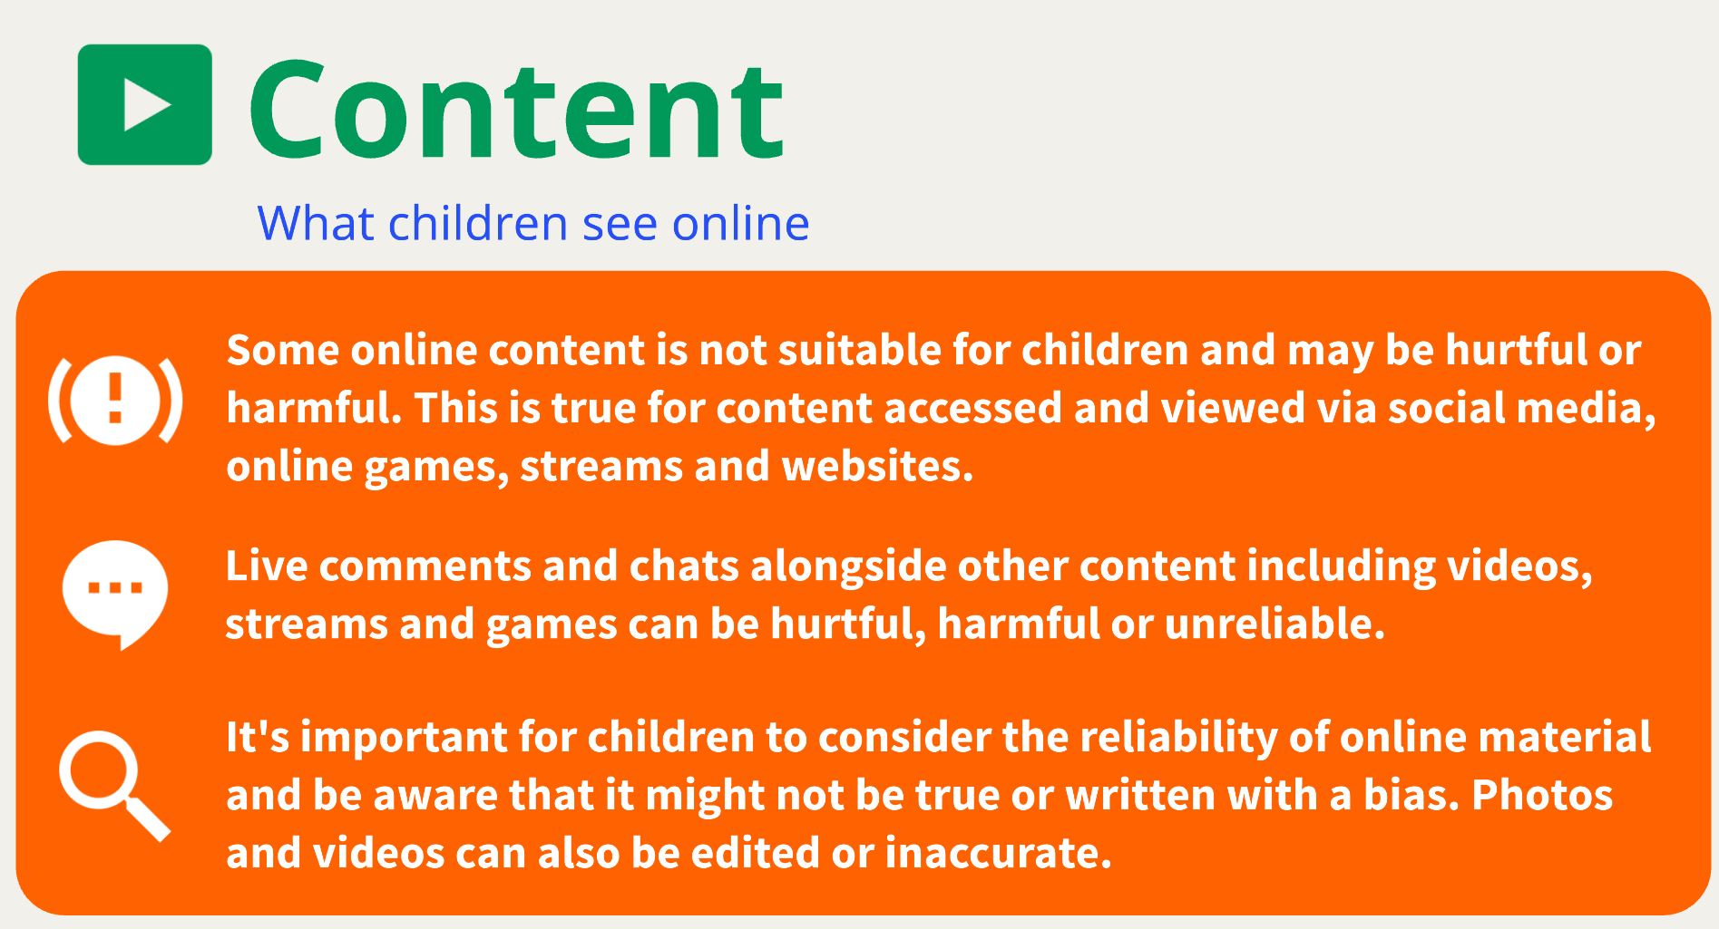

Slide 6
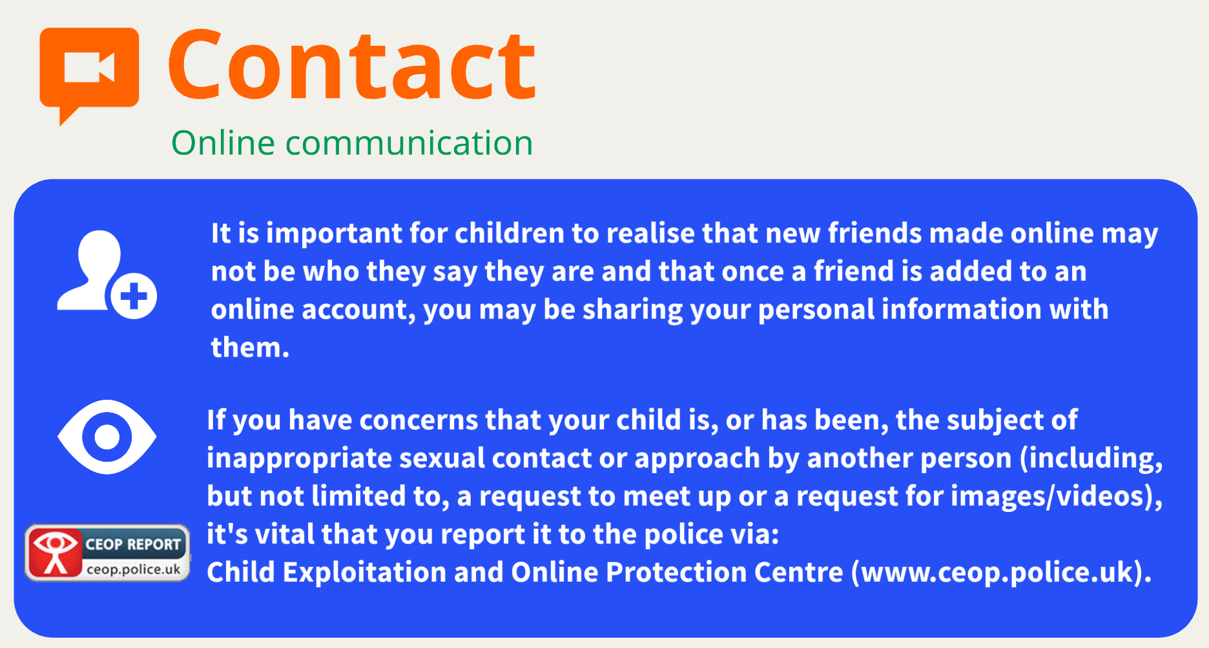

Slide 7
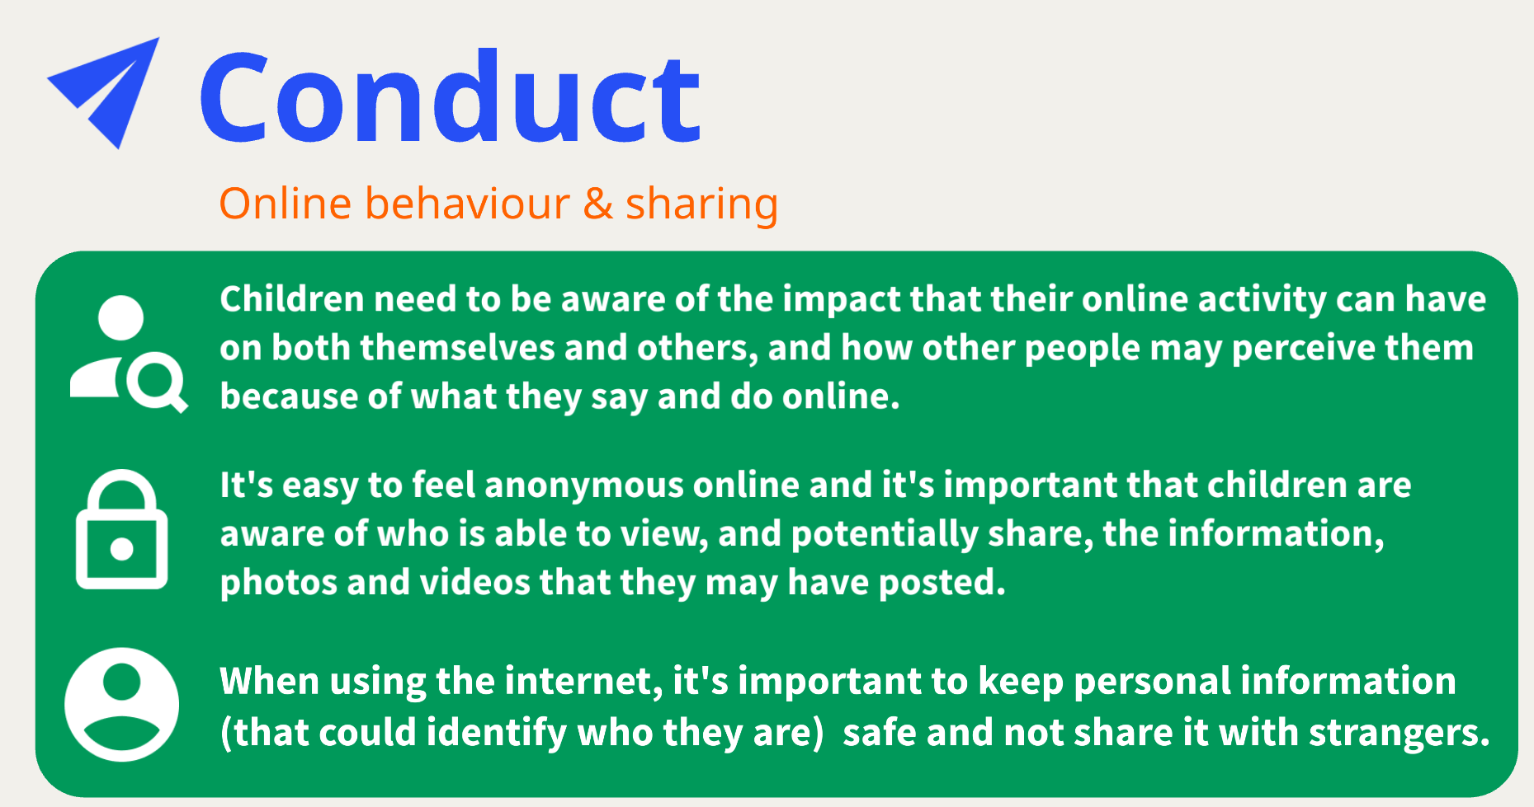

Slide 8
Commerce
Commerce – risks such as:
Hacking
inappropriate advertising
In-app/in-game purchases
Loot Boxes or virtual currency (V-Buck, Mine coins)
Gambling
Risk of malware on free-to-download games
SCAMS: Phishing (email), vishing (voice calls) and smishing (text)
Copyright infringement

Slide 9
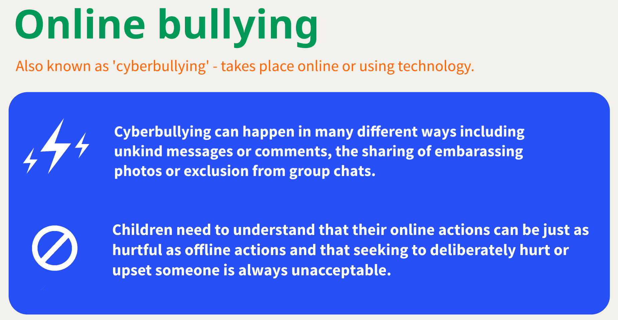

Slide 10
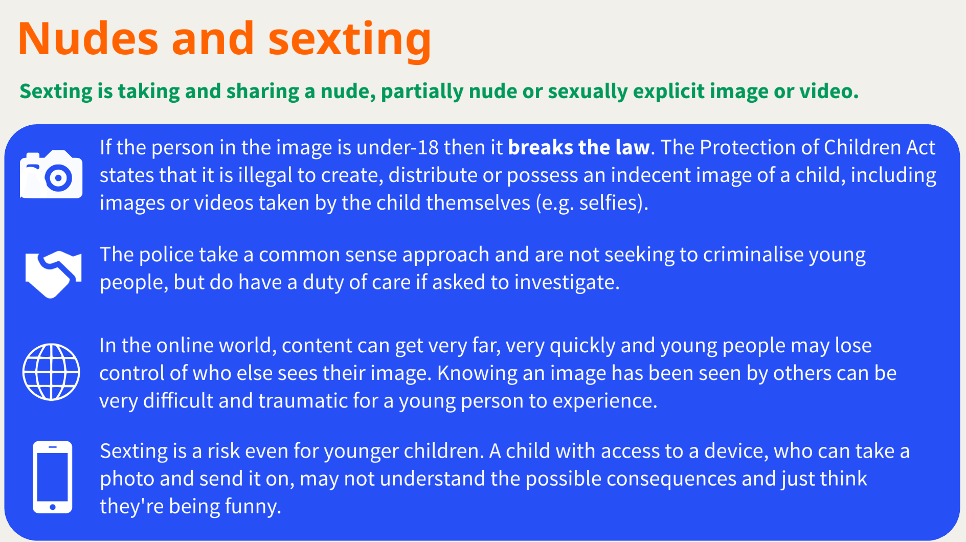

Slide 11
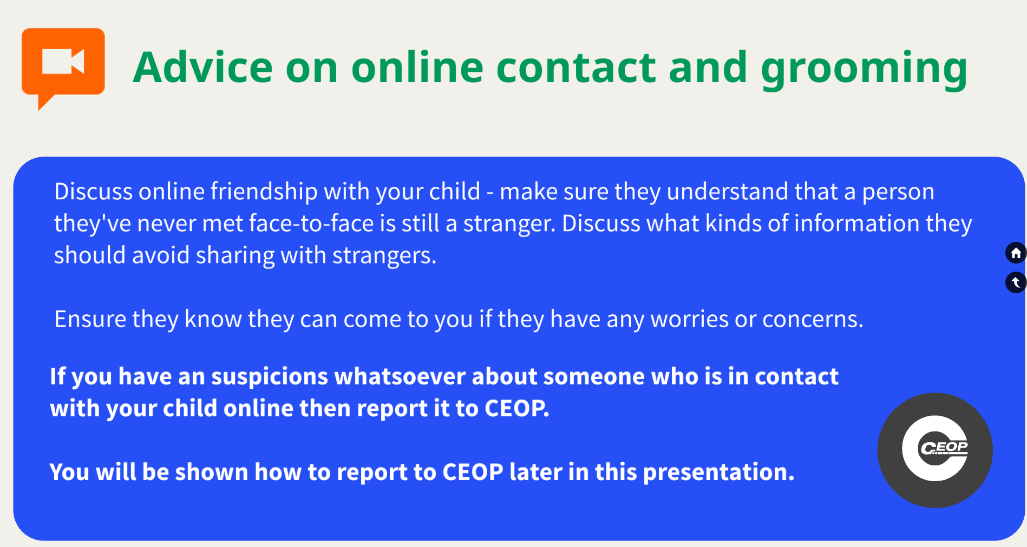

Slide 12
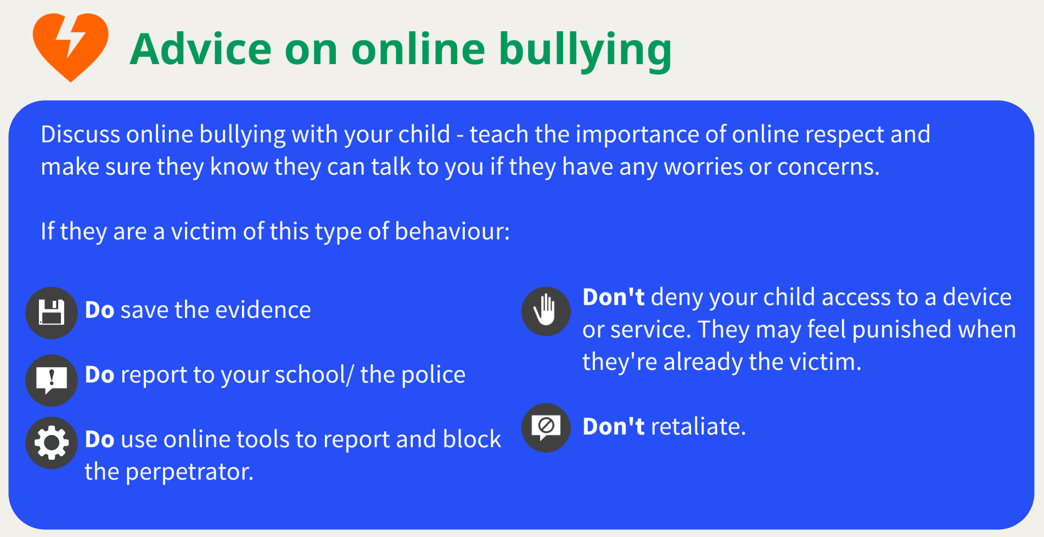

Slide 13
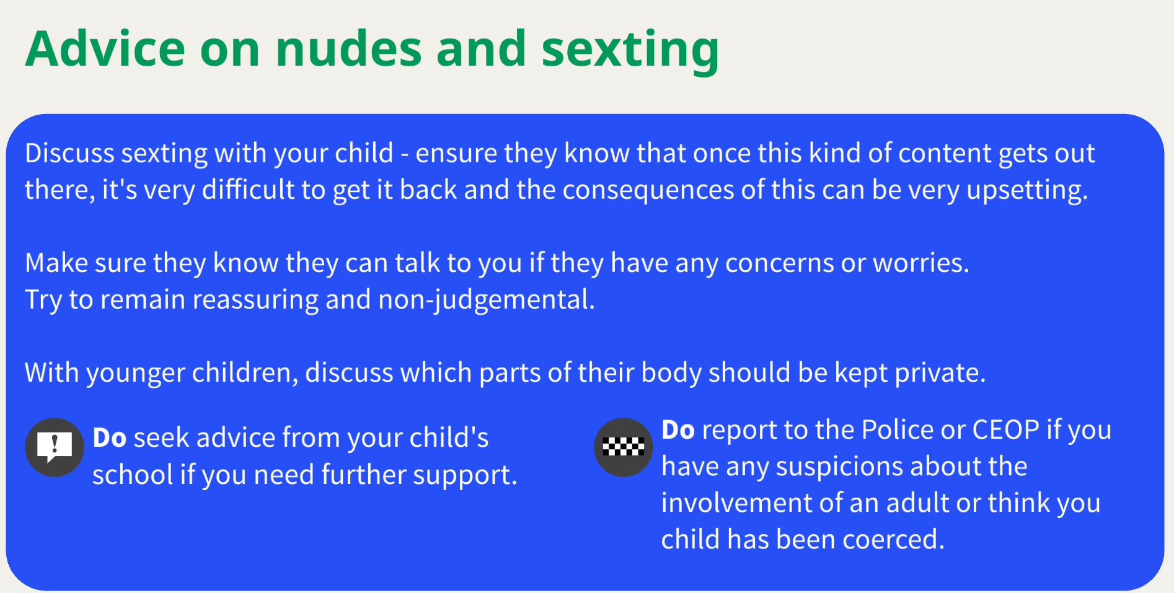

Slide 14
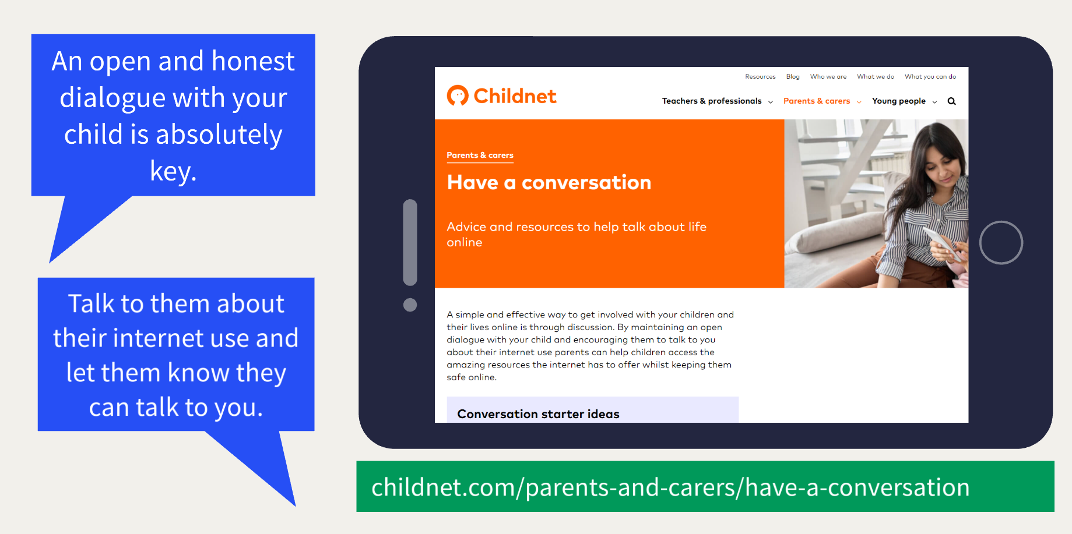

Slide 15
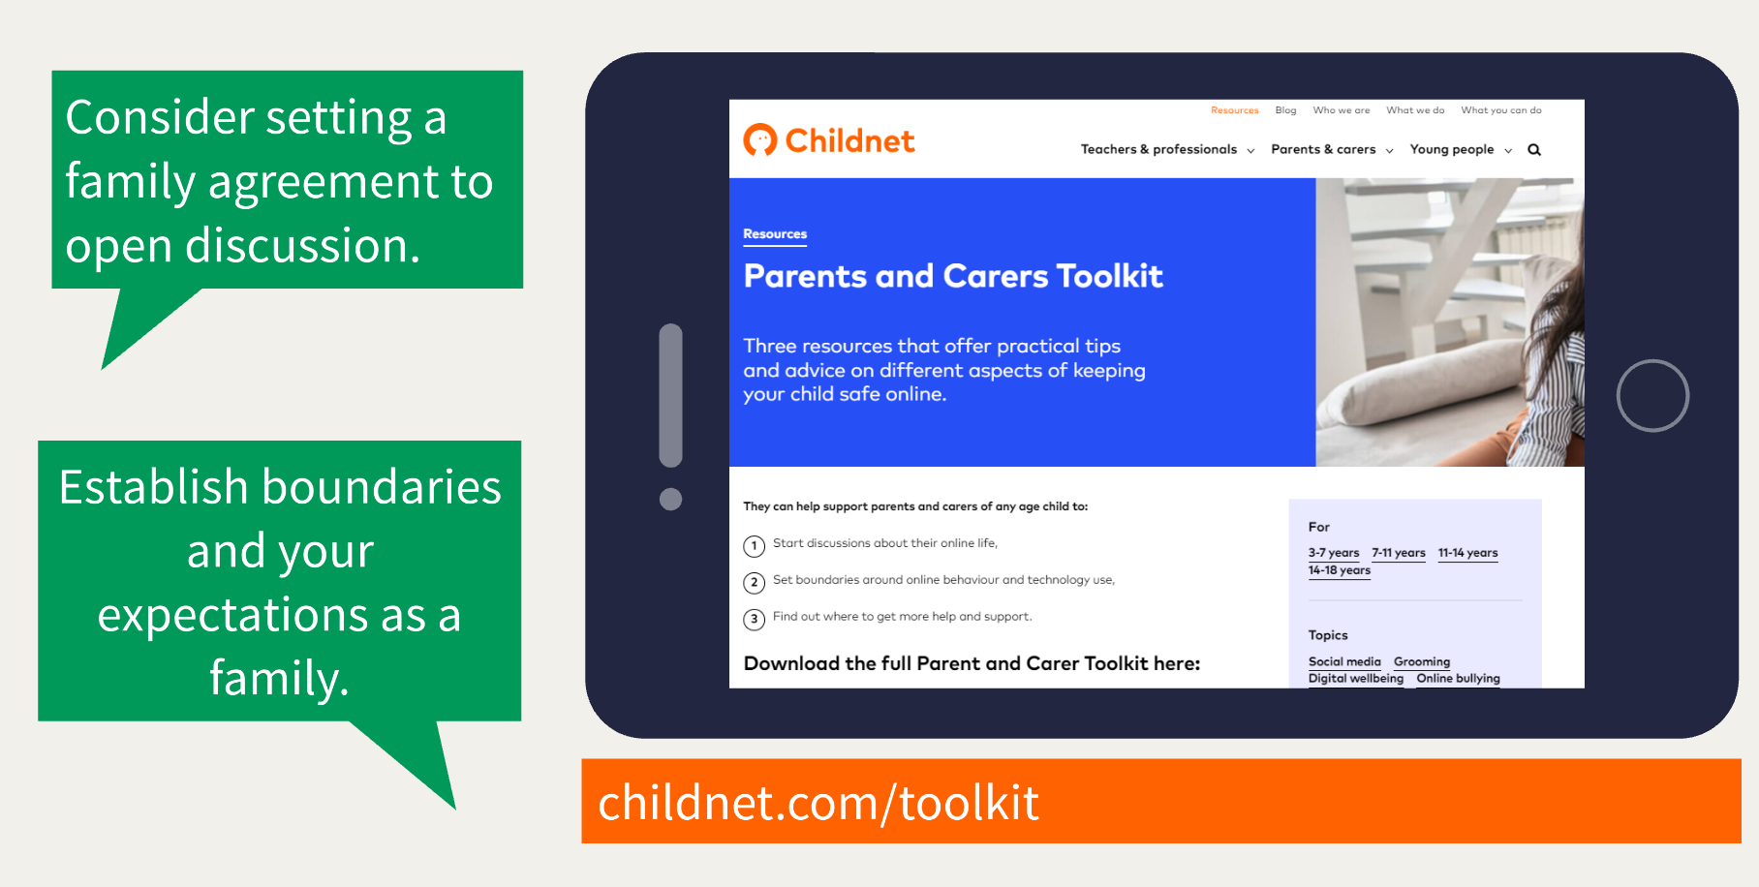

Slide 16
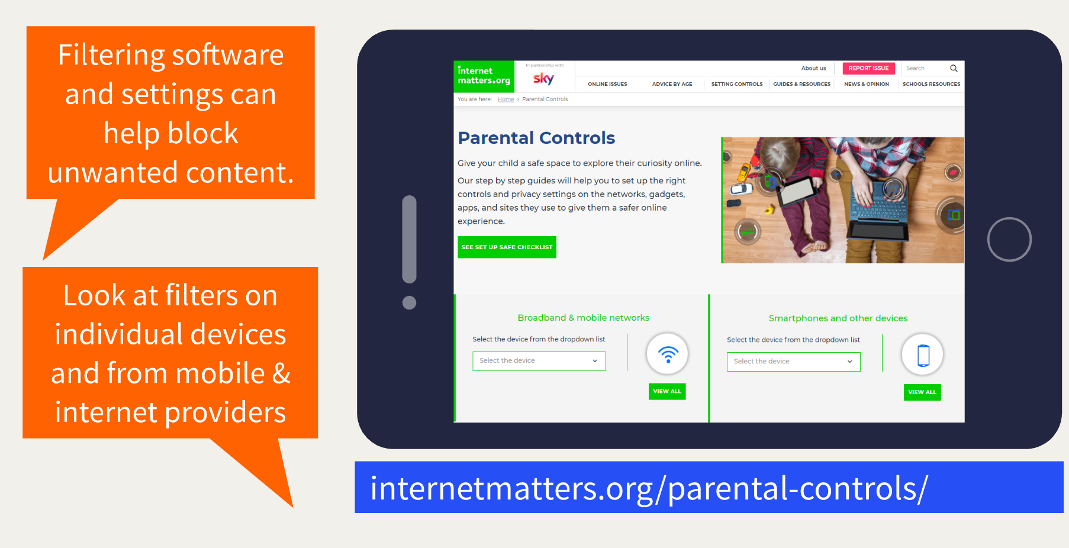

Slide 17
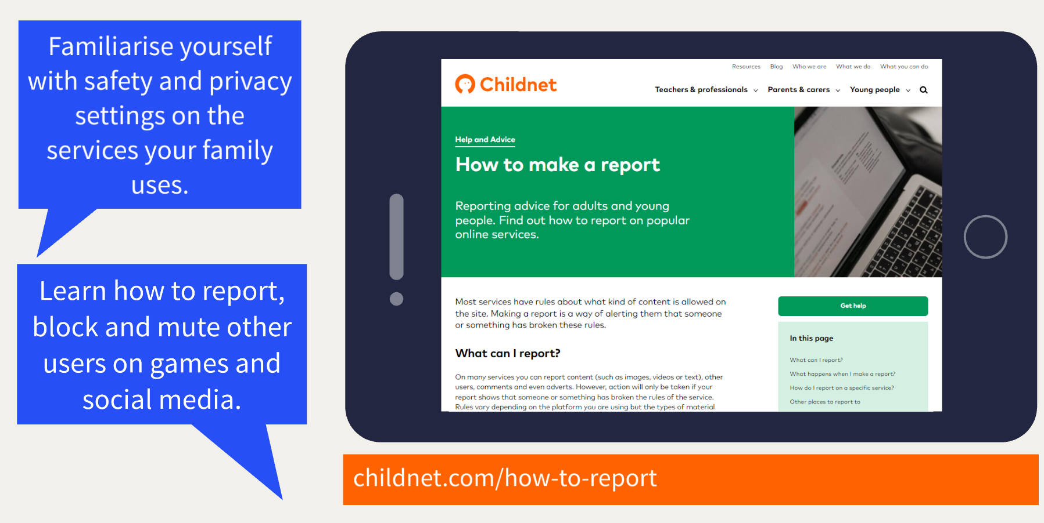

Slide 18
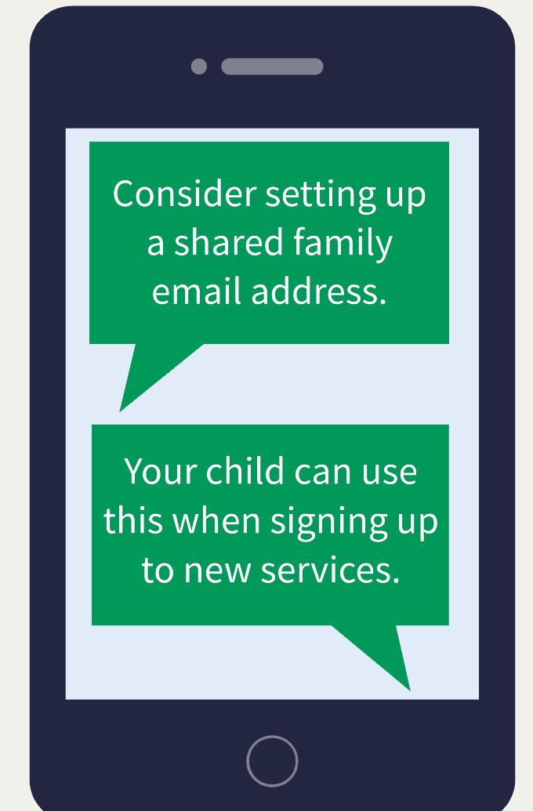
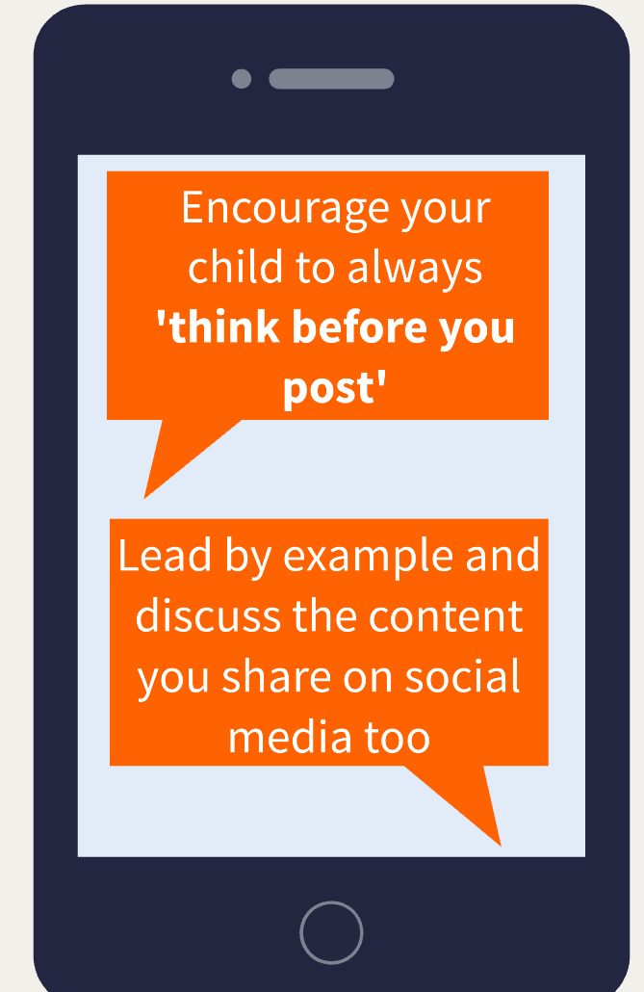
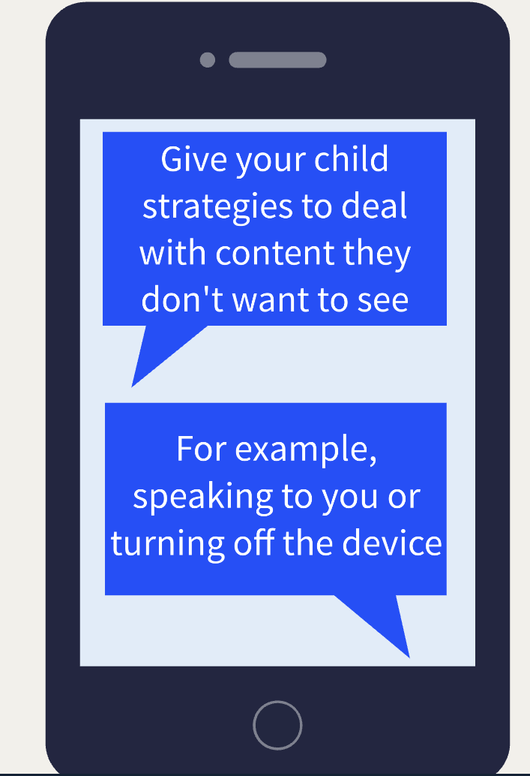

Slide 19
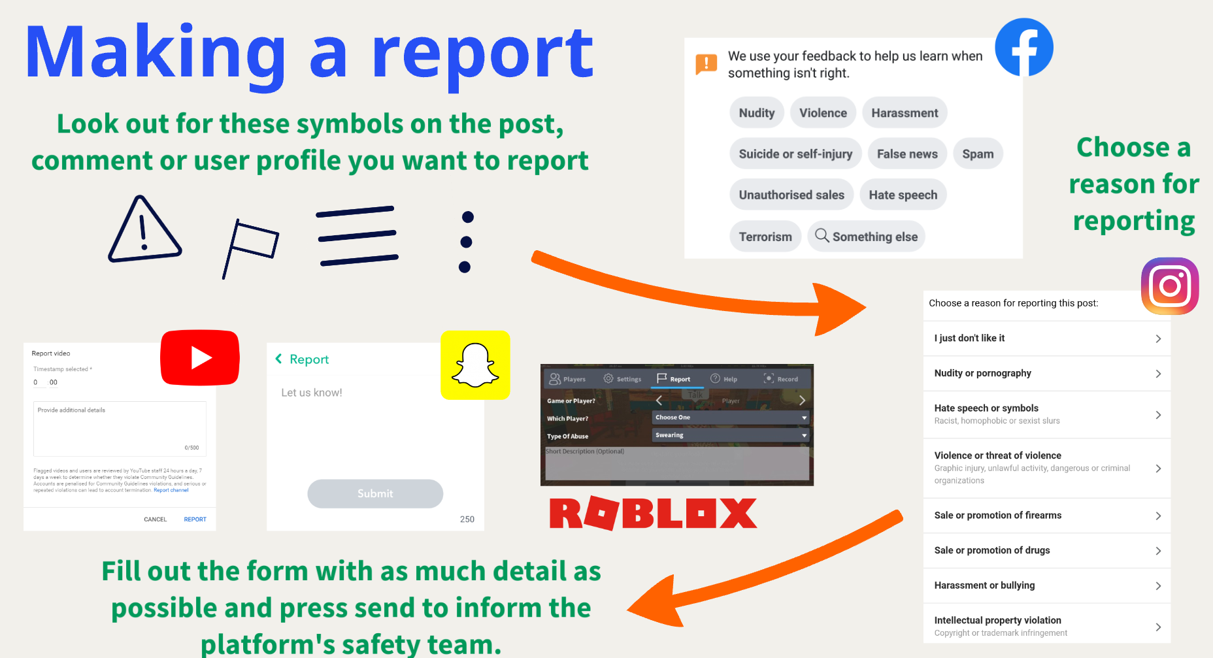

Slide 20
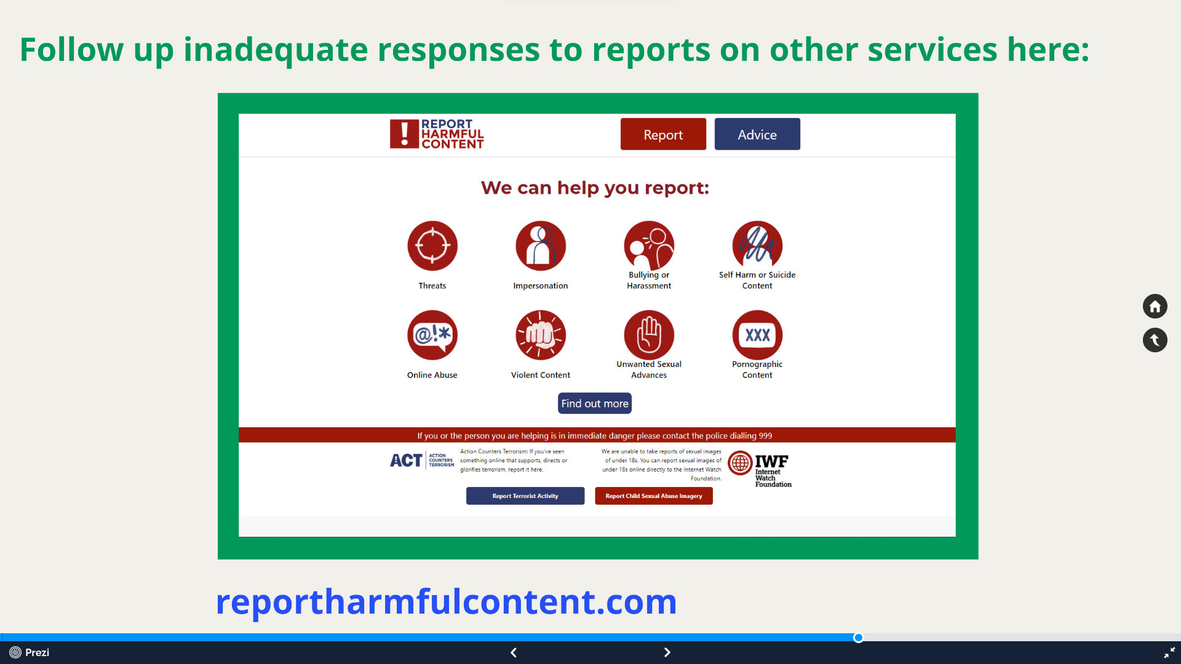

Slide 21
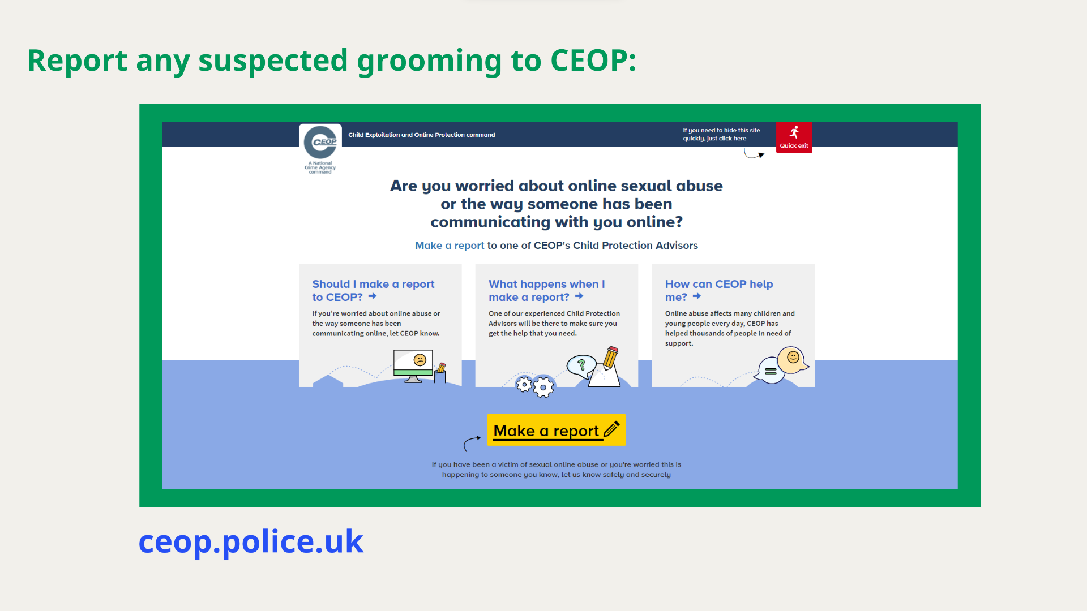

Slide 22
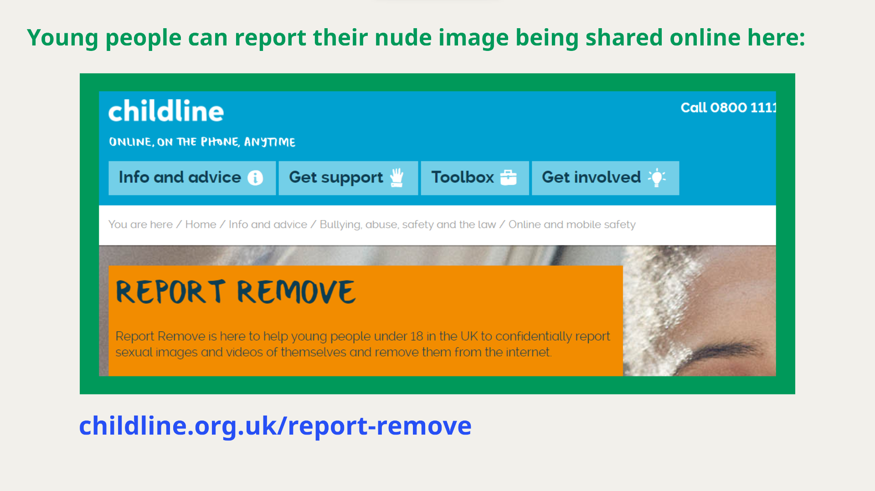

Slide 23
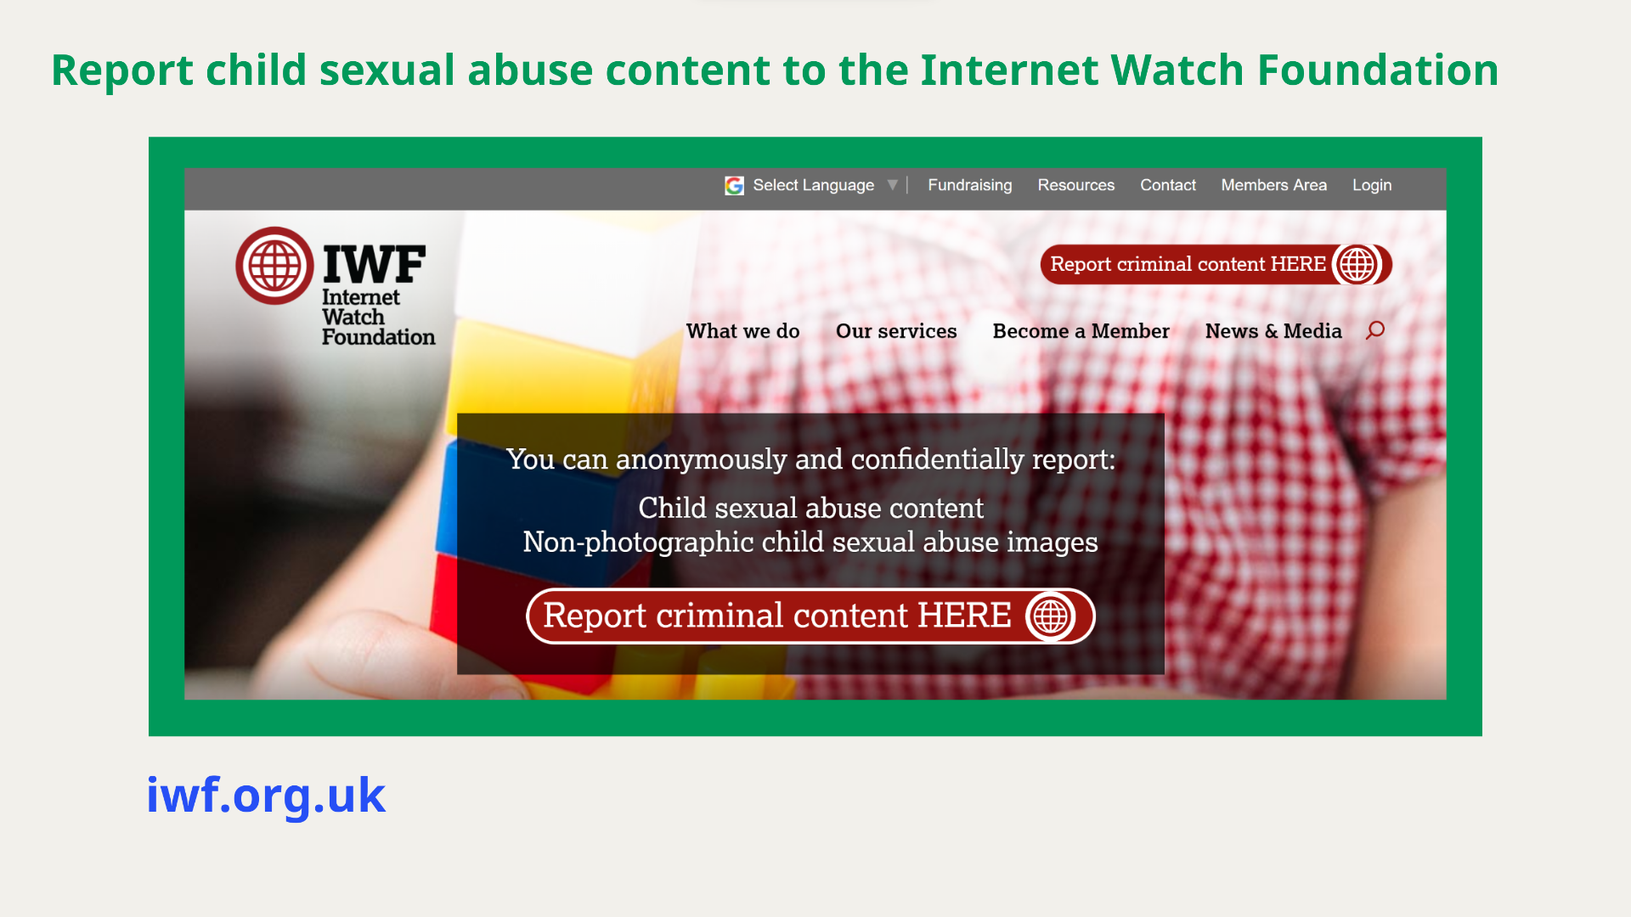

Slide 24
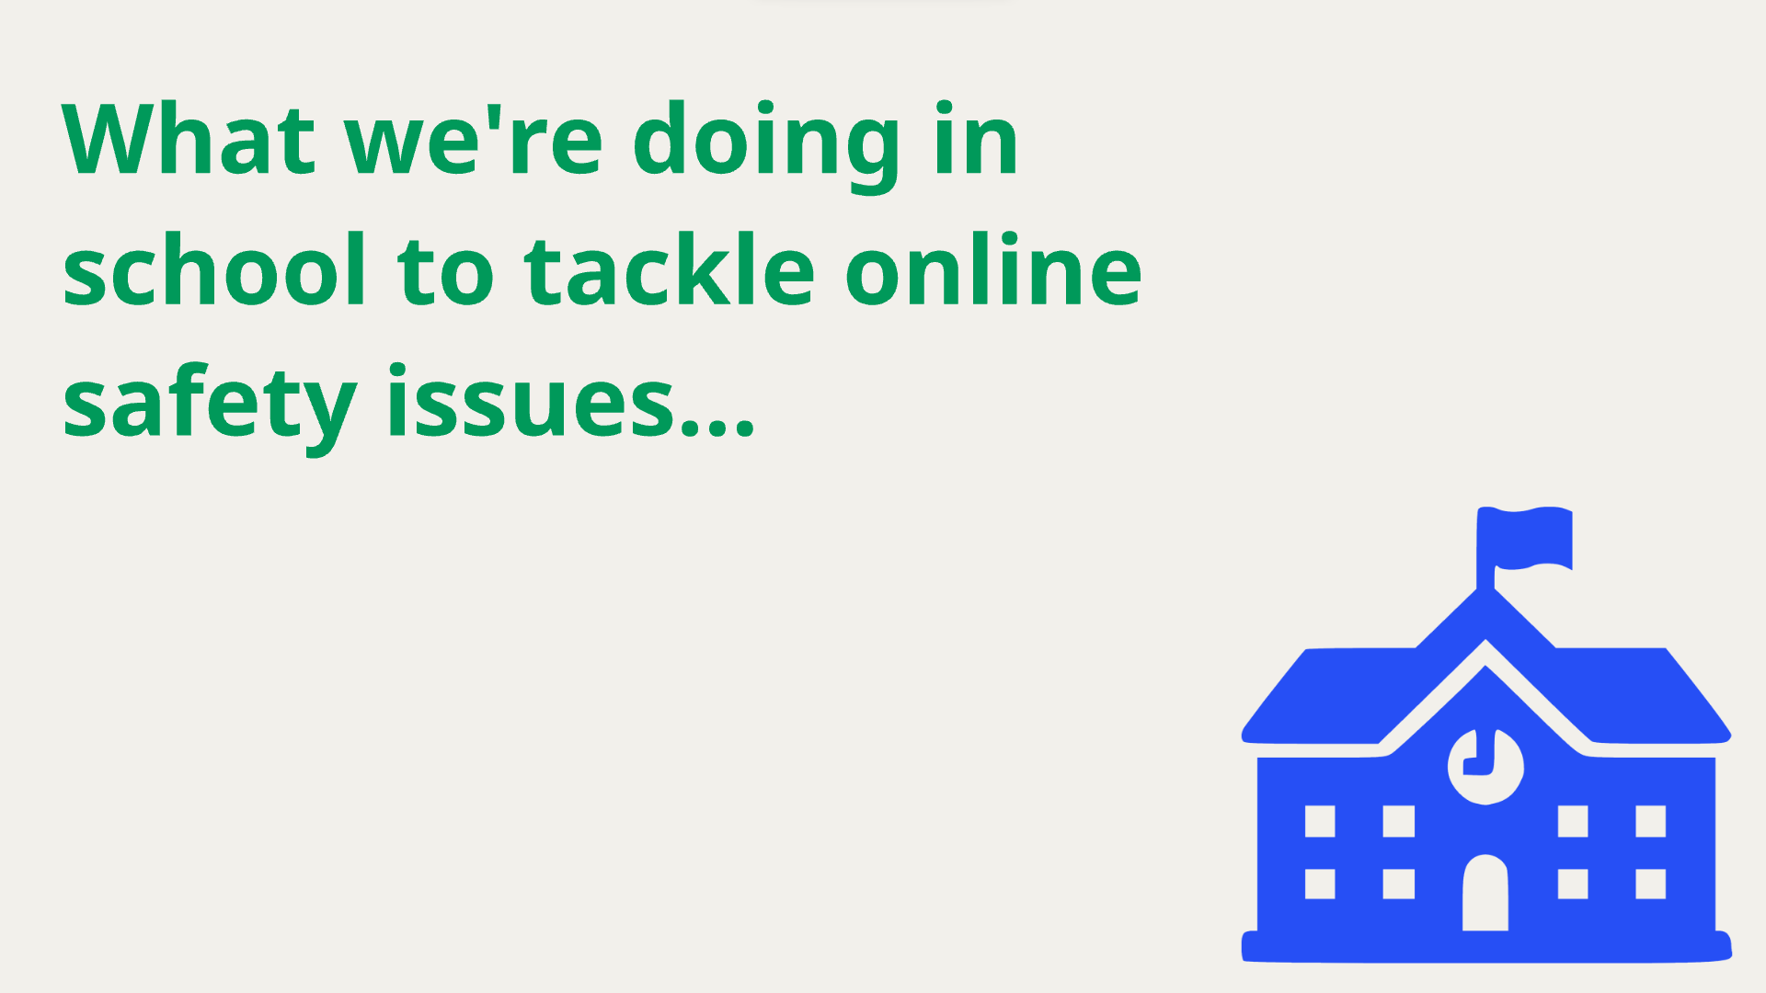

Slide 25
Termly Internet Safety Lessons as part of both the Computing and PHSE curriculum
Internet Safety Day
Revisiting with PHSE Lessons when we notice any issues arising
Monitoring systems (OnGuard) in place on all school computers, laptops and tablets
Online Safety Safeguarding Training
Filtering System - NetSweeper

Slide 26
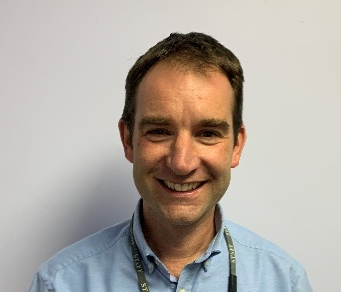
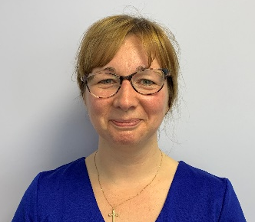
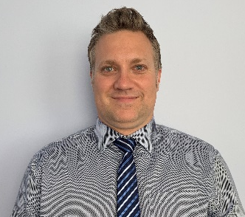

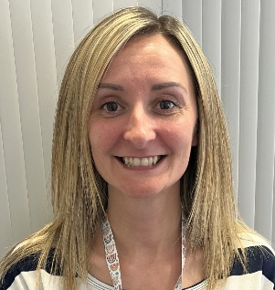
Our DSL Team
“The designated safeguarding lead should take lead responsibility for safeguarding and child protection (including online safety).”
KCSIE 2023
Christian Kelly-DSL
Jo Apps – Governor SL
Adam Smiley - DDSL
Polly Long - DDSL
Katie Green- DDSL

Slide 27

Filtering and Monitoring
Notes:
This slide will need to be prepared ahead of time to outline what your school’s filtering and monitoring system includes.
As part of our responsibility to safeguard and promote the welfare of children, we provide them with a safe environment in which to learn, and do all we reasonably can to limit children’s exposure to online risks on our school networks and devices. We do this by having appropriate filtering software installed: outline information about filtering provider and how this works in your school. Consider school owned devices as well as personal devices connected to the network.
No filtering system can be 100% effective and we cannot rely on them alone to protect pupils online, which is why we also have effective monitoring strategies in place to help us identify potential safeguarding concerns that may occur using our school network or systems: outline school’s monitoring approach and staff roles and responsibilities to implement these.
It is helpful for all staff to understand why filtering and monitoring decisions have been made, with consideration to the age, needs and vulnerabilities of your school community, whilst ensuring “that “over blocking” does not lead to unreasonable restrictions… with regard to online teaching and safeguarding.”. This deeper understanding ensures greater compliance with the policy/system and contributes to the safeguarding culture within the setting.
The DSL, senior leadership and governing body have overall responsibility for filtering and monitoring decisions, but all staff have a role to play in recognising and responding to concerns. Ensure all staff understand their responsibilities and expectations around classroom management of devices. Be clear about the process for reporting and recording incidents and escalating concerns in line with your Child Protection Policy.

Slide 28


Slide 29
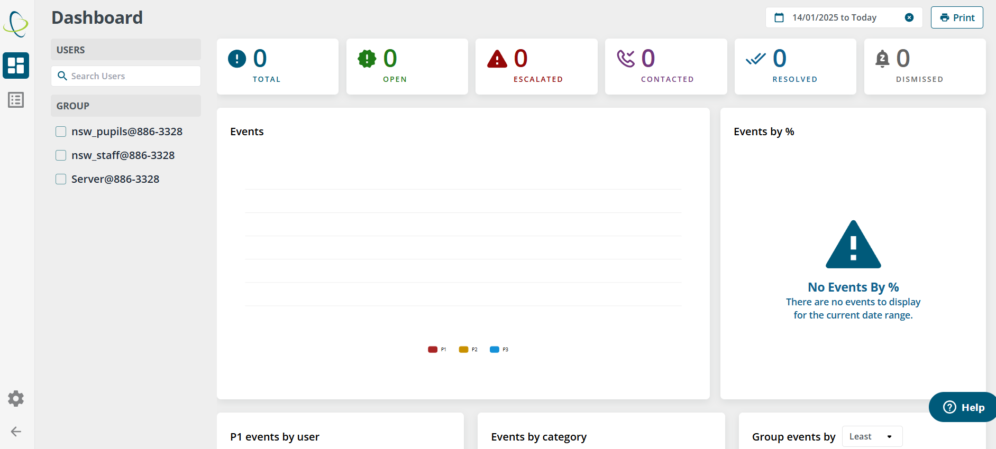
Filtering and Monitoring
Notes:
This slide will need to be prepared ahead of time to outline what your school’s filtering and monitoring system includes.
As part of our responsibility to safeguard and promote the welfare of children, we provide them with a safe environment in which to learn, and do all we reasonably can to limit children’s exposure to online risks on our school networks and devices. We do this by having appropriate filtering software installed: outline information about filtering provider and how this works in your school. Consider school owned devices as well as personal devices connected to the network.
No filtering system can be 100% effective and we cannot rely on them alone to protect pupils online, which is why we also have effective monitoring strategies in place to help us identify potential safeguarding concerns that may occur using our school network or systems: outline school’s monitoring approach and staff roles and responsibilities to implement these.
It is helpful for all staff to understand why filtering and monitoring decisions have been made, with consideration to the age, needs and vulnerabilities of your school community, whilst ensuring “that “over blocking” does not lead to unreasonable restrictions… with regard to online teaching and safeguarding.”. This deeper understanding ensures greater compliance with the policy/system and contributes to the safeguarding culture within the setting.
The DSL, senior leadership and governing body have overall responsibility for filtering and monitoring decisions, but all staff have a role to play in recognising and responding to concerns. Ensure all staff understand their responsibilities and expectations around classroom management of devices. Be clear about the process for reporting and recording incidents and escalating concerns in line with your Child Protection Policy.

Slide 30
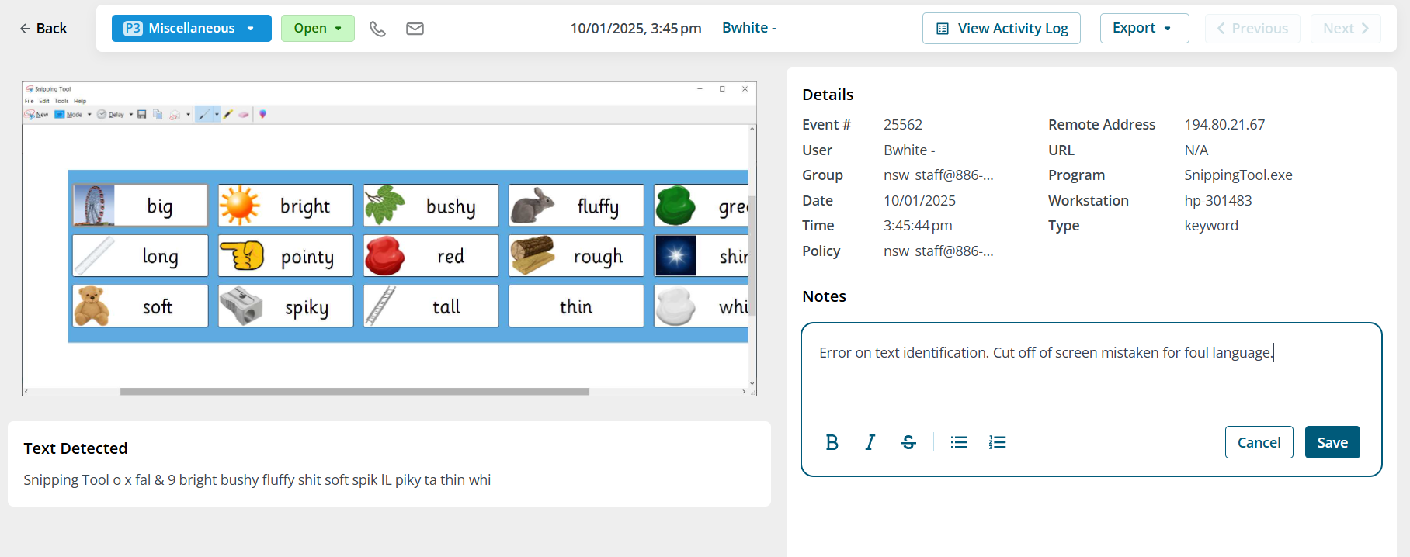
Filtering and Monitoring
Notes:
No filtering system can be 100% effective and we cannot rely on them alone to protect pupils online, which is why we also have effective monitoring strategies in place to help us identify potential safeguarding concerns that may occur using our school network or systems: outline school’s monitoring approach and staff roles and responsibilities to implement these.
It is helpful for all staff to understand why filtering and monitoring decisions have been made, with consideration to the age, needs and vulnerabilities of your school community, whilst ensuring “that “over blocking” does not lead to unreasonable restrictions… with regard to online teaching and safeguarding.”. This deeper understanding ensures greater compliance with the policy/system and contributes to the safeguarding culture within the setting.
The DSL, senior leadership and governing body have overall responsibility for filtering and monitoring decisions, but all staff have a role to play in recognising and responding to concerns. Ensure all staff understand their responsibilities and expectations around classroom management of devices. Be clear about the process for reporting and recording incidents and escalating concerns in line with your Child Protection Policy.

Slide 31
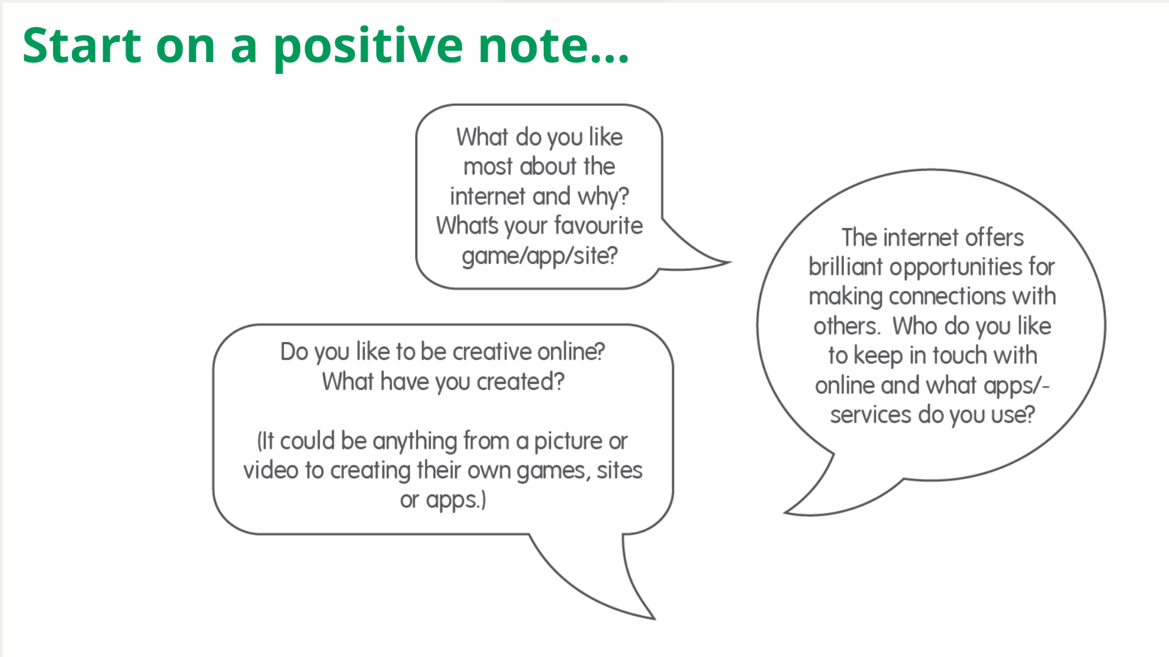

Slide 32


