Slide 1

Home Learning
Year 2 Term 5 Week 4

Slide 2
Message from the class teacher
Hi Year 2!
I hope you have had a wonderful weekend. My weekend has been fabulous!! I am so excited to tell you my brother and his wife ( Mrs Bartlett who has been in to help with reading in your class in Year 1 and Year 2) had a baby on Saturday 2nd May. I am so happy and very excited to meet my little niece when we are out of lockdown. That’s right I said NIECE… she is the first girl on my side of the family! YAY! For now I will have to have to spend my time facetiming them and peeping through their window!! I know what you’re thinking… I sound crazy… but we all knew that anyway… right?! Have a great week, miss you all. I hope you enjoyed our Bapchild School lockdown video! Love Mrs Unsworth x
Hello Year 2
I hope you’ve had a lovely weekend, the weather was a little cooler wasn’t it but I bet all the plants enjoyed the rain. On Saturday it was Mr Clark’s birthday so we had a family Sports Day in the garden with egg and spoon, obstacle and 3-legged races. Then we had a long cycle ride to the woods. After all that activity we snuggled up to watch two films which my boys chose ‘Spies in Disguise’ and ‘The Rise of Skywalker’. Then we had steak and chips for dinner. Yum!! Once again we hope you are doing well at home with your families. Did you see the Bapchild School lockdown video? It’s on the school website so have a look if you haven’t seen it. The boys and I had a lot of fun dancing to S Club 7! I hope you liked it, it reminds us that we are all still part of Bapchild School and we hope it made you smile.
Miss you all, Love Mrs Clark x
Mrs Bradley sends you all her love and hopes you liked her bright yellow swimming hat. x

Slide 3

Reading
Hopefully you have access to books at home, but we have sent home extra books with your child.
Accelerated Reading
Home quizzing is not always recommended but in this case we have adjusted the settings to allow quizzing to happen at home.
If your child wants to read a book from home, please check that there is a quiz available for the book and that the book level (BL) is within or near to your child’s reading range. Also take note of the quiz number for future reference.
To check books please visit: https://www.arbookfind.co.uk/
Go to the next page for how to quiz.

Slide 4



AR quizzing at home.
To log into AR to take a quiz please visit: https://ukhosted27.renlearn.co.uk/2240835/
Your child should know what to do from here and should know their login details. If they are not aware, most details are written in their reading record.
Click on Accelerated reader.
Type in the name the book or the quiz number.
We advise students complete quizzes unaided. If parents/carers wish to support their child, they can do so in the following ways:
Discuss the book with your child as the book is being read
Ask your child to read the question out loud
Re-word questions for your child, if necessary
Ask your child which answers are not correct

Slide 5

Visit http://readon.myon.co.uk

Slide 6

Choose an area that interests you or use the search option.

Slide 7


Using My Maths
Children should know their way round My Maths but here are some reminders on how access the lessons. Visit: www.mymaths.co.uk
bapchild
divide162

Slide 8

Using My Maths
Access any lesson based on what your child is learning in class or search the topic in the search bar.
Use the login portal to access specific homework and lessons that your teacher has set.

Slide 9

Maths – White Rose Home Learning
In school we follow the White Rose scheme of learning. Their website has put together free lessons and resources that link to the learning taking place in school. Please visit: https://whiterosemaths.com/homelearning/

Slide 10



TT Rockstars
To access TT Rockstars please visit: https://play.ttrockstars.com/auth/school
Start typing in the school name or the post code (ME99NL)
Pupils type in their username and password, usually written in their reading record.
Pupils can practice all tables but Year 2 should be practicing 2, 5, and 10’s
Year 3: 2,5,10,3,4,8’s
Year 4,5,6: all tables

Slide 11

Accessing Twinkl
Many educational content providers are offering free access to their resources. Twinkl is a website that we use from time to time to resource our lessons to aid in teacher input and pupil activities.
We will be able to direct you towards activities and learning via this website based on lessons that may be missed due to absence. To access Twinkl please visit: www.twinkl.co.uk/offer
You will have to sign up and put in the offer code: UKTWINKLHELPS

Slide 12

English Learning
This week in English we are going to continue with Clever Cakes by Michael Rosen. There are some more comprehension questions to make sure you have understand your reading, a writing task to predict the next part of the story and some SPaG tasks thinking about adjectives, spellings and handwriting.
I have included the extract again over the next few slides for you to read before you complete the tasks.

Slide 13
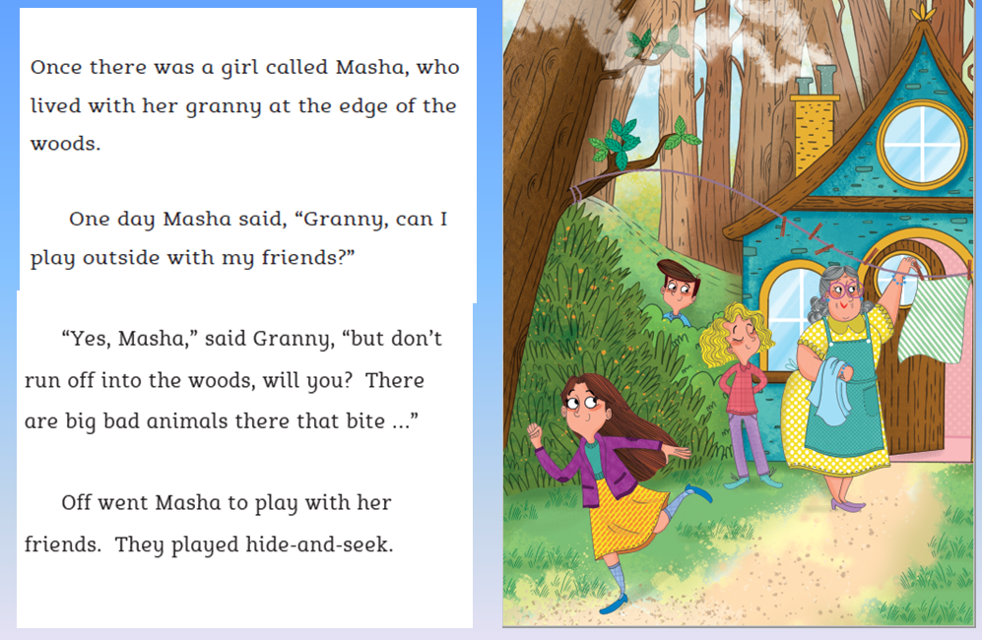

Slide 14
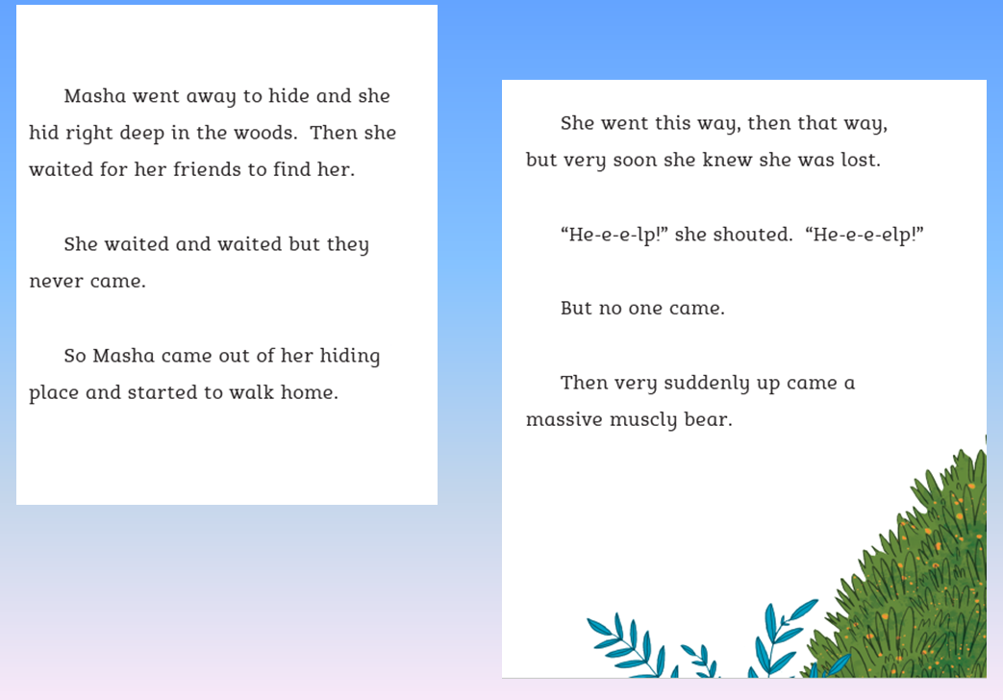

Slide 15
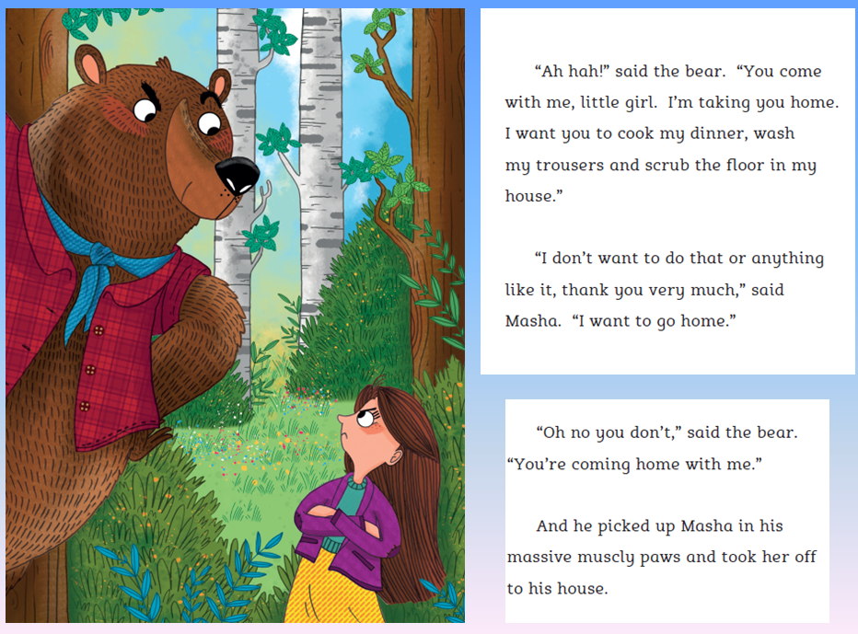

Slide 16
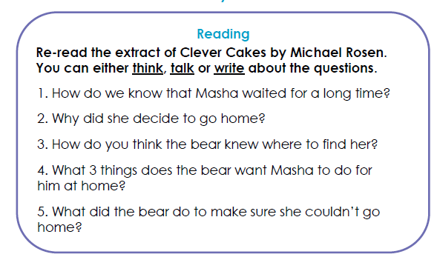
Task 1: Reading and understanding the text.

Slide 17
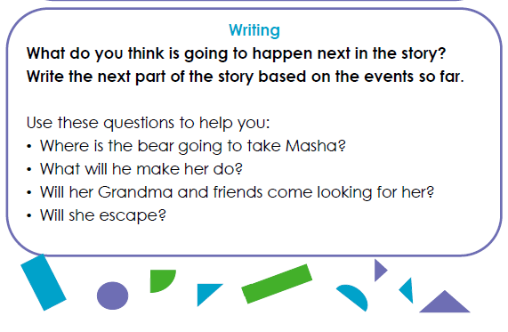
Task 2: Predict the next part of the story.

Slide 18
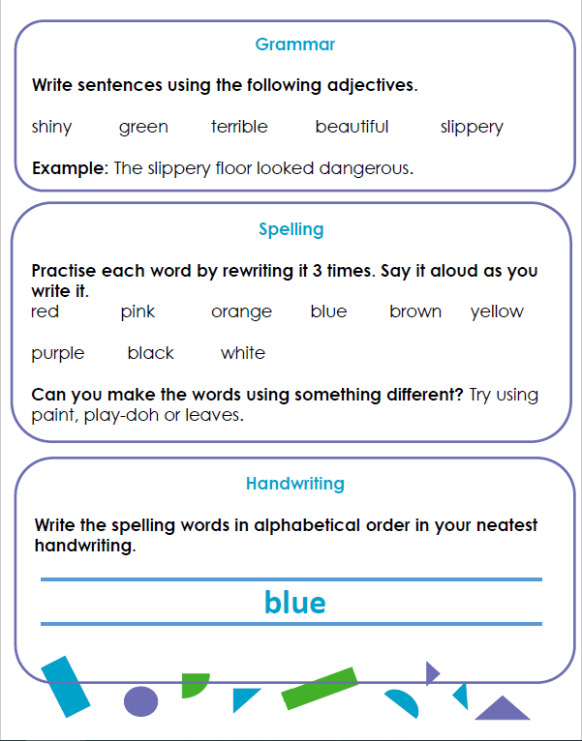
Task 3 SPaG
Now you have finished your 3 tasks click on the link below listen to Michael Rosen read the whole story of Clever Cakes.
Notice how he uses his voice to create expression in the character's voices.
How close was your prediction to the actual ending of the story?
Did you enjoy Michael Rosen’s ending or was yours better?
https://www.youtube.com/watch?v=1qRfNnv9MUE

Slide 19
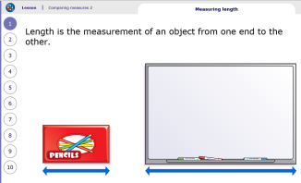
Maths Learning
This week we will continue with the unit measuring. The online videos on this website are really good, please watch the short video before completing the activity. Please do not feel you have print off the activity you could draw out your own examples.
Activity 1 – White rose home learning →Summer Term – Week 2 (w/c 27th April) → Lesson 1 Compare Lengths. If you are not able to print the worksheet perhaps compare lengths of objects in your home.
Activity 2 – White Rose Home Learning → Summer Term – Week 2 (w/c 27th April) → Lesson 2 Order Lengths.
Activity 3 – White Rose Home Learning → Summer Term – Week 2 (w/c 27 April)
Lesson 3 – Four operations with length.
If you are finding you are completing these activities quickly you could try the Friday challenges on the white rose website.
On My Maths if you want extra learning you can go to measurement→ y2 comparing measures→ chapter 1, 2 and 3 on the online lesson will provide further consolidation of the unit.
Also don’t forget to be regularly learning your times tables on TT Rockstars. Our focus in Year 2 is the 2x, 5x and 10x tables.

Slide 20
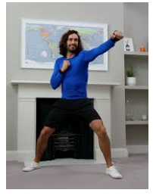
PSHE
The last few weeks have been very different and it is strange to not know when life will go back to normal. You have all done brilliantly so far by staying at home to do your learning. This week we are going to think about how important it is to keep ourselves healthy on the inside and the outside while we are at home. The 3 tasks this week are all to do with keeping ourselves feeling happy and positive in these unusual times.
Task 1: Keeping our bodies active with exercise releases special chemicals called endorphins into our brains which make us feel happy and energetic. This week try to do 30 minutes exercise a day. This could be playing a sport like football in the garden or doing some exercise in your living room. Try doing Joe Wicks PE lessons everyday on YouTube. They are live at 9am so you could do it then or choose a different time in the day. Try to get everyone in your house to join in.
https://www.youtube.com/watch?v=2iDqBO34ieA

Slide 21
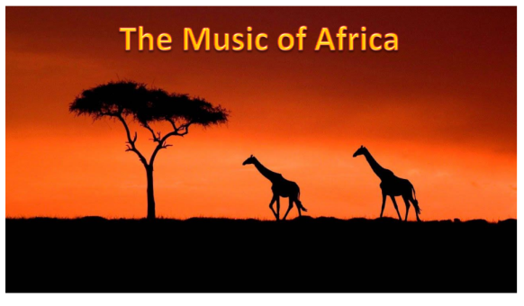
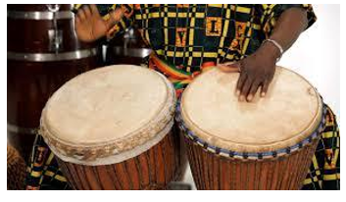
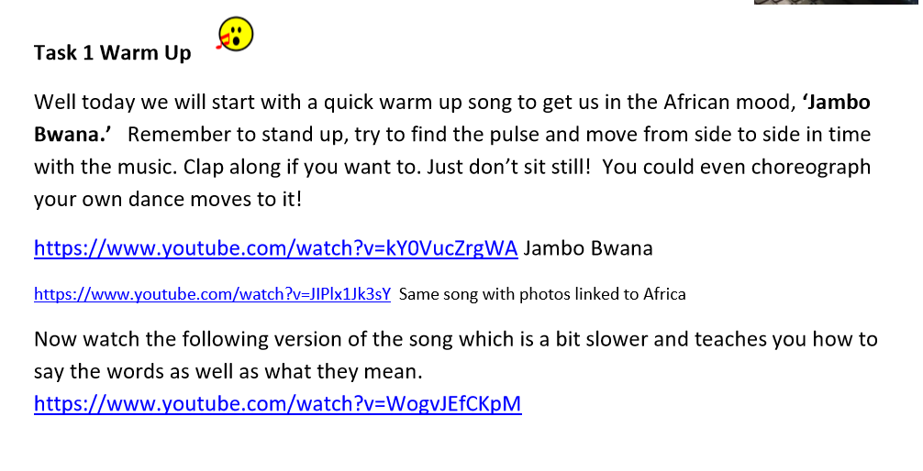

Task 2: Music is a great way to express how we are feeling and to help ourselves feel calm and happy. Try this activity that Mrs Julier has sent. The theme is ‘The Music of Africa’ and this task is a lovely way listen to and try and join in some African music.

Slide 22



Task 3: Art is another way to show how we are feeling and make us feel more positive. Using any art materials you have at home including paints, coloured pencils, crayons and collage create a picture of a raincloud, a rainbow and a sun.
Inside the rainbow write all the ways that you and your family are making the best of this time and what you are enjoying the most.
Inside the raincloud write all the things that you feel worried or unsure about.
Inside the sun write all the things you are looking forward to doing when this strange time is over.
1. The raincloud reminds us that life is sometimes tricky and it is normal to feel worried.
2. The rainbow reminds us of hope, that things will get better and in the meantime we are doing our best to stay strong and happy.
3. The sun reminds us that sunny, happy times are on their way when we can all be together again.

Slide 23

P.E.
It is important to keep your children active. If it is safe to do so, ensure they have some time outside throughout the day. Please visit Joe Wicks YouTube channel (https://www.youtube.com/channel/UCAxW1XT0iEJo0TYlRfn6rYQ), which has lots of exercise videos for children. He will also be hosting a live P.E. lessons Monday to Friday at 9:00am.

Slide 24

Classroom Secrets
The site classroom secrets https://classroomsecrets.co.uk/free-home-learning-packs/ has free class packs which provide some great additional ideas and resources you can use.

