Slide 1

Home Learning
Year 2 Term 5 Week 3

Slide 2
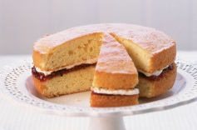
Message from the class teacher
Hi Year 2!
I hope you are all well staying safe. I hope you are enjoying your home learning and making the most of the sunshine. This week we have been spending time outside in the garden and being creative with Ronnie’s home learning. We have been on a bike ride every day and we tried to make a Victoria Sponge…. I must say cooking is not my specialty as the edges of the cake were a little too crispy! We have been reading lots of books together and we are enjoying reading Julia Donaldson books, even though Teddy only wants to listen to books about dinosaurs! Have a lovely week, we miss you all so much and we are thinking of you everyday. Stay safe, love Mrs Unsworth x PS. My cake did NOT look like this →
Hello Year 2,
Another week has gone by already. I hope you have enjoyed your weekend and are ready to have a go at a few more challenges. I have set myself a challenge this week. I am going to have a bike ride everyday. I have only just started to ride again after lots and lots of years! I went on a 5 mile ride yesterday with Mr Clark, George, Charlie and Arthur but I’m still not too confident so I want to get even better. I don’t know about you lot but I wish I could have shared a bit of that cake Mrs Unsworth made, it sounds delicious. Have you lot been doing any baking? Well take care and as always you know we are missing you and thinking about you every day.
Stay safe, love Mrs Clark xx

Slide 3

Reading
Hopefully you have access to books at home, but we have sent home extra books with your child.
Accelerated Reading
Home quizzing is not always recommended but in this case we have adjusted the settings to allow quizzing to happen at home.
If your child wants to read a book from home, please check that there is a quiz available for the book and that the book level (BL) is within or near to your child’s reading range. Also take note of the quiz number for future reference.
To check books please visit: https://www.arbookfind.co.uk/
Go to the next page for how to quiz.

Slide 4



AR quizzing at home.
To log into AR to take a quiz please visit: https://ukhosted27.renlearn.co.uk/2240835/
Your child should know what to do from here and should know their login details. If they are not aware, most details are written in their reading record.
Click on Accelerated reader.
Type in the name the book or the quiz number.
We advise students complete quizzes unaided. If parents/carers wish to support their child, they can do so in the following ways:
Discuss the book with your child as the book is being read
Ask your child to read the question out loud
Re-word questions for your child, if necessary
Ask your child which answers are not correct

Slide 5

Visit http://readon.myon.co.uk

Slide 6

Choose an area that interests you or use the search option.

Slide 7


Using My Maths
Children should know their way round My Maths but here are some reminders on how access the lessons. Visit: www.mymaths.co.uk
bapchild
divide162

Slide 8

Using My Maths
Access any lesson based on what your child is learning in class or search the topic in the search bar.
Use the login portal to access specific homework and lessons that your teacher has set.

Slide 9

Maths – White Rose Home Learning
In school we follow the White Rose scheme of learning. Their website has put together free lessons and resources that link to the learning taking place in school. Please visit: https://whiterosemaths.com/homelearning/

Slide 10



TT Rockstars
To access TT Rockstars please visit: https://play.ttrockstars.com/auth/school
Start typing in the school name or the post code (ME99NL)
Pupils type in their username and password, usually written in their reading record.
Pupils can practice all tables but Year 2 should be practicing 2, 5, and 10’s
Year 3: 2,5,10,3,4,8’s
Year 4,5,6: all tables

Slide 11

Accessing Twinkl
Many educational content providers are offering free access to their resources. Twinkl is a website that we use from time to time to resource our lessons to aid in teacher input and pupil activities.
We will be able to direct you towards activities and learning via this website based on lessons that may be missed due to absence. To access Twinkl please visit: www.twinkl.co.uk/offer
You will have to sign up and put in the offer code: UKTWINKLHELPS

Slide 12

English Learning
In English this week we are looking at a new story called Clever Cakes by Michael Rosen who is one of the authors that we study in Year 2.
Over the next few slides you will find an extract of the story and then 3 tasks to complete throughout the week. To begin read this extract. (Who knows what an extract is? Answer below). Read this to yourself or with an adult. Read it through 2-3 times so you get to know it really well.
*An extract is specially selected part of a story, not the whole thing.

Slide 13
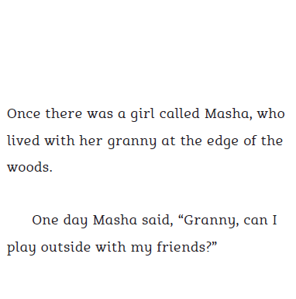
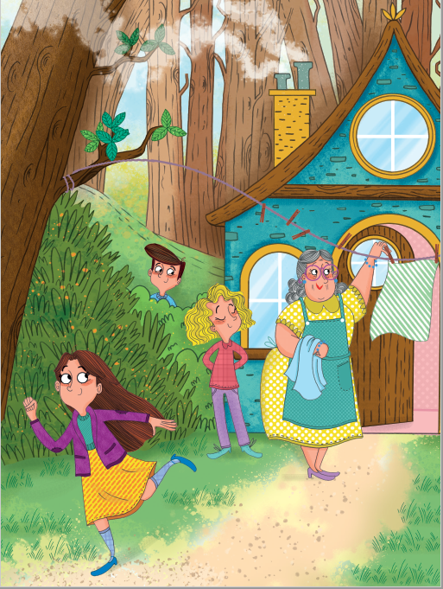
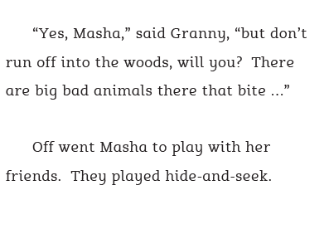

Slide 14
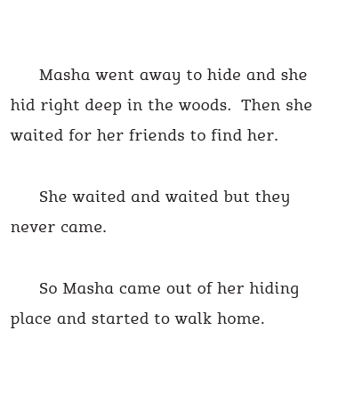
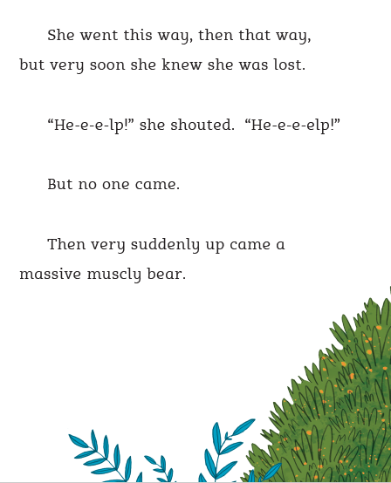

Slide 15
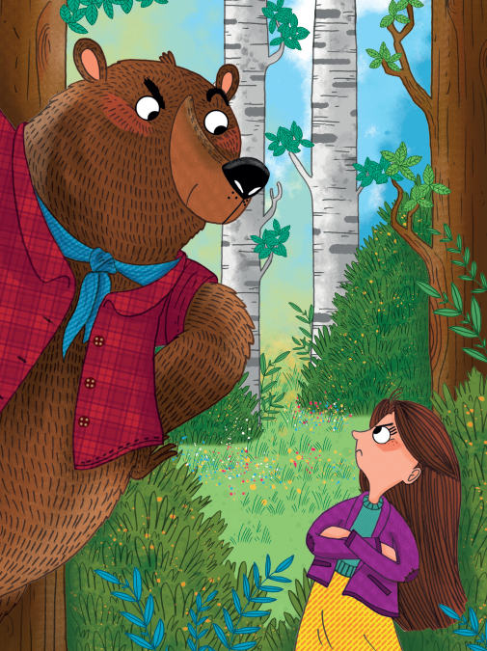
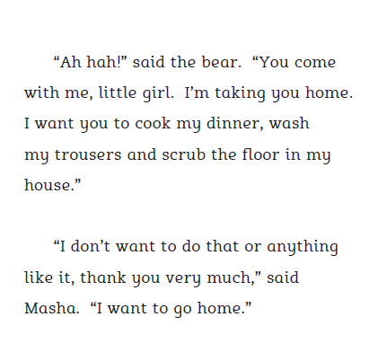
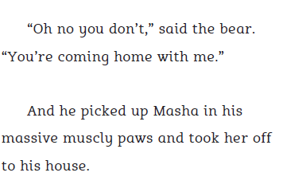

Slide 16
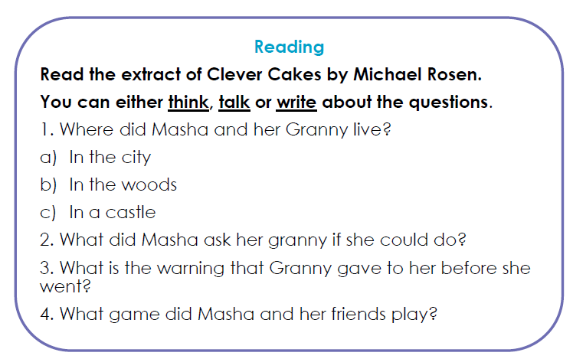
Task 1: Your reading challenge is to answer the questions about the story to make sure you have understood what you have read. You can discuss these answers with a grown up and/or write them down. Remember when you answer comprehension questions to always use examples or evidence from the text to explain or prove your answer.

Slide 17
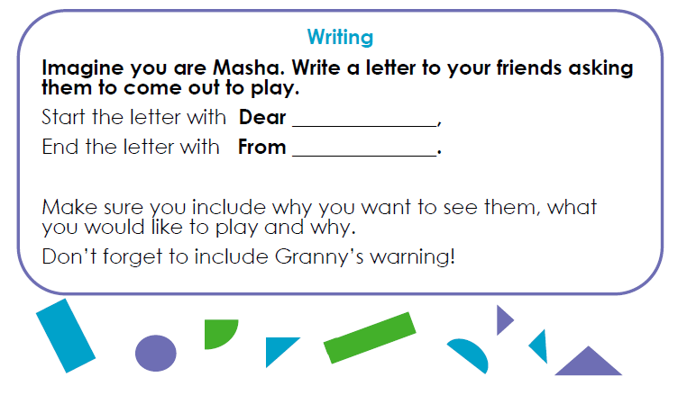
Task 2: Your writing challenge is to write a letter from Masha to a friend. Follow the instructions on who to write your letter to and from and what it is about. Remember to include To/Dear and Love/From.

Slide 18
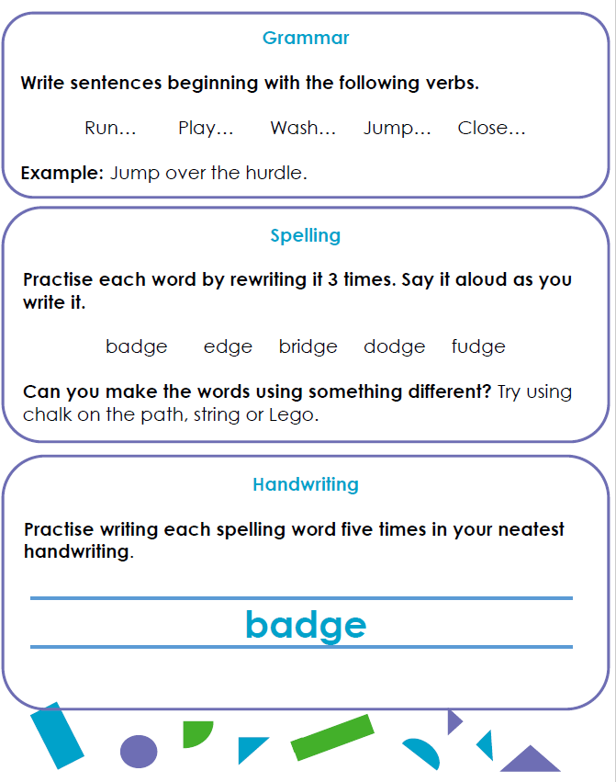
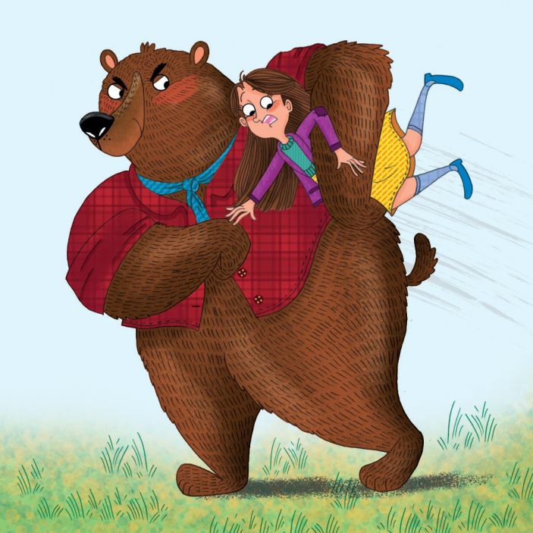
Task 3: Your SPaG challenges are to complete the activities below. There are some sentences to practice using your verbs, a spelling activity to practice the dge spelling and some handwriting practice.
Challenge: In your daily reading time this week try and find other Michael Rosen stories or poems to read either online or you may have some at home. There are also some good clips on Youtube of Michael Rosen reading his own poems that you could watch. Which is your favourite? Why?

Slide 19
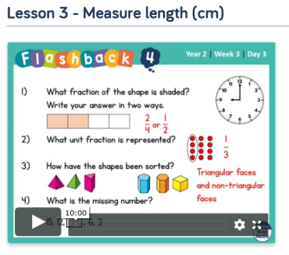
Maths Learning
This week we will continue to learn to tell the time. We will then move onto measuring using the home learning lessons from the white rose website.
Activity 1 – My Maths → Online homework will be set for comparing time. Please complete the online lesson before completing the homework.
https://app.mymaths.co.uk/5937-lesson/comparing-time-2
Homework will appear on your child’s personal dashboard.
Activity 2 – White Rose Home Learning → Summer Term – Week 1 (w/c 20 April) https://whiterosemaths.com/homelearning/year-2/
Lesson 3 - measuring length (cm)
The online videos on this website are really good, please watch the short video before completing the activity. Please do not feel you have print off the activity you could draw out your own examples.
Activity 3 – White Rose Home Learning → Summer Term – Week 1 (w/c 20 April)
Lesson 4 - measuring length (m)

Slide 20

RE
Creation: Being Busy & Resting
Thinking back on the creation story can you watch this clip:
https://www.youtube.com/watch?v=teu7BCZTgDs
Try to ask the following questions:
What do you think about the creation story?
Can you remember what happened on each day?
What was special about Day 7?
Why is it important to rest?
Possible Activities:
Draw a picture showing what you do to rest. Write a few sentences to explain what you are doing and how it makes you feel
Write a sentence explaining what happened on each day in the Creation Story.
If God is the Creator, what rules might he give about how to look after the world? Could you create a set of rules.

Slide 21

P.E.
It is important to keep your children active. If it is safe to do so, ensure they have some time outside throughout the day. Please visit Joe Wicks YouTube channel (https://www.youtube.com/channel/UCAxW1XT0iEJo0TYlRfn6rYQ), which has lots of exercise videos for children. He will also be hosting a live P.E. lessons Monday to Friday at 9:00am.

Slide 22

Classroom Secrets
The site classroom secrets https://classroomsecrets.co.uk/free-home-learning-packs/ has free class packs which provide some great additional ideas and resources you can use.

