Slide 1
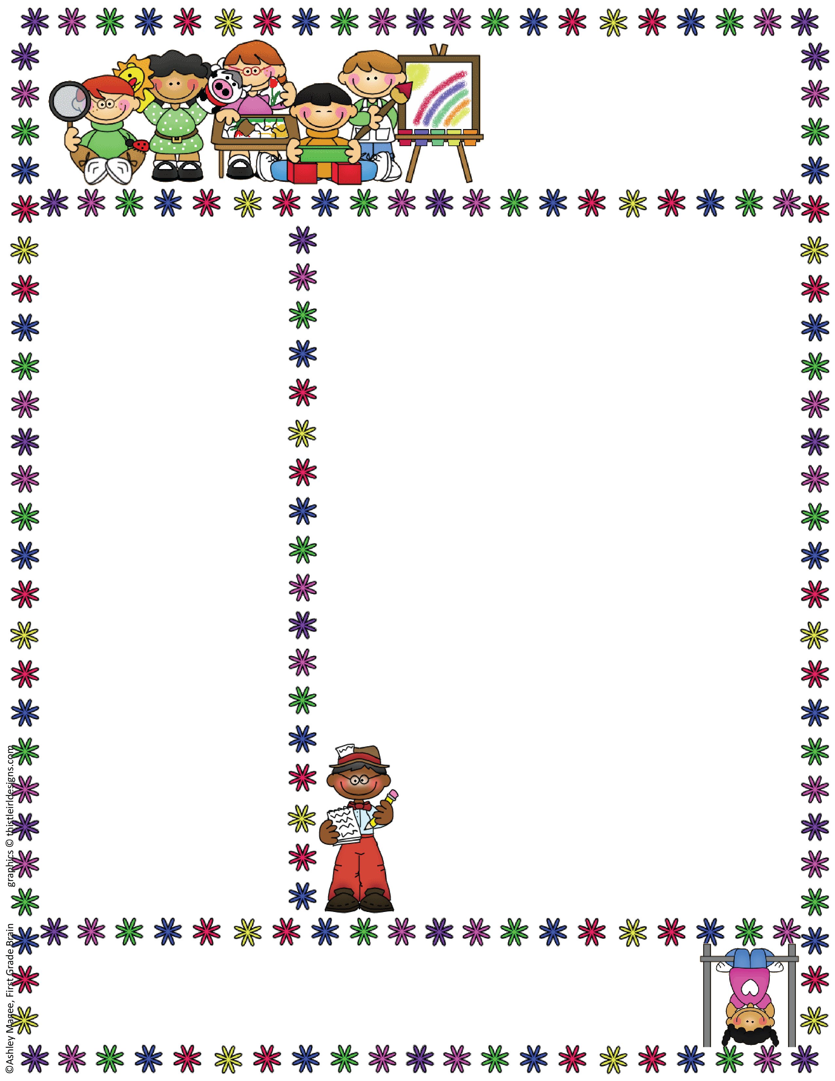
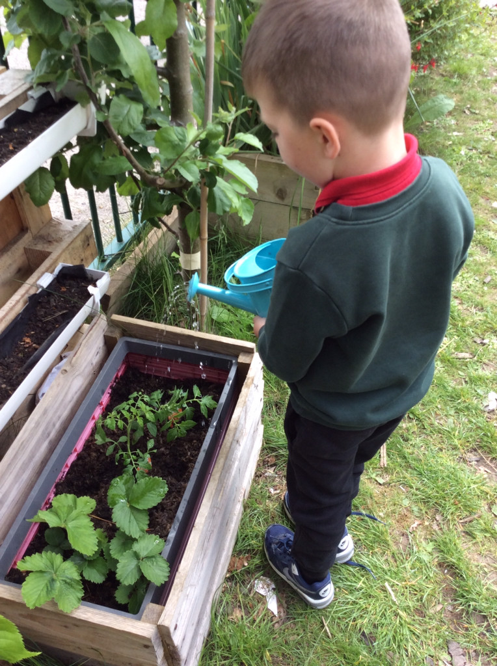
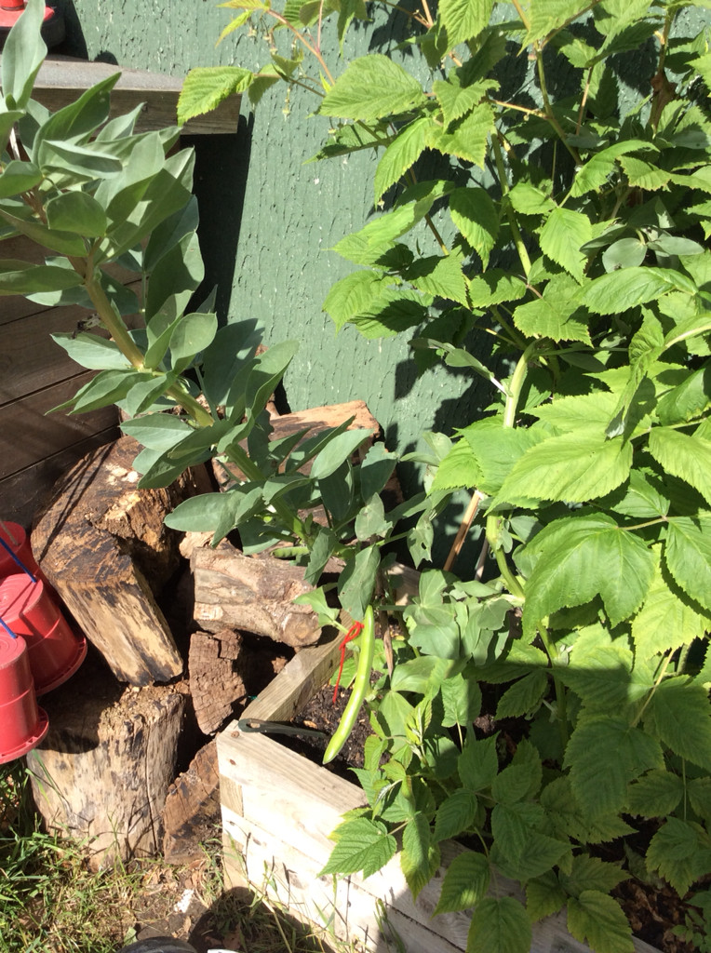


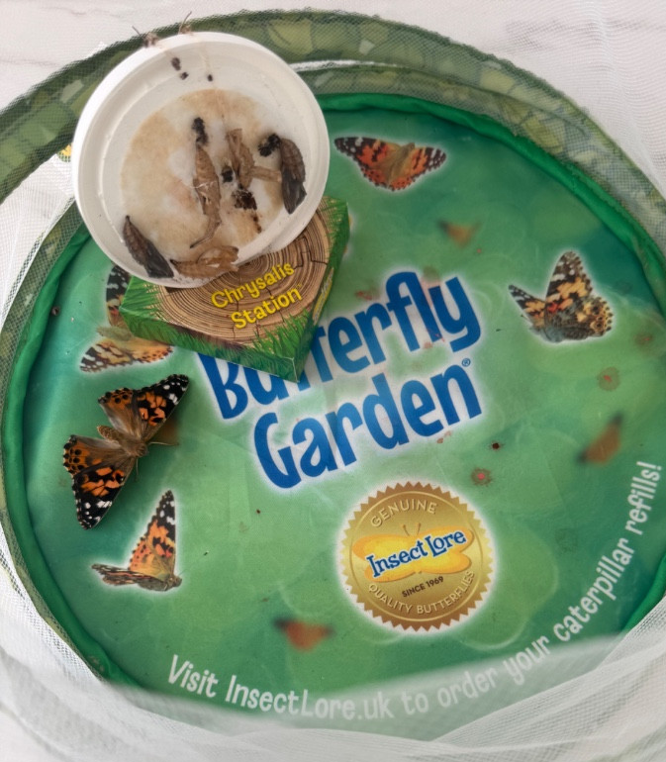
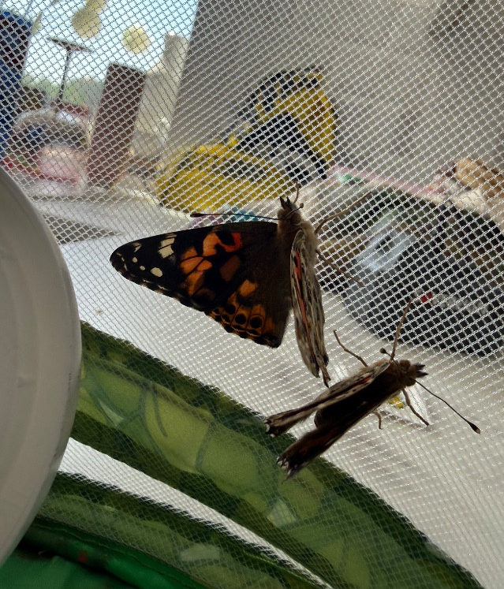
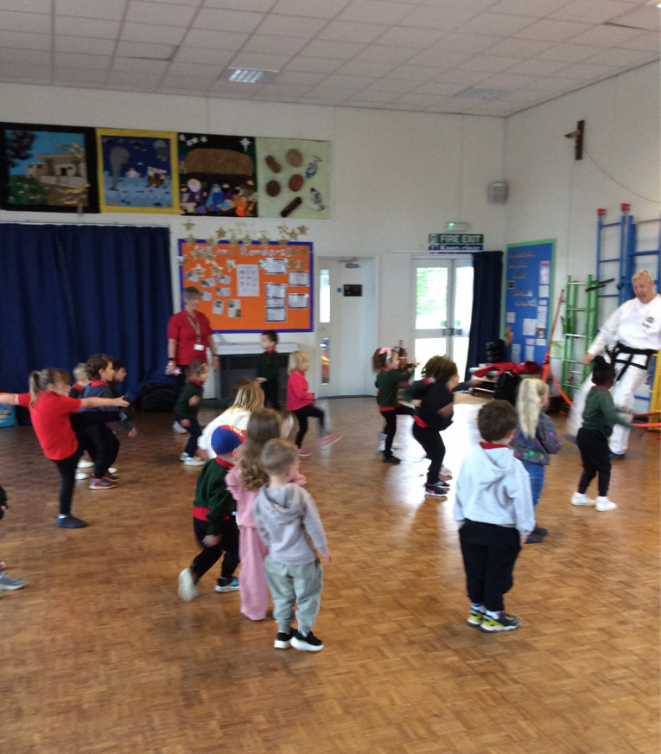
Bapchild and Tonge Nursery
Newsletter
Term 6
Term 5 Look what we have been up to
Although this term was a short term the nursery children have been very busy. We have been busy planting in our garden and watching them change and grow, we have strawberries, beans, sunflowers and raspberries growing in our garden. We explored how frogs grow and change and made our own frog pond and watched caterpillar change into butterflies. We enjoyed joining in with Taekwondo and dance for our WAW week.
Our topic this term.
This term our topic is ‘Can you tell me a story?’ We have started off our first week back with our you choose story characters. We looked at who would be in our stories.
Our stories are traditional tales like The 3 little pigs
and Jack and the beanstalk. The children will get
the opportunity to explore some of their
favourite stories. We also have our Nursery
sports afternoon and our Nursery Graduation for
those children who are going to big school in September.
Attendance
When contacting School about your Nursery child’s absence
please contact the School Office, 01795 424143
Reminder: if your child is vomiting or has diarrhea, it is 48hrs before they can return to Nursery.

Slide 2
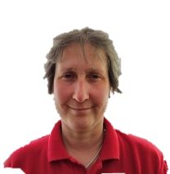
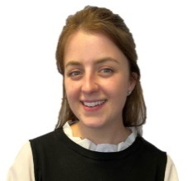

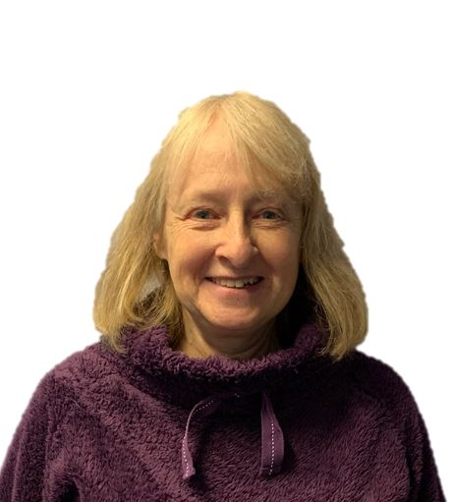
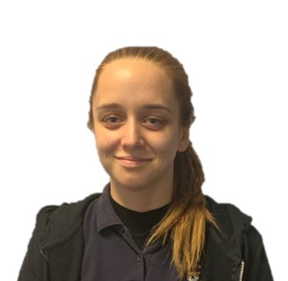


Bapchild and Tonge Nursery
Newsletter
Term 6
Meet the team
Summer Excitement
Sports morning - Thursday 18th June 9.30 -10.30
The nursery children will be taking part in the sports morning. All the children are welcome to attend and parents can come and watch them take part in the races.
If you child is not in session you are welcome to bring them for this morning event but you will need to stay with them.
Nursery Graduation – Friday 10th July 2pm
If your child will be leaving nursery at the end of this term to go into big school you are invited to join us
and celebrate with our Graduation party.
Join us and celebrate with certificate giving and a bouncy castle afterwards.
Mrs Dadd
(Lorraine)
Mrs Hatcher
(Polly)
Mrs Lee-Harrison
(Janet)
Miss Tewkesbury
(Amber)
Mrs Fox
(Kerry)
Socks and spare clothes
If you have any socks, trousers or leggings that your children have grown out
and no longer need, we are looking to add to our spare clothes.

Slide 3
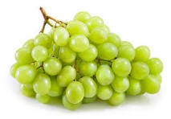
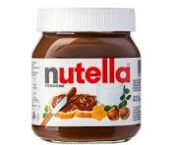

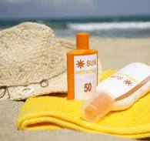
Bapchild and Tonge Nursery
Newsletter
Term 6
Tapestry
We are all very excited to share your children’s learning with you and Tapestry is a fantastic way to do this. Through tapestry we add observations and for those wow moments we might also add next steps. We will flag areas of learning seen and also celebrate their successes with you.
Once you have set up the log in...
1. On the right hand side near the top click the + observation button.
2. Under select child, you must select your child (no other children are available but you still have to select).
3. Give the observation a title and then add your notes.
4. Add photo or video, click add files then click start upload.
5. When you have finished click Save, then you can log out.
Reminder
Can we reminder parents that send in packed lunches with their children that we can not have nut based foods in their lunches please as we have several children how are allergic to nuts. This includes things like peanut butter and Nutella sandwich spread. Can we also remind parents that if children have grapes they need to be cut in half and no popcorn to avoid chocking hazards.
Summer weather
Now we are in the Summer Term we hope to have some nice sunny weather. With this in mind we encourage children to bring sun hats
(named please).
Please could you apply suncream to your child
before nursery when necessary
and then we can apply
more during the day
m. Wwith your child’s suncream
at the nursery.
.
See a member of the team if you need help logging on.
Things To Remember
Please can you ensure that your child’s jumpers and cardigans are named.

