Slide 1
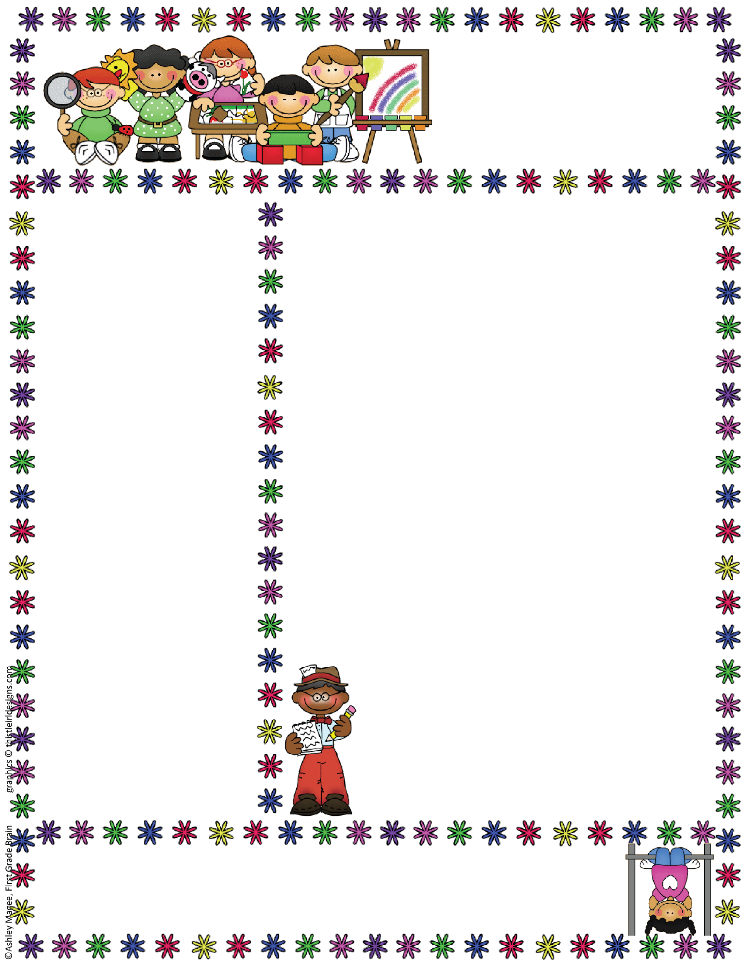
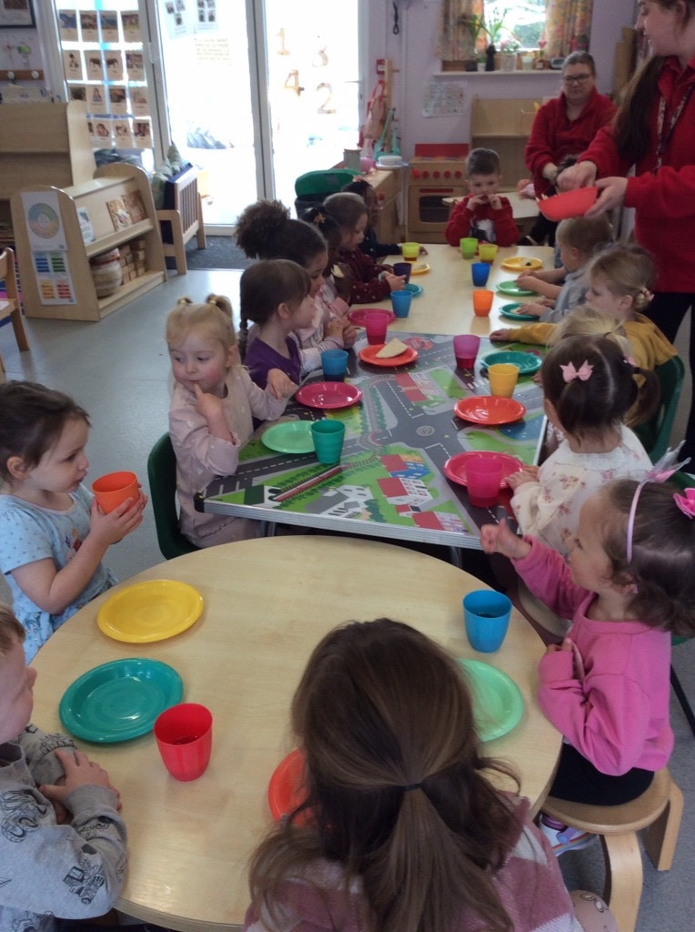


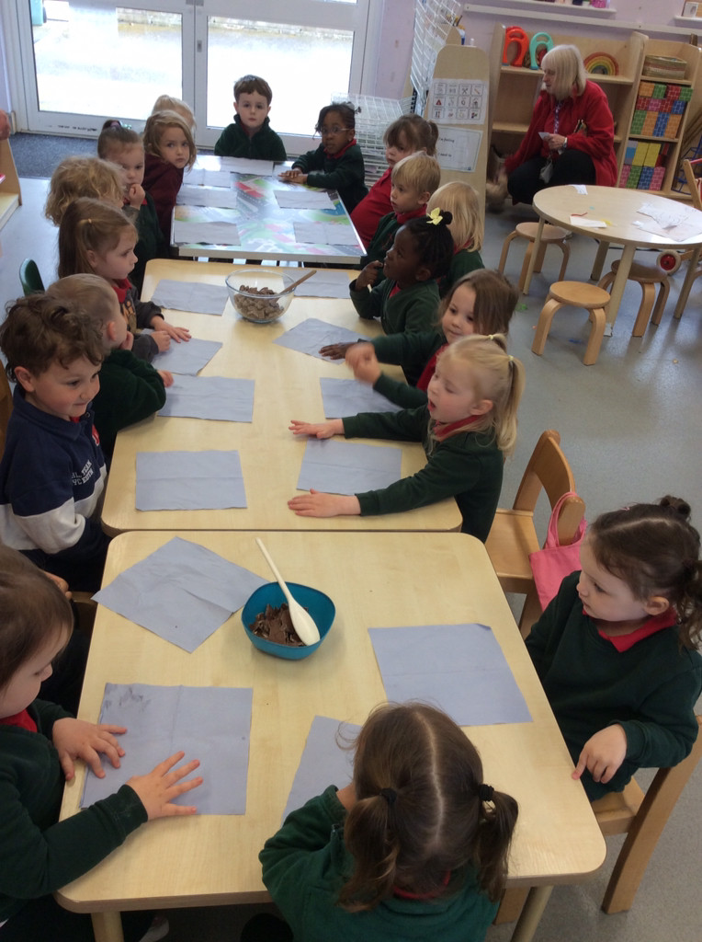
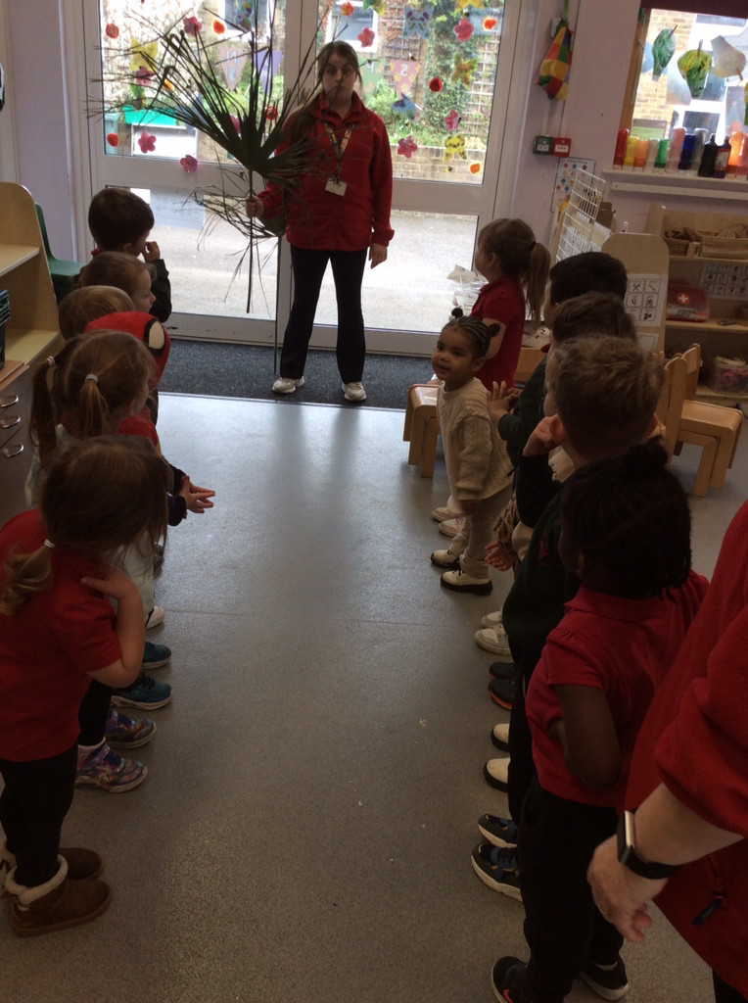
Bapchild and Tonge Nursery
Newsletter
Term 5
Term 4 Look what we have been up to
Hope you had a great Easter Break and got lots of Easter Eggs. It has been lovely to see the children back and ready for the lovely weather. Last term we were really busy looking at where our food comes from and taking part in our STEM week. We tested different biscuits and planted seeds for our nursery garden. The children also enjoyed taking part in reenacting Palm Sunday and singing in our Easter service at the Church.
Our topic this term.
This term our topic is ‘Why do things change?’
This term we are looking at different life cycles and how things change over time. The children will be exploring
how the world around us changes and looking for signs of Spring.
The children will be looking at the different jobs
and are looking forward to a visit from our local Firefighters.
Attendance
When contacting School about your Nursery child’s absence
please contact the School Office, 01795 424143
Reminder: if your child is vomiting or has diarrhea, it is 48hrs before they can return to Nursery.

Slide 2
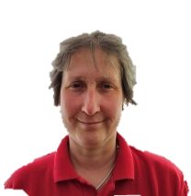
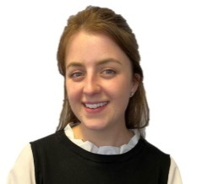
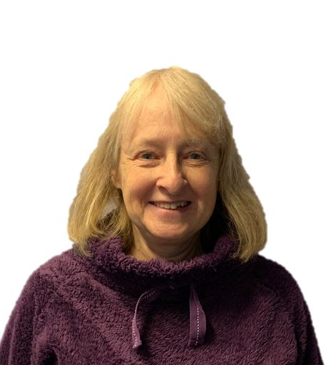
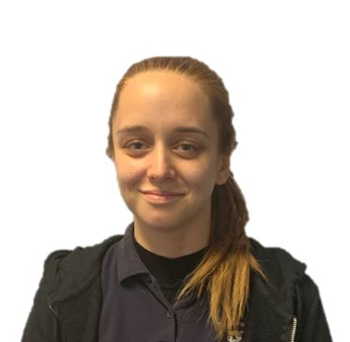
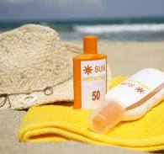
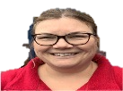
Bapchild and Tonge Nursery
Newsletter
Term 5
Meet the team
Summer
Now we are in the Summer Term we hope to have some nice sunny weather. With this in mind children must bring in a sun hat
(named please) and suncream to nursery.
Please could you apply suncream to your child before nursery when necessary and then we can apply more during the day.
It is important your child brings in a named bottle of suncream to leave at nursery and make sure you have signed the consent form so we can re-apply the cream if necessary.
Mrs Dadd
(Lorraine)
Mrs Hatcher
(Polly)
Mrs Lee-Harrison
(Janet)
Miss Tewkesbury
(Amber)
Mrs Fox
(Kerry)

Slide 3


Bapchild and Tonge Nursery
Newsletter
Term 5
Tapestry
We are all very excited to share your children’s learning with you and Tapestry is a fantastic way to do this. Through tapestry we add observations and for those wow moments we might also add next steps. We will flag areas of learning seen and also celebrate their successes with you.
Once you have set up the log in...
1. On the right hand side near the top click the + observation button.
2. Under select child, you must select your child (no other children are available but you still have to select).
3. Give the observation a title and then add your notes.
4. Add photo or video, click add files then click start upload.
5. When you have finished click Save, then you can log out.
Welcome to NELI
We are well and truly into our NELI programme and the children are loving the different stories.
We have been exploring different activities linked to the books and had fun learning our new special words each week.
If you do any activities at home, it would be lovely if you could post your activities on Tapestry. You can also find what book we are doing on the school website under nursery/ NELI.
.
See a member of the team if you need help logging on.
Things To Remember
The weather in now hot remember to bring your named sun hat.

