Slide 1
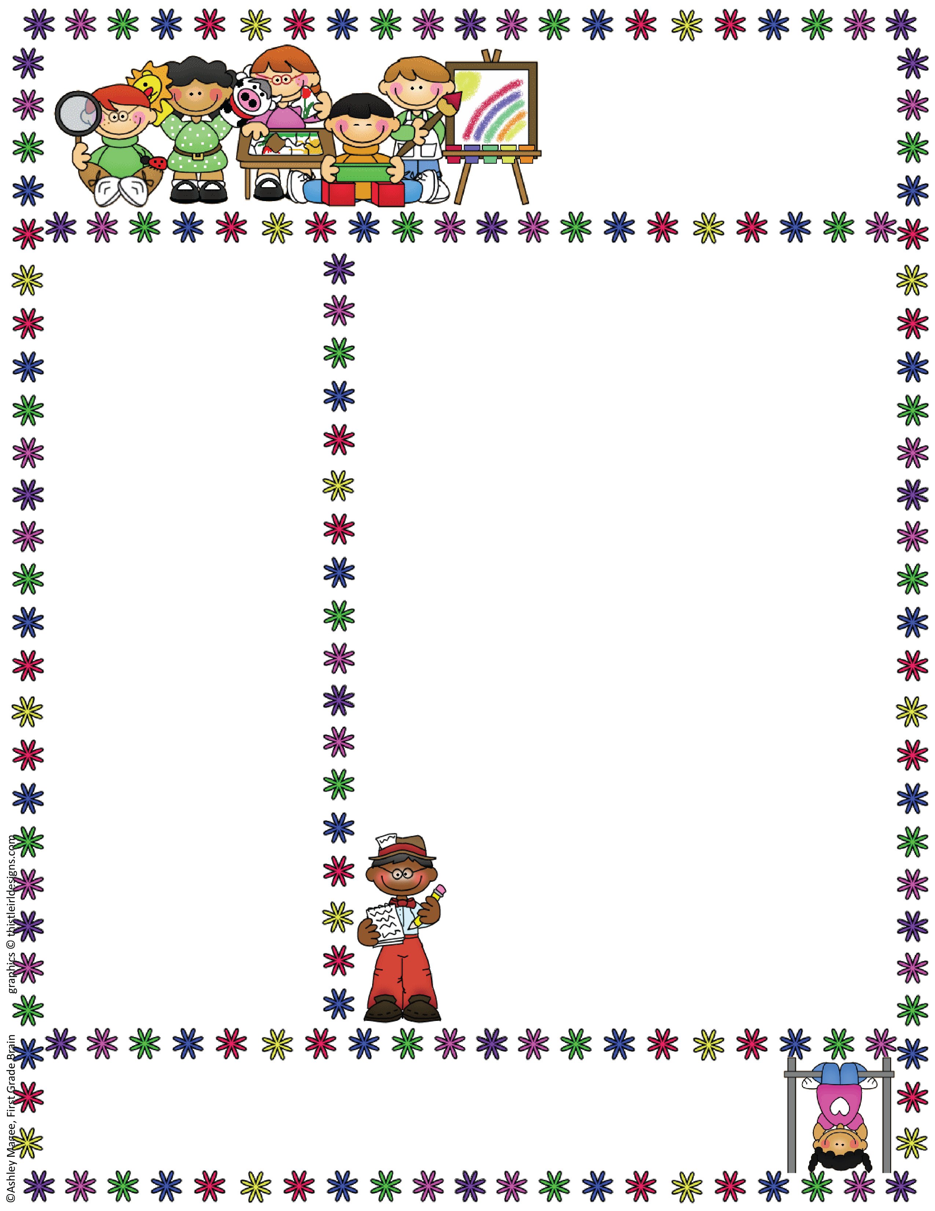
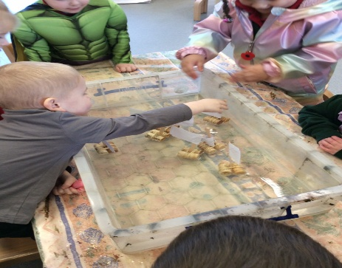
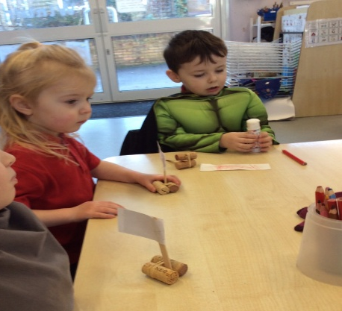


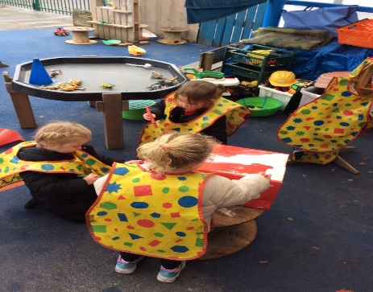
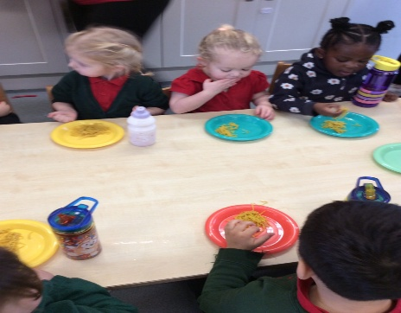
Bapchild and Tonge Nursery
Newsletter
Term 4
Term 3 Look what we have been up to
Welcome back to Term 4. We had great fun last term exploring whether It is true?. We have sailed the seas with pirates, and had fun decorating magic pants. We were also visited by dinosaurs and unicorns and experienced a different culture during the Chinese New Year.
Our topic this term.
This term our topic is 'Where does it come from?' and we are exploring where our food comes from and looking at Jesus’ trials during lent.
We will also be making plant pots out of
recycled materials. We are going to plant
different seeds and watch the them grow.
Attendance
When contacting School about your Nursery child’s absence
please contact the School Office, 01795 424143
Reminder: if your child is vomiting or has diarrhea, it is 48hrs before they can return to Nursery.

Slide 2

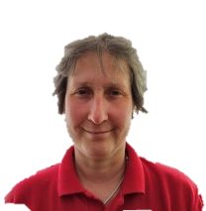
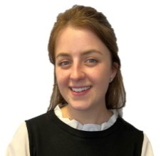
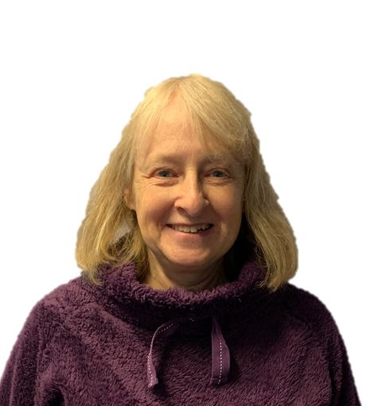
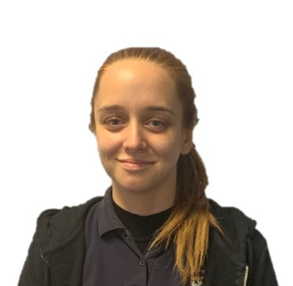

Bapchild and Tonge Nursery
Newsletter
Term 4
Meet the team
Maths Champions
We have been lucky to be accepted into a Early years Maths programme called Maths Champions.
The programme helps us support the children’s progress in Maths. As part of the programme we can offer some fun Maths activities for you to try at home with your children. Keep an eye out for our Maths Champion email that will be pinging its way to you so you can get started at home.
Don’t forget to add your activities on to
Tapestry so we can celebrate your children Maths fun as well.
Mrs Dadd
(Lorraine)
Mrs Hatcher
(Polly)
Mrs Lee-Harrison
(Janet)
Miss Tewkesbury
(Amber)
Mrs Fox
(Kerry)
Easter service
You are invited to come and see our Easter service on
Wednesday 1st April collect children at 2.30 and service is at 2.45.

Slide 3


Bapchild and Tonge Nursery
Newsletter
Term 4
Tapestry
We are all very excited to share your children’s learning with you and Tapestry is a fantastic way to do this. Through tapestry we add observations and for those wow moments we might also add next steps. We will flag areas of learning seen and also celebrate their successes with you.
Once you have set up the log in...
1. On the right hand side near the top click the + observation button.
2. Under select child, you must select your child (no other children are available but you still have to select).
3. Give the observation a title and then add your notes.
4. Add photo or video, click add files then click start upload.
5. When you have finished click Save, then you can log out.
Welcome to NELI
We are well and truly into our NELI programme and the children are loving the different stories.
We have been exploring different activities linked to the books and had fun learning our new special words each week.
At Nursery we love sharing books and reading new and familiar stories.
Don’t forget to bring our child’s story book back to nursery regularly so they can continue to enjoy sharing new stories.
.
See a member of the team if you need help logging on.

