Slide 1
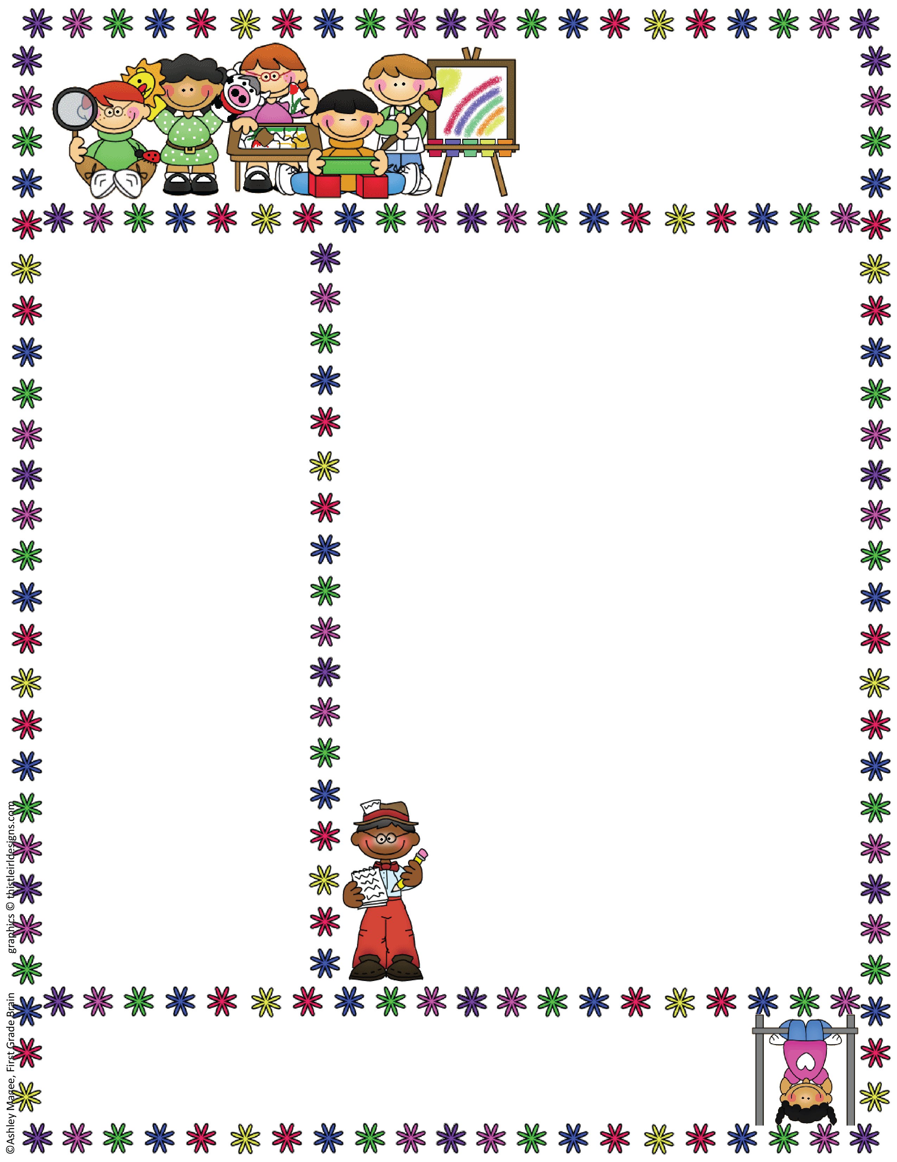
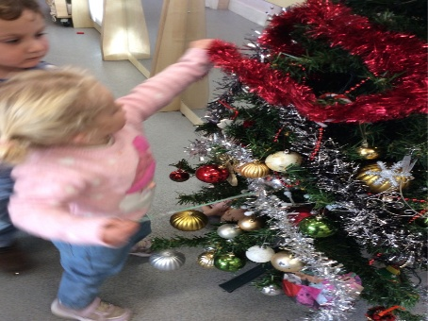
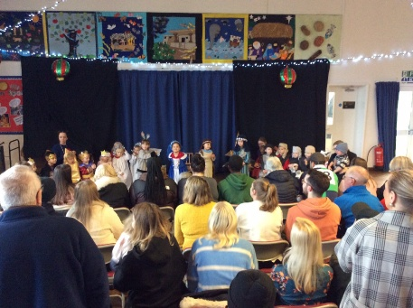


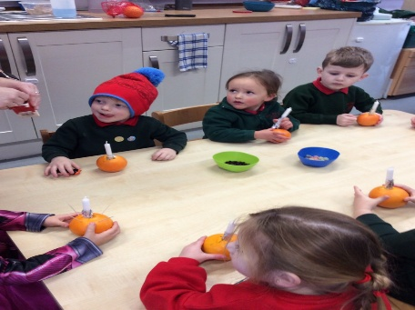
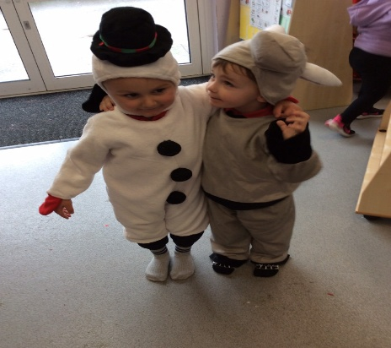
Bapchild and Tonge Nursery
Newsletter
Term 3
Term 2 Look what we have been up to
Welcome back to Term 3. We hope you had a lovely Christmas and we are looking forward to an exciting New Year. Last term was a very busy Christmas term and the children enjoyed showing the Nativity story to their parents, as well as having fun at the Nursery Christmas Party. We also explored different celebrations including Hanukkah, Diwali and birthdays.
Our topic this term.
Term 3 Is Is it true?
We will be looking at different fantasy
stories like, The dinosaur who pooped a
planet, there’s a dragon in my book,
Supertato, Aliens love underpants.
Attendance
When contacting School about your Nursery child’s absence
please contact the School Office, 01795 424143
Reminder: if your child is vomiting or has diarrhea, it is 48hrs before they can return to Nursery.

Slide 2
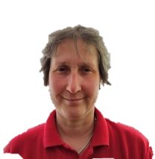
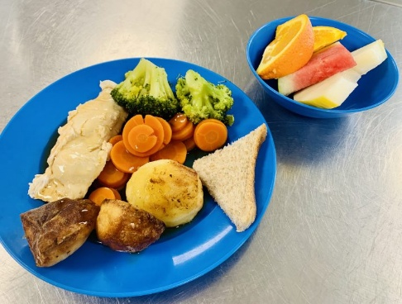
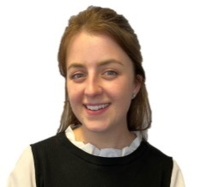
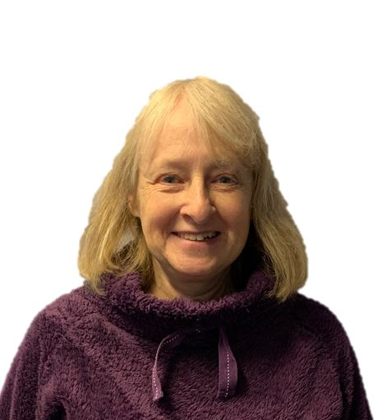
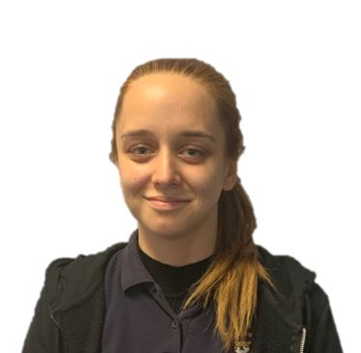
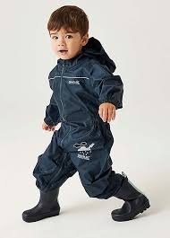
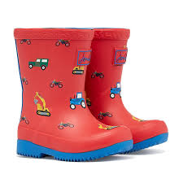
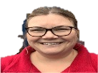
Bapchild and Tonge Nursery
Newsletter
Term 3
Meet the team
School Lunches
Please can you let a member of staff know in the morning if your child requires a cooked school lunch.
Packed Lunches; please make sure you provide your child with a balanced/heathy packed lunch, we do not encourage chocolate bars or sweets.
Wellies and puddles suits
Please can you make sure that your child has wellies and a puddle suit at nursery as we go out into the garden all year round. Please can you make sure they are named.
Mrs Dadd
(Lorraine)
Mrs Hatcher
(Polly)
Mrs Lee-Harrison
(Janet)
Miss Tewkesbury
(Amber)
Mrs Fox
(Kerry)
Please could the children bring their spare clothes to nursery in a
draw string bag, as we are struggling to get everything on the trolley.

Slide 3




Bapchild and Tonge Nursery
Newsletter
Term 3
Tapestry
We are all very excited to share your children’s learning with you and Tapestry is a fantastic way to do this. Through tapestry we add observations and for those wow moments we might also add next steps. We will flag areas of learning seen and also celebrate their successes with you.
Once you have set up the log in...
1. On the right hand side near the top click the + observation button.
2. Under select child, you must select your child (no other children are available but you still have to select).
3. Give the observation a title and then add your notes.
4. Add photo or video, click add files then click start upload.
5. When you have finished click Save, then you can log out.
Welcome to NELI
This term we will be starting our NELI programme which supports the development of childrens’ speech
and language.
Each week there will be some fantastic focus books and focus vocabulary for the children to explore.
We will be sending home some activities you could do with your child at home linked to the book. You can also find what book we are doing on the school website under nursery/ NELI.
.
See a member of the team if you need help logging on.
Things To Remember
The weather in now very cold. The children have access to the outside all throughout the day. It is important that they have a warm coat and, also can wear a hat, scarf and gloves.
Please can you make sure they are named.

