Slide 1
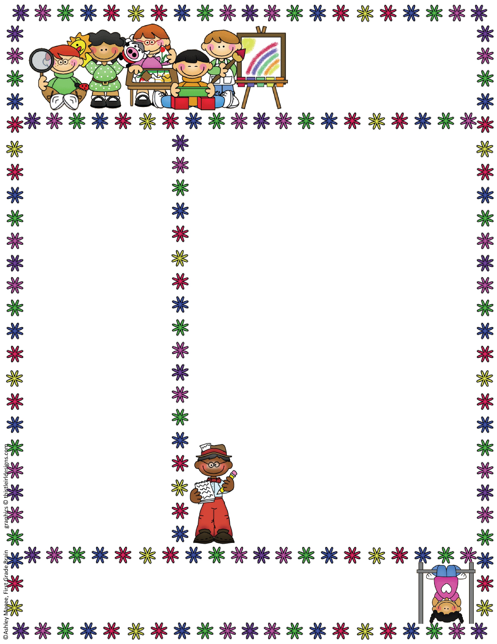
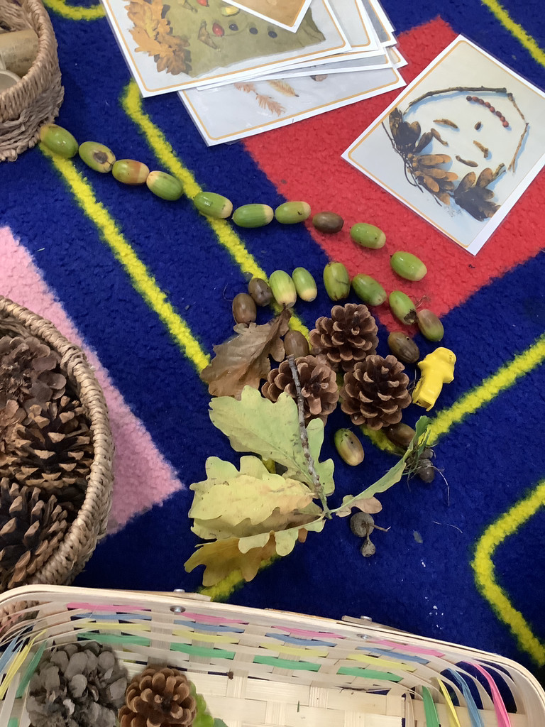
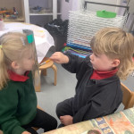
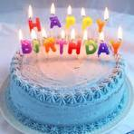

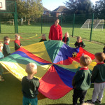
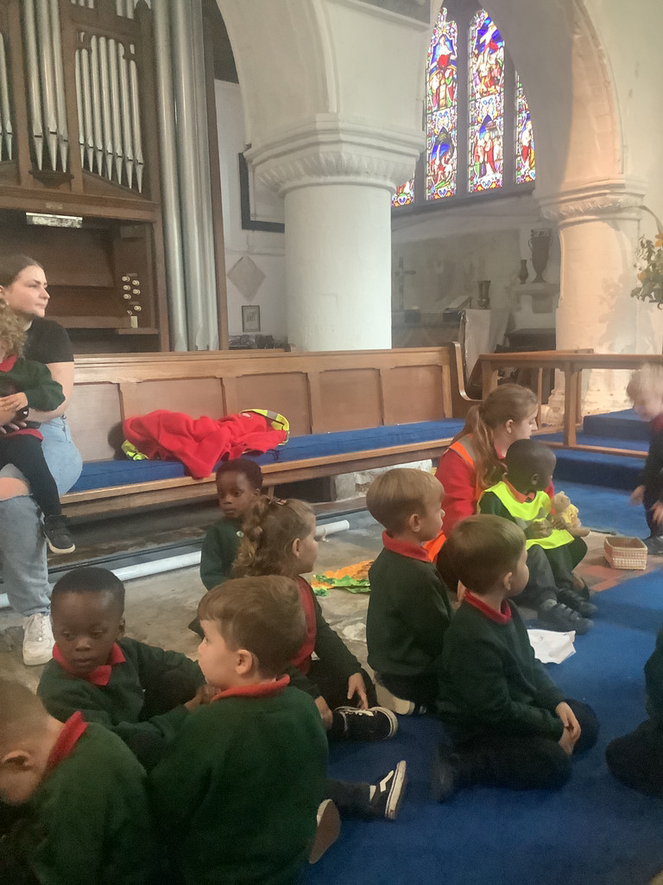
Bapchild and Tonge Nursery
Newsletter
Term 2
Term 1 Look what we have been up to
Hope you had a great half term. Term 1 our topic was Who am I? We had fun looking at the differences and similarities between us. We used different media to make pictures of ourselves including loose parts, paint and natural materials. The children also enjoyed exploring the new MUGGA and took part in the harvest festival at the church..
Our topic this term is Who’s having a party?
The children will be exploring different festivals
and how different people around the world celebrate and remember.
We are looking at Fireworks Night,
Birthdays, Remembrance day, Diwali, Hannukah, and Christmas.
Attendance
When contacting School about your Nursery child’s absence
please contact the School Office, 01795 424143
Reminder: if your child is vomiting or has diarrhea, it is 48hrs before they can return to Nursery.

Slide 2
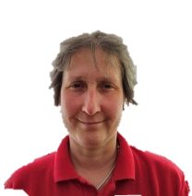
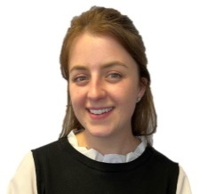
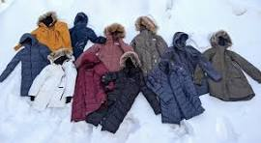
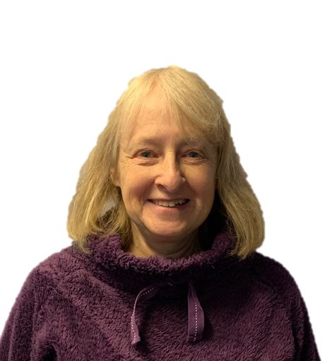
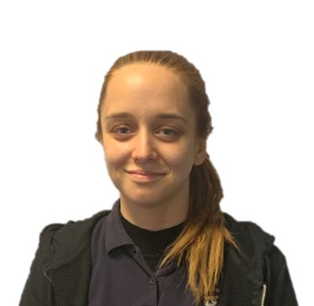
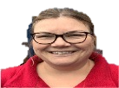
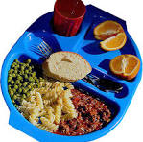
Bapchild and Tonge Nursery
Newsletter
Term 1
Meet the team
Things To Remember
The weather in now getting colder. The children have access to the outside all throughout the day. It is important that they have a warm coat and sensible outside shoes.
Please can you also bring in a named pair of wellington boots for your child that we can keep at Nursery for them to use for outdoor play.
Lunches; please make sure you provide your child with a balanced/heathy packed lunch, we do not
encourage chocolate bars or sweets. You do
have the option for a hot school dinner, just ask on morning drop off.
Mrs Dadd
(Lorraine)
Mrs Hatcher
(Polly)
Mrs Lee-Harrison
(Janet)
Miss Tewkesbury
(Amber)
Our newest member
of the team
Mrs Fox
(Kerry)
Nursery Nativity – Tuesday 17th December
Our Nursery Nativity is on Tuesday 17th December 9.30am.
We hope you can all join us..

Slide 3
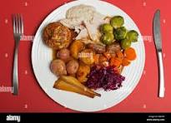


Bapchild and Tonge Nursery
Newsletter
Term 1
. Christmas Lunch
Tuesday 17th December is our Christmas Lunch. The children will enjoy sharing a wonderful Christmas dinner together.
Tapestry
We are all very excited to share your children’s learning with you and Tapestry is a fantastic way to do this. This week you should have (if you haven't already) received an email asking you to activate your account. Once this is set up you can begin to add observations. These can be anything from a family picnic, to drawing, to playing in the garden. You will also be able to see any observations that we put up for your child and you can add comments or simply press the like button. Through tapestry we add observations and for those wow moments we will add next steps. We will flag areas of learning seen and also celebrate their successes with you.
Once you have set up the log in...
1. On the right hand side near the top click the +observation button.
2. Under select child, you must select your child (no other children are available but you still have to select).
3. Give the observation a title and then add your notes.
4. Add photo or video, click add files then click start upload.
5. When you have finished click Save, then you can log out.
Nursery stories
In the nursery we value reading stories with children. The children will be bringing reading folder home and the children will be given a book to share with you at home. We change books once a week
.
Christmas Party – Wednesday 18th December
We will be having a Christmas party with the children on
Wednesday 18th December and invite you to join in our Christmas celebration
.

