Slide 1

Home Learning
Year 2 Term 5 Week 1

Slide 2
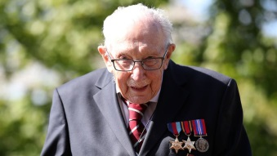
Message from the class teacher
Hi Year 2. I hope you’ve had a nice weekend and I hope you are helping your grown ups at home with all their jobs. Did you see the amazing effort that Captain Tom made this week? He set himself a challenge to do 100 laps of his garden before he turned 100. He has raised over 21 million pounds for the NHS. Isn’t that fantastic? If you would like to make Captain Tom a card for his 100th birthday (which is on Thursday) you can send it to Captain Tom Moore, c/o Post Office Limited, 67 Bedford Road, Marston Moretaine, Bedfordshire, MK43 OLA.
I hope you enjoy your week, stay safe, Love Mrs Clark
Hello Year 2! I hope you have all enjoyed your weekend. I wonder if you are all still eating Easter eggs? I know I am… I cannot stop eating chocolate. My plan is to melt down all the easter eggs and make some rice crispie cakes! I hope you are enjoying spending time at home and working through the home learning. Did you all make a rainbow for your windows? We have made a tally chart of how many we have spotted on our daily walk. We have also started to go on bear hunts as many people are now putting teddy bears in their windows for children to spot and find. Maybe you could do the same. Stay safe everybody and stay home! Lots of love Mrs Unsworth.

Slide 3

Reading
Hopefully you have access to books at home, but we have sent home extra books with your child.
Accelerated Reading
Home quizzing is not always recommended but in this case we have adjusted the settings to allow quizzing to happen at home.
If your child wants to read a book from home, please check that there is a quiz available for the book and that the book level (BL) is within or near to your child’s reading range. Also take note of the quiz number for future reference.
To check books please visit: https://www.arbookfind.co.uk/
Go to the next page for how to quiz.

Slide 4



AR quizzing at home.
To log into AR to take a quiz please visit: https://ukhosted27.renlearn.co.uk/2240835/
Your child should know what to do from here and should know their login details. If they are not aware, most details are written in their reading record.
Click on Accelerated reader.
Type in the name the book or the quiz number.
We advise students complete quizzes unaided. If parents/carers wish to support their child, they can do so in the following ways:
Discuss the book with your child as the book is being read
Ask your child to read the question out loud
Re-word questions for your child, if necessary
Ask your child which answers are not correct

Slide 5

Visit http://readon.myon.co.uk

Slide 6

Choose an area that interests you or use the search option.

Slide 7


Using My Maths
Children should know their way round My Maths but here are some reminders on how access the lessons. Visit: www.mymaths.co.uk
bapchild
divide162

Slide 8

Using My Maths
Access any lesson based on what your child is learning in class or search the topic in the search bar.
Use the login portal to access specific homework and lessons that your teacher has set.

Slide 9

Maths – White Rose Home Learning
In school we follow the White Rose scheme of learning. Their website has put together free lessons and resources that link to the learning taking place in school. Please visit: https://whiterosemaths.com/homelearning/

Slide 10



TT Rockstars
To access TT Rockstars please visit: https://play.ttrockstars.com/auth/school
Start typing in the school name or the post code (ME99NL)
Pupils type in their username and password, usually written in their reading record.
Pupils can practice all tables but Year 2 should be practicing 2, 5, and 10’s
Year 3: 2,5,10,3,4,8’s
Year 4,5,6: all tables

Slide 11

Accessing Twinkl
Many educational content providers are offering free access to their resources. Twinkl is a website that we use from time to time to resource our lessons to aid in teacher input and pupil activities.
We will be able to direct you towards activities and learning via this website based on lessons that may be missed due to absence. To access Twinkl please visit: www.twinkl.co.uk/offer
You will have to sign up and put in the offer code: UKTWINKLHELPS

Slide 12
English Learning
In English in Term 5 we think about characters in stories. This week we would like you to read the story Clara’s Crazy Curls by using the link below.
https://readon.myon.co.uk/reader/index.html?a=cyrtr_clcrc_s14
Read the book to yourself or with a grown up a few times until you know the story well and then have a go throughout the week at the following activities.
Write a book review. You could use a template from twinkl or make up your own using subheadings such as; Title, Author, What is the book about?, What is your favourite part of the story, Who would enjoy this story and why?. Then you could copy your favourite illustration from the book and even give it a rating out of 5 stars! Here’s a link to an example of a book review.
https://www.twinkl.co.uk/resource/au-l-061-book-review-worksheet
Write a character description of Clara. Include a description of what she looks like, what
sort of girl she is (kind, adventurous, friendly etc), who she lives with, what
she does at school, what makes her unusual. Then you can draw a picture of Clara.
The title of the story Clara’s Crazy Curls uses words that all start with the same letter.
This is called alliteration and it is a great way to make our writing more interesting. Try
making up the names of some more characters that could be used in stories using
alliteration. For example Tim’s Tiny Toes or Lucy’s Long Legs. List as many new characters
as you can and perhaps include an illustration for each one.

Slide 13
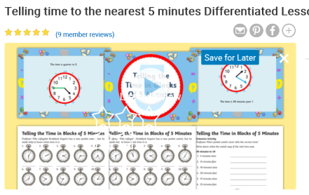
Maths Learning
This week we will continue to learn to tell the time.
Activity 1 – MyMaths → Online homework will be set for telling for telling the time (quarter to and quarter past.) Please complete the online lesson for a refresher of o’clock and half past. Here is the link to the online lesson. https://app.mymaths.co.uk/5935-lesson/telling-the-time-quarter-to-past
Homework will appear on your child’s personal dashboard.
Activity 2 – MyMaths → Online homework will be set for telling the time to 5 minutes. Please complete the online lesson first. Here is the link to the online lesson. https://app.mymaths.co.uk/5936-lesson/telling-the-time-to-5-mins.
Actviity 3 – Telling the time to 5 minutes worksheet. If you are unable to print the worksheet perhaps you could use a real analogue clock in the house and change the time with your child, or you could even get them draw some clocks out to practise drawing the clock face and hands correctly. There us a powerpoint in this packs to suport your child’s learning
https://www.twinkl.co.uk/resource/t-n-914-telling-the-time-in-blocks-of-5-task-setter-powerpoint-with-worksheets

Slide 14
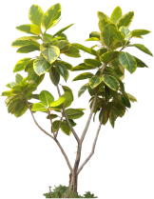
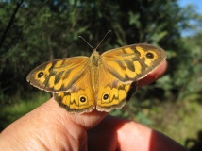
Science
Our topic this term in Science is Living Things and Their Habitats.
Investigation: This week try and get out into your garden or look out of the window and either take photographs or draw examples of any plants or animals that you see.
Research: Using the internet or any books you have about plants and animals try and find out the names of the things you have seen.
Results: Create a fact file with all the pictures of living things you have found and what they are called.
Challenge 1: Try to find and write a fact about each of the living things you find to go onto our factfile.
Challenge 2: Research a typical garden in a different country. Why do you think different plants grow and different animals live in different gardens around the world?

Slide 15

P.E.
It is important to keep your children active. If it is safe to do so, ensure they have some time outside throughout the day. Please visit Joe Wicks YouTube channel (https://www.youtube.com/channel/UCAxW1XT0iEJo0TYlRfn6rYQ), which has lots of exercise videos for children. He will also be hosting a live P.E. lessons Monday to Friday at 9:00am.

Slide 16

Classroom Secrets
The site classroom secrets https://classroomsecrets.co.uk/free-home-learning-packs/ has free class packs which provide some great additional ideas and resources you can use.

